Slide 1
Adopt a Float Program
How have oceanographers measured the oceans?

Slide 2
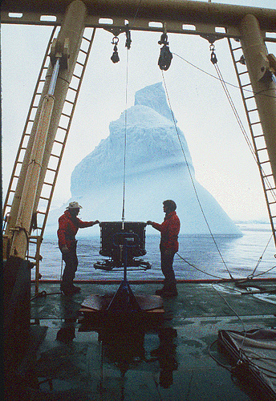
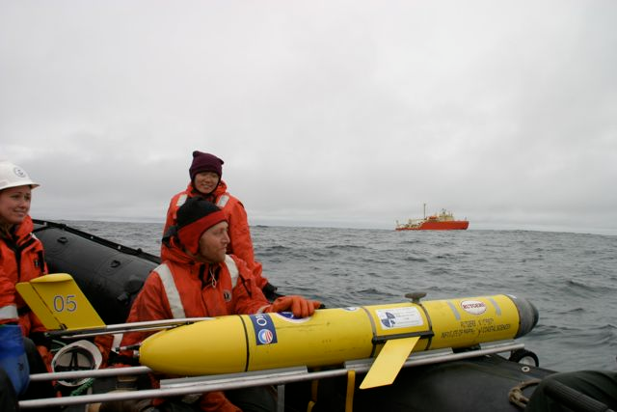
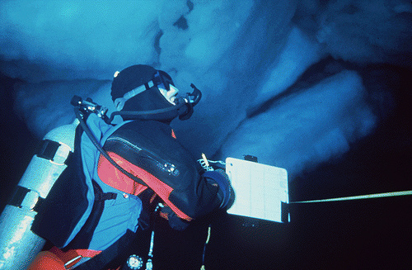
Oceanographers and polar scientists get to do all kinds of cool fieldwork to collect the data.
Source: Dr. Schofield MBARI EARTH 2016 &
http://pal.lternet.edu/education/photos
/72157636881581306

Slide 3
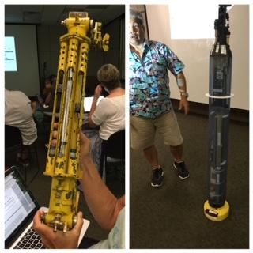
Over time, the equipment has become more sophisticated 1970’s vs. present day

Slide 5
Working together, scientists have produced large accessible data sets.

Slide 6
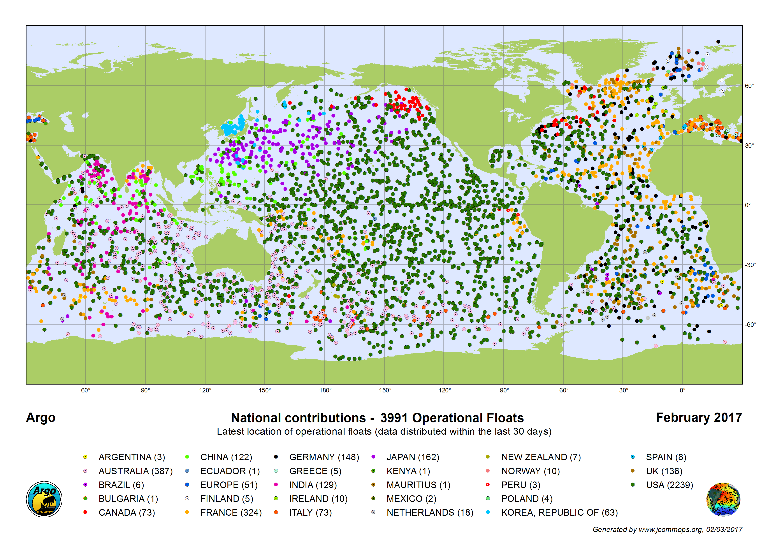

Slide 7
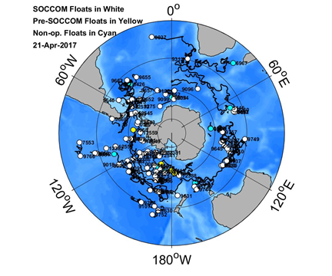

Slide 8
Data From the Float
How does the float work?

Slide 9
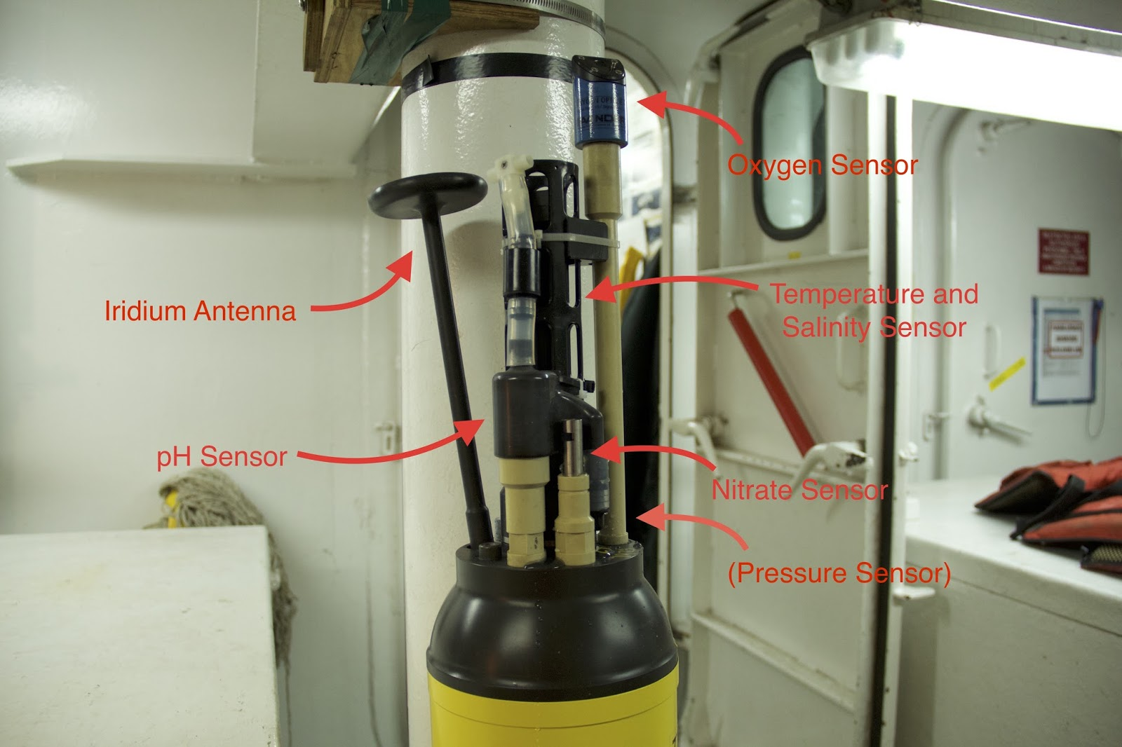
A set of chemical and biological sensors now exist that track the basics of ocean:
respiration,
net production by phytoplankton,
biomass,
chlorophyll,
ocean acidification,
ocean deoxygenation….

Slide 11
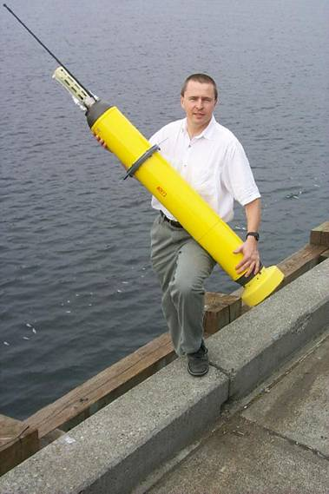
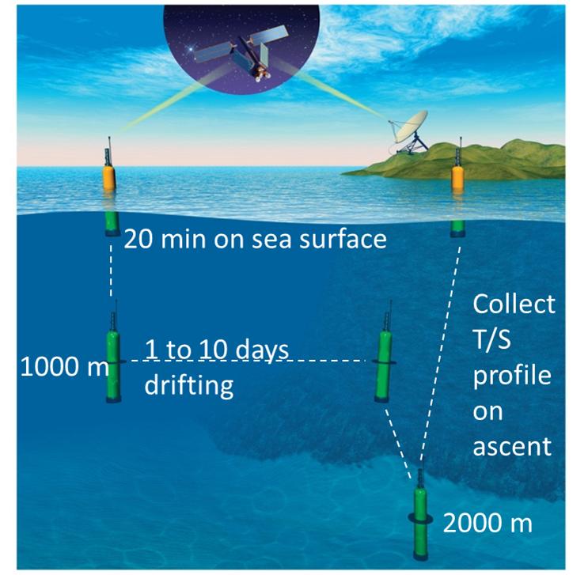
The Argo profiling float. The model shown here is an APEX.
280 cycles at 10 day intervals = 7 year lifetime

Slide 12
Profiling float
Density = Mass/Volume
Oil inside the float, volume decreased and float sinks

Slide 13
Profiling float
Density = Mass/Volume
Oil pumped into external bladder, volume increased and float rises

Slide 14
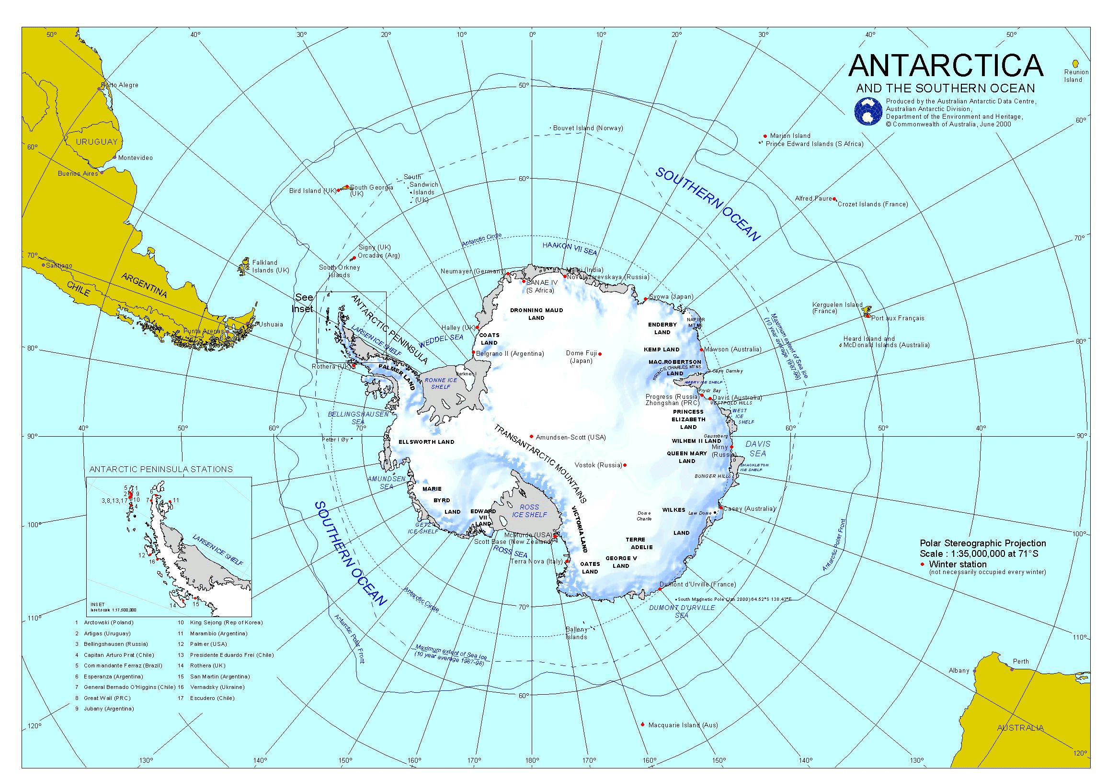
Where is our float?

Slide 16
But it is up to us (you) to work with the data.
Are you ready to submerge yourself?
Source: http://pal.lternet.edu/education/photos/72157636951002793

