Slide 1
What’s the Bigger Picture?
Combining Art and Science

Slide 2
Do Now:
Observe the following pieces of art. Record what you see.
Image used with permission from Jill Pelto

Slide 3
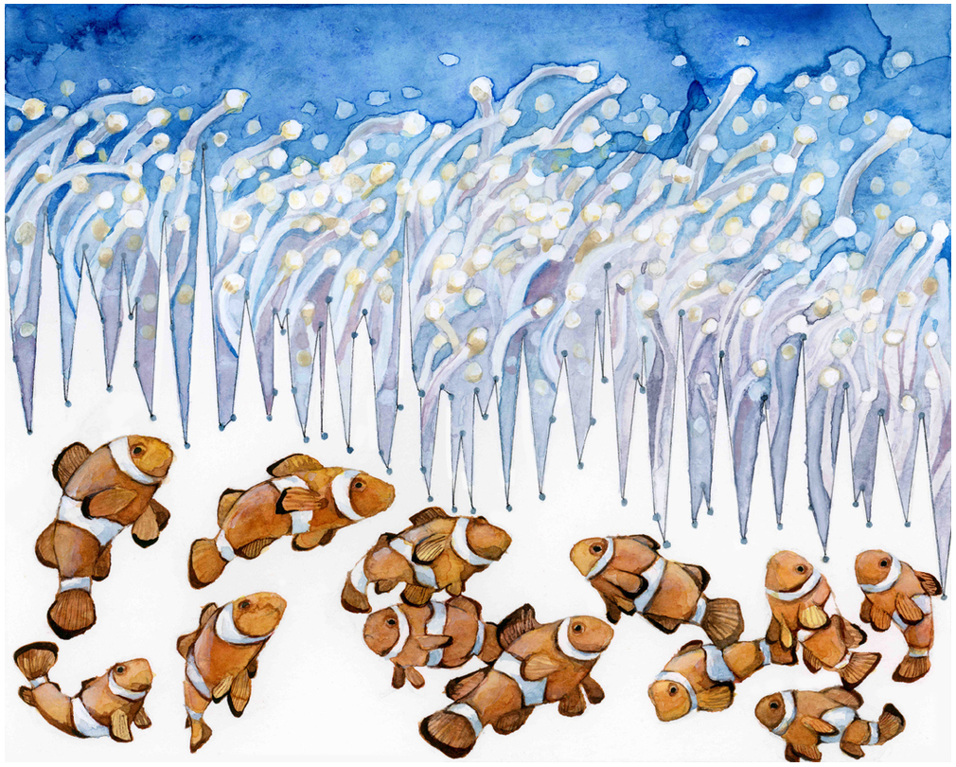

Slide 4
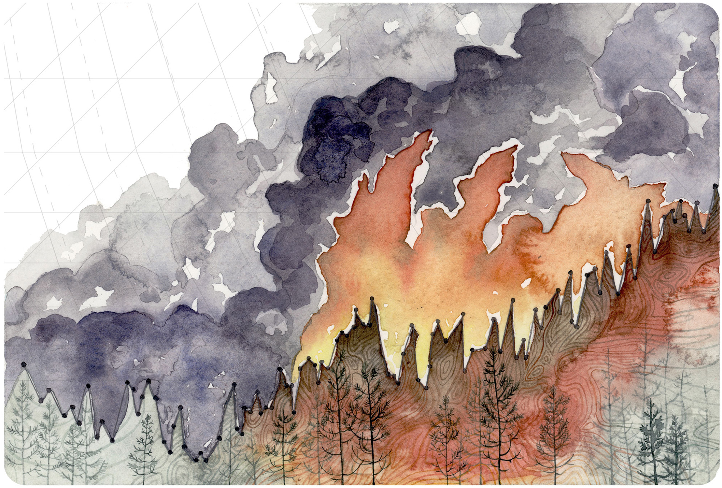

Slide 5
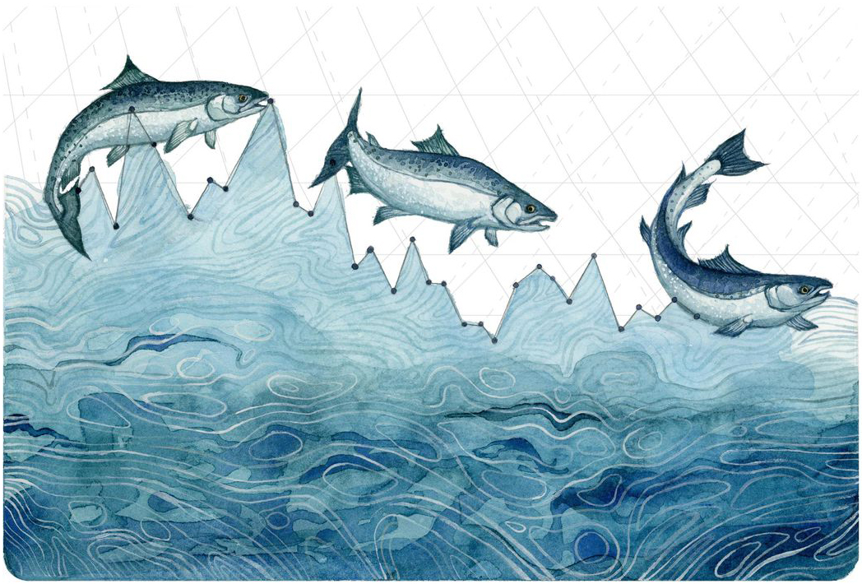

Slide 6
Let’s discuss…
What did you notice?
What trends or patterns did you observe?
What is this image trying to convey?
Notes:
Be sure to point out to the students and discuss that there are graphs embedded in the artwork.

Slide 7
Artist & Scientist: Jill Pelto
These images were created by Jill Pelto. She is a graduate from the University of Maine and uses her degrees in Studio Art and Earth Science to create images to illustrate environmental issues.
Her field work has taken her to the glaciers in Washington, the dry valleys of Antarctica, and the carved cirques of the Falkland Islands.
Let’s take a look at the artist’s descriptions about her art.

Slide 8
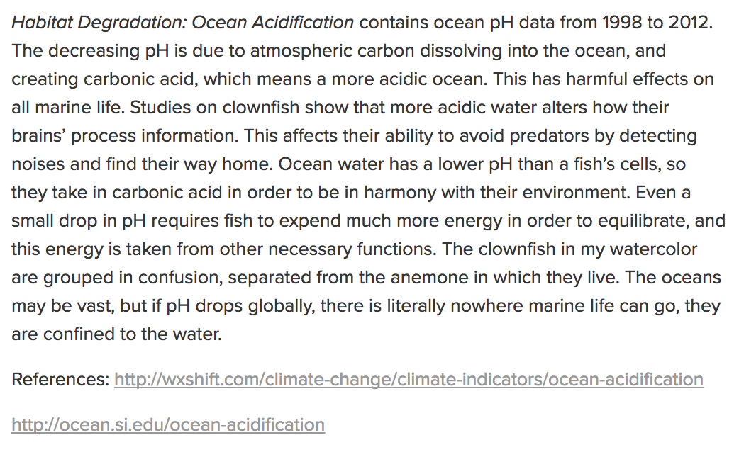
Source: http://www.jillpelto.com/ocean-acidification

Slide 9
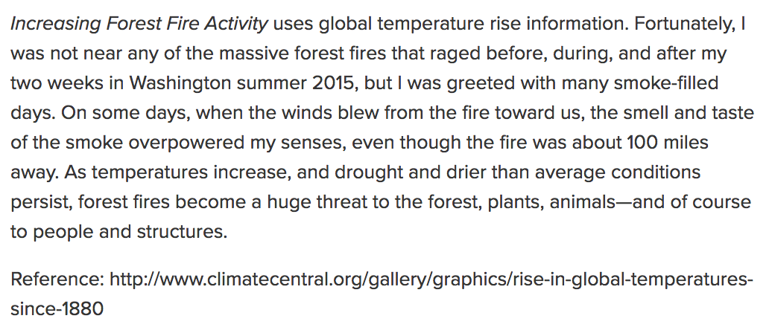
Source: http://www.jillpelto.com/increasing-forest-fire-activity

Slide 10
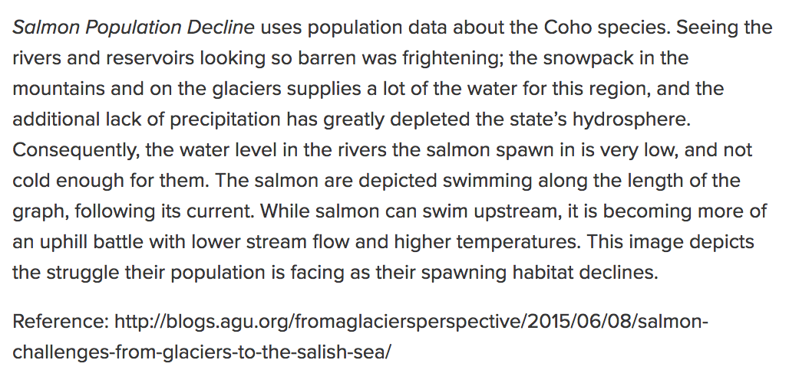
Source: http://www.jillpelto.com/salmon-population-decline

Slide 11
Your Assignment (Part 1):
Analyze and interpret the graph you have been given. (You may want to use the Graph Analysis Worksheet to lead your thinking.)
Once you have identified the trend of your graph, research the topic in more detail.

Slide 12
Your Assignment (Part 2):
Decide upon an illustration that would best communicate the issue contained in your graph.
Illustrate your graph.
Develop an ‘Artist Statement’ (modeled after Jill Pelto’s) to accompany your art. Include your references.
Prepare your art and statement for a Gallery Walk.

Slide 13
Gallery Walk
As you move through the gallery, make observations, note patterns, and define problems.

Slide 14
What’s the bigger picture?
Using the information you have just gathered, make a statement about how the pieces of data fit together.
What broader issue is the data illustrating?
What trends support your statement?
Support your claim with logical reasoning, relevant and accurate data, and evidence that demonstrates your understanding of the topic.

