Slide 1
Have an Eye in the Sky…
Using Satellites and drones to do scientific research

Slide 2
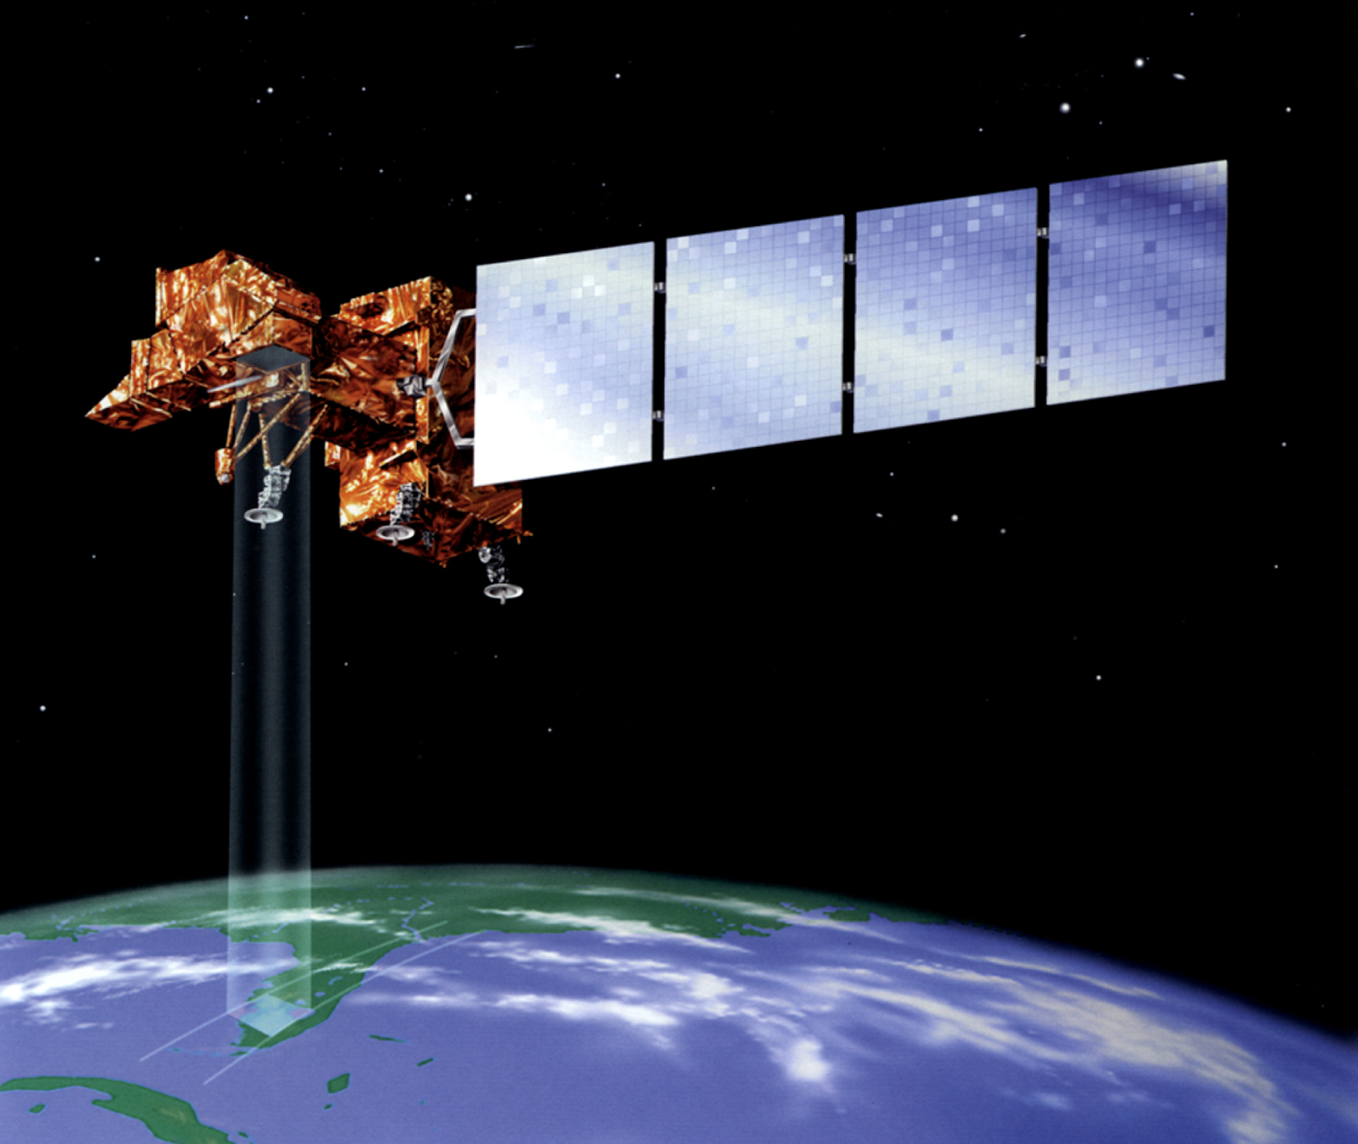
Part A
Using Satellites to do scientific research
Image from: https://landsat.gsfc.nasa.gov/about/history/

Slide 3
Satellite images From Landsat
On July 23, 1972 the Earth Resources Technology Satellite was launched. This was eventually renamed to Landsat.
USGS & NASA Landsat project is the world’s longest continuously-operating satellite project monitoring the Earth’s surface
The most recent, Landsat 8, was launched on February 11, 2013.
The instruments on the Landsat satellites have acquired millions of images.
Each Landsat scene is about 115 miles long and 115 miles wide.

Slide 4
Lets look at the Arctic – Bathurst Island, Canada
Image from : https://earthexplorer.usgs.gov/

Slide 5
Task
Compare
Compare the images on the Landsat images PowerPoint or the color copies
Observe
Use your observations of the images to answer the questions on the worksheet
Discuss
Be ready to take part in the class discussion

Slide 6
Discussion:- What are some of the advantages or disadvantages of using satellite images for research
Advantages | Disadvantages

Slide 7
Discuss:- Lets get closer to Earth
What if you want to look at a particular land feature, ice flow, coastline or even an animal?
Would satellite images help us with this?
What other technologies could you use?

Slide 8
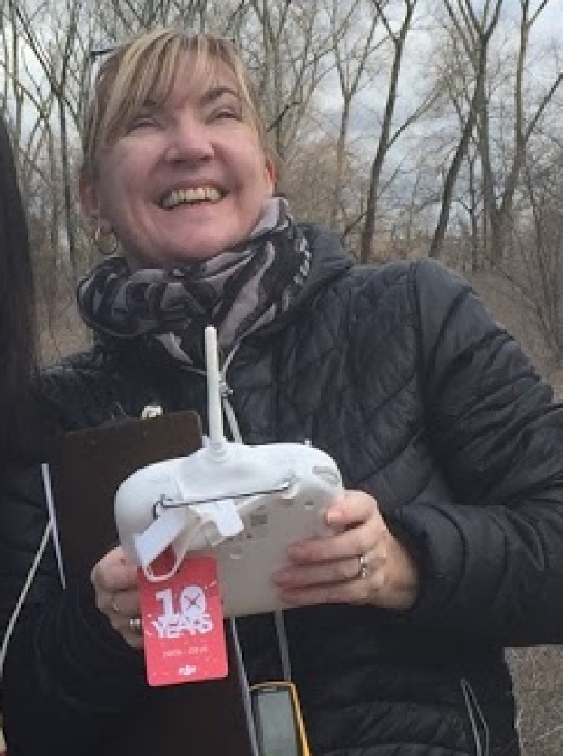
Part B
Using Drones to do scientific research

Slide 9
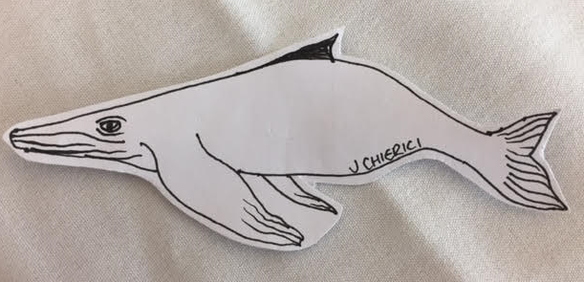
Our Study Group: Humpback whales
Location: Antarctic Peninsula
Scientists: Ari Friedlaender, David Johnston
Technology: Drones

Slide 10
Our Study Group: Humpback whales
Image: Ari S. Friedlaender

Slide 11
Location: Antarctic Peninsula
Image From: http://lima.nasa.gov/pdf/A3_overview.pdf

Slide 12
Meet the Scientist
Ari Friedlaender is an Associate Professor at Oregon State University’s Marine Mammal Institute.
His research focuses on developing new tags and tag sensors to study the underwater foraging behavior of marine mammals.
The main focus of his research is on humpback and minke whales in Antarctica, and blue and fin whales in California waters.
Ari’s passion for research and education has helped lead to new visualization tools that can be shared with broader audiences and students of all ages.
From: http://www.mbari.org/earth-2017-scientists/

Slide 13
Meet the Scientist
David W. Johnston, Ph.D. is Assistant Professor of the Practice of Marine Conservation & Ecology at Duke University Marine Laboratory.
He works with Ari to produce the drone images
He is using new technology to study the ecology and habitat needs of marine vertebrates in relation to pressing conservation issues, and advance new ways to communicate science effectively
From:https://sites.nicholas.duke.edu/johnston/about/

Slide 14
From: https://news.science360.gov/obj/video/52c64827-0463-443a-bfa5-317073944ed7/digital-eye-sky

Slide 15
Deploying a drone

Slide 16
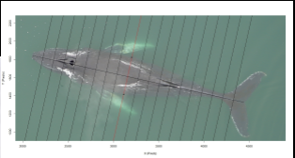
We can measure the size of the whale using drone images

Slide 17
Task
Measure
Measure the images on the copies provided and check your answers.
Calculate your percentage error (if any)
Infer
Use your observations and measurements of the images to answer the questions on the worksheet
Discuss
Be ready to take part in the class discussion

Slide 19
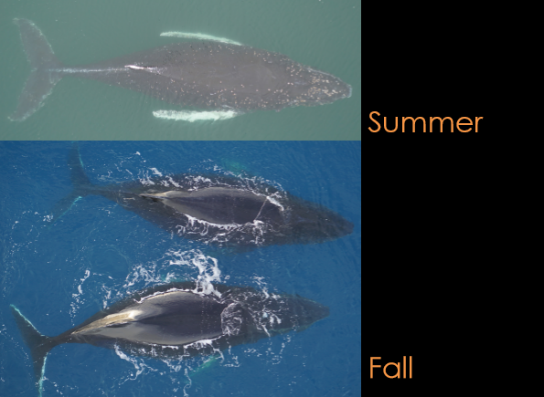
images
COMING SOON!!

Slide 20
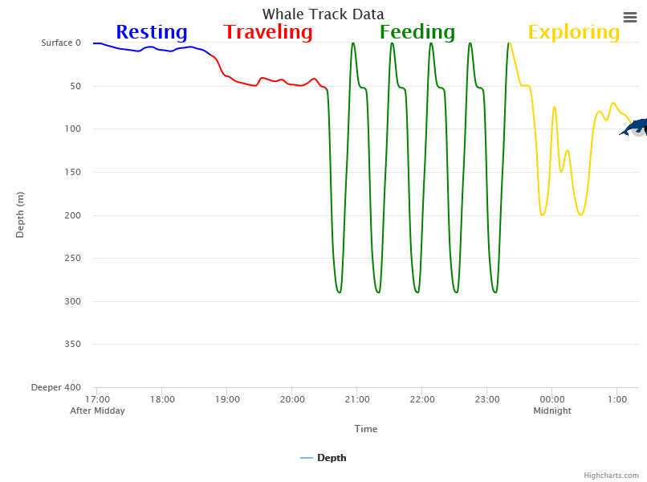
Questions
How do you think the extra body weight affects the whales’ movement in general?
How do you think the extra body weight affects the whales’ feeding habits?
How do you think the extra body weight affects the whales’ exploring habits?

