Slide 1
Accessing and Analyzing Authentic MBARI Real-Time Data*
Patrick Murray
*Everything you ever wanted to know about Ken.Johnson’s float data but were afraid to ask

Slide 2
Learn a little about what kind of data we collect about Oceans by using some of it and then writing a Python program that does precisely the same thing and therefore you cannot bluff your way though it one iota.

Slide 3
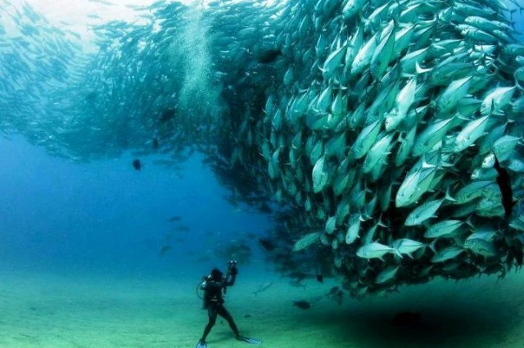
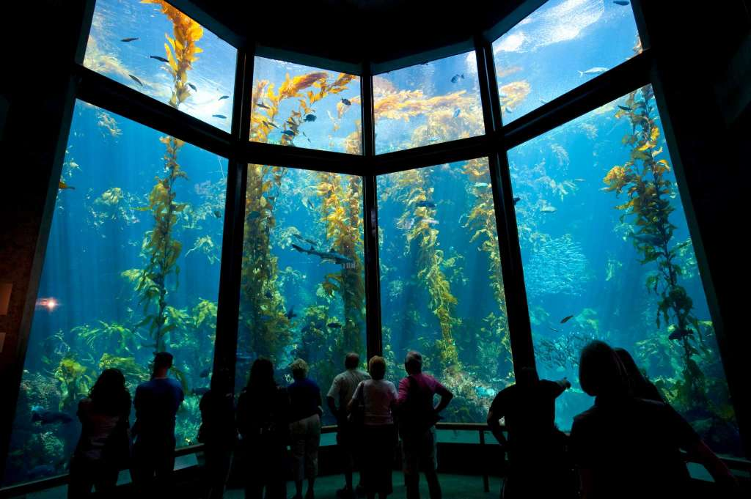
So grab some data from MBARI’s data bank
Learn a little about the Ocean.
After all, it’s singularly the most important life-giving force on Earth.

Slide 4
Accessing and Analyzing Authentic MBARI Real-Time Data
Run Ken Johnson’s report generator as well as his data dump.
Design, code, and write a Python Program to make a graph.
Use his data as input to your Python Program.
Run your program to create the same graph he did.
Use his report to check yours is correct.
What is your graph telling you?
Ken’s program will run any graph on almost any data.
Is he or is he not a programming god? ___yes ,____ um, yes

