Slide 1
Where There is Water, There is Life!
Exploring the endemic and cosmopolitan diatom species in the McMurdo Dry Valley, Antarctica using the MCM LTER database
EARTH 2016 - New Brunswick, NJ
Alia Thompson and Olivia Swanson Jern

Slide 2
Summary
Microbes, specifically diatoms are not only abundant in all ecosystems on Earth but have a profound impact on the functioning of the Earth as a system. Understanding and identifying diatoms becomes important to determine the success of the ecosystem. Humans also have a profound impact on the environment by transporting alien species through tourism and scientific research expeditions. Students will be exploring what endemic and cosmopolitan species are on a local, regional and global scale using a variety of activities and technology. Students will also explore the positive and negative roles humans play in changing an ecosystem.
On a global basis...the two great destroyers of biodiversity are, first habitat destruction and, second, invasion by exotic species. - E.O. Wilson

Slide 3
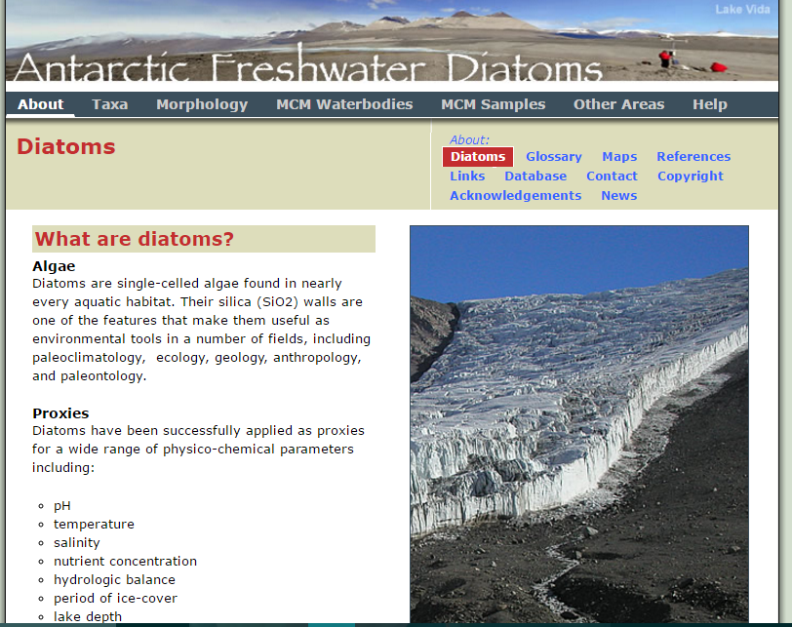
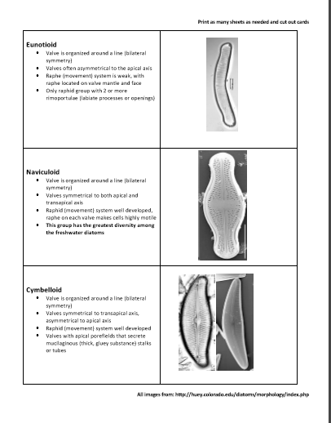
Lesson Format: 5 E
Engage = Brainstorm...Diatoms? Antarctic ecosystems?
Antarctic Climate Secrets : Diatom Tour Video (2:07 min)
Antarctic Film Fest: Diatoms Video (3:05 min)
Diatoms in Antarctica Video (1:57 min)

Slide 4
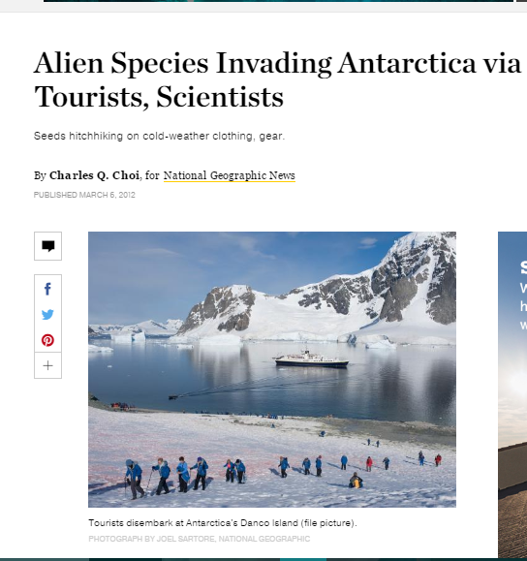
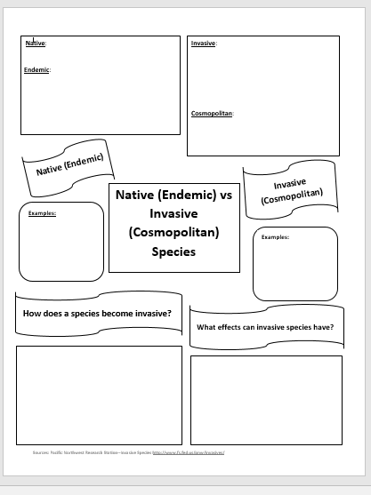
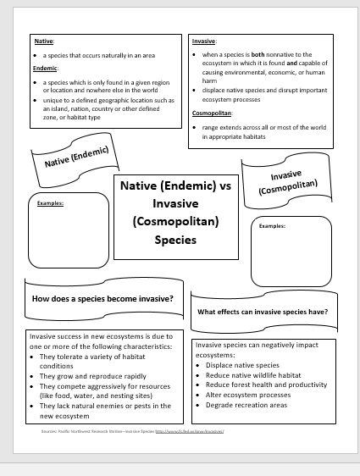
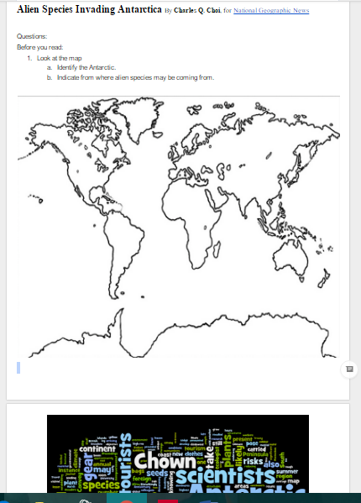
Lesson Format: 5E
Explore = Identify the differences in native & invasive species with examples.

Slide 5
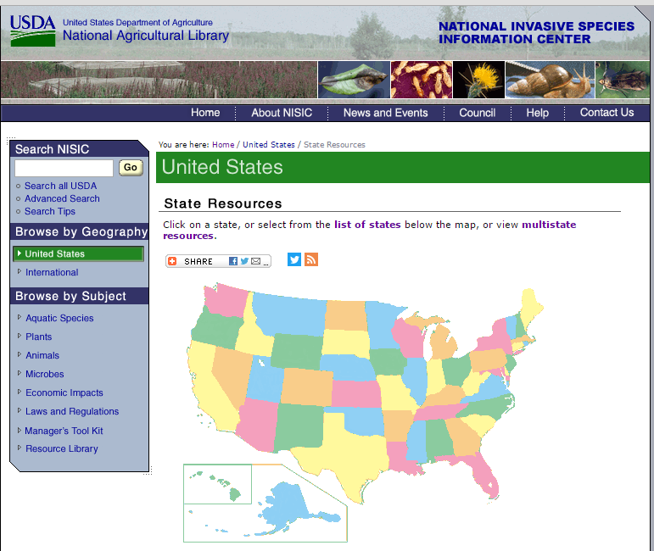
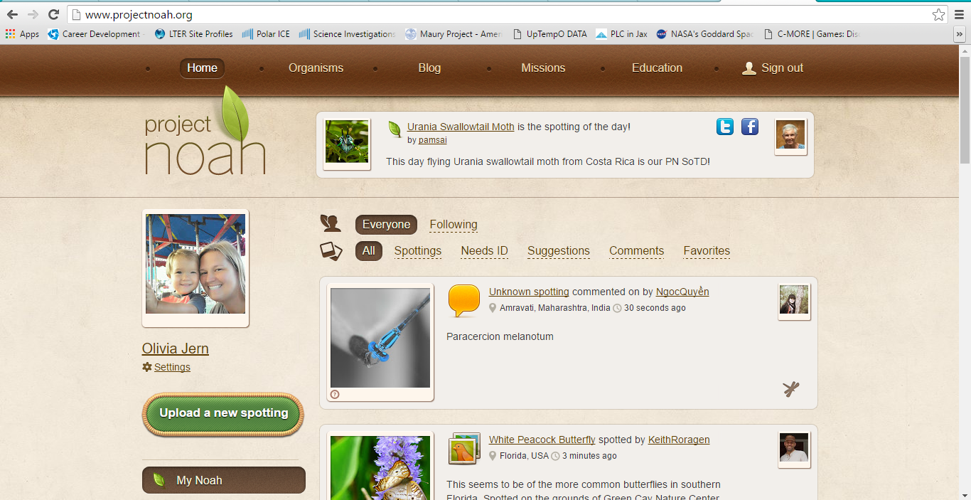
Lesson Format: 5E
Explore cont:
Rewatch Diatoms video to look for possible species introductions
Extension Activity

Slide 6
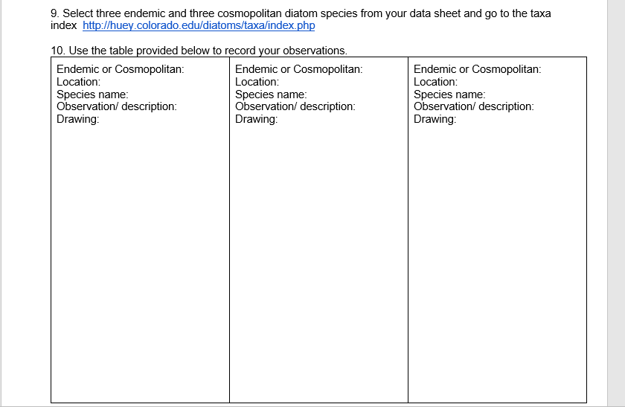
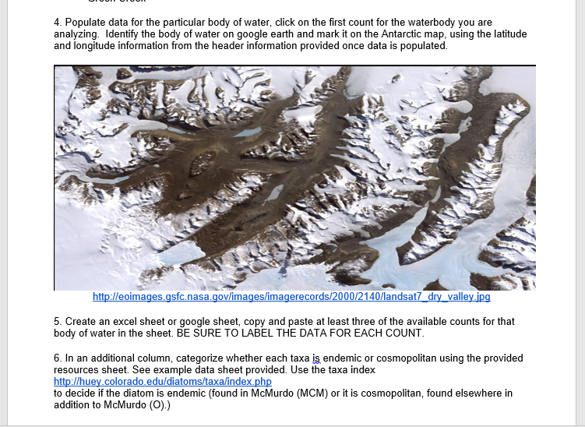
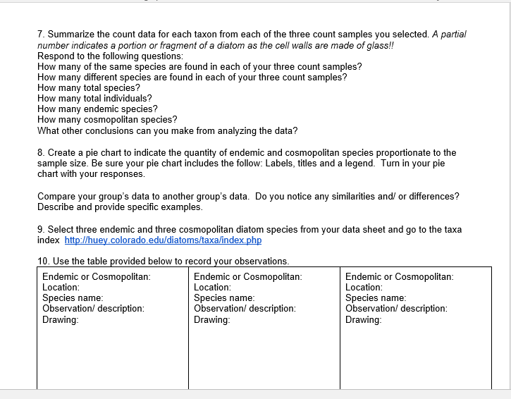
Lesson Format: 5E
Explain = Using Data

Slide 7
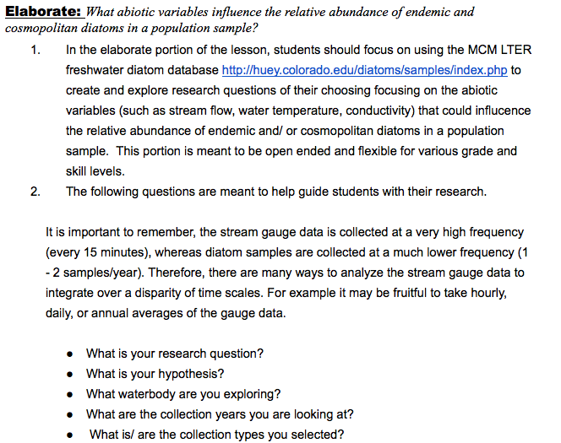
Lesson
Format: 5E
Elaborate =

Slide 8
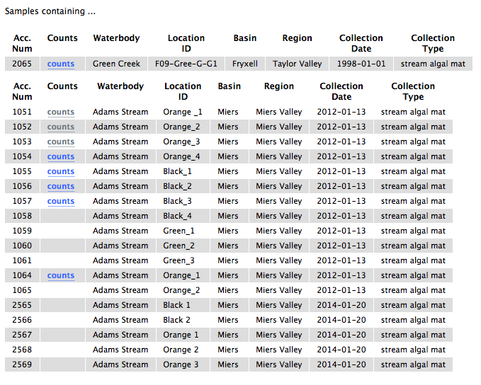
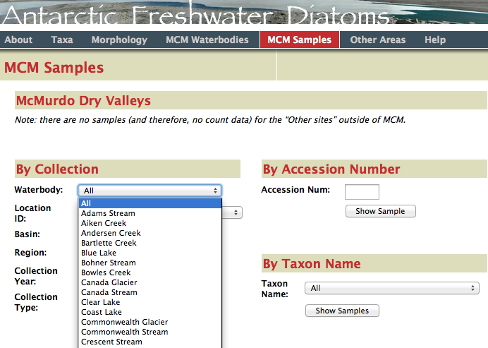
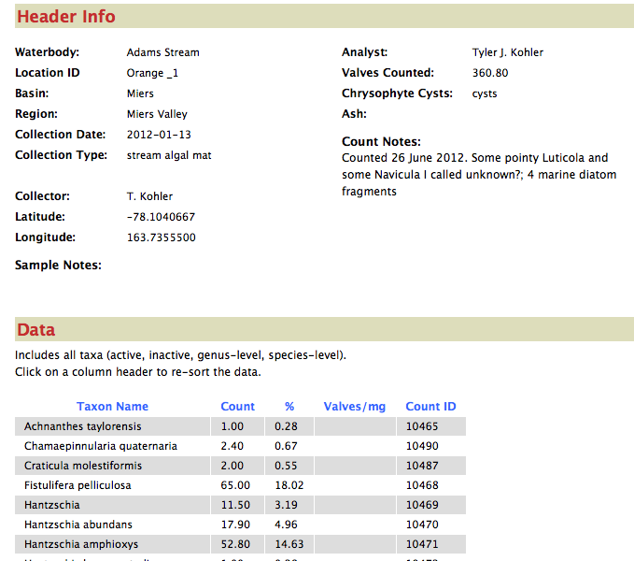
Database

Slide 9
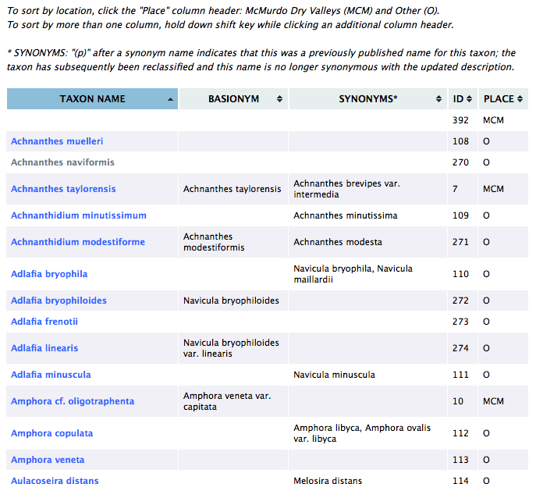
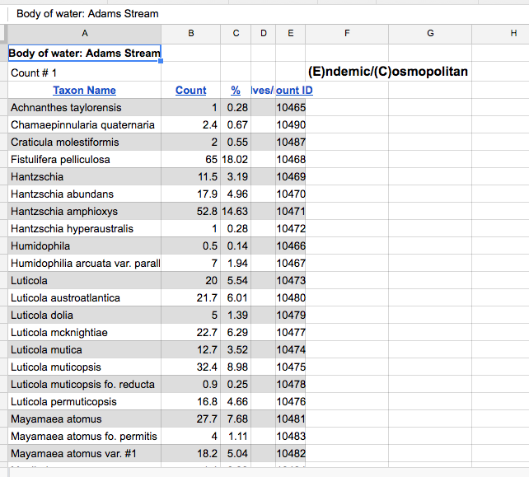
Data sets

Slide 10
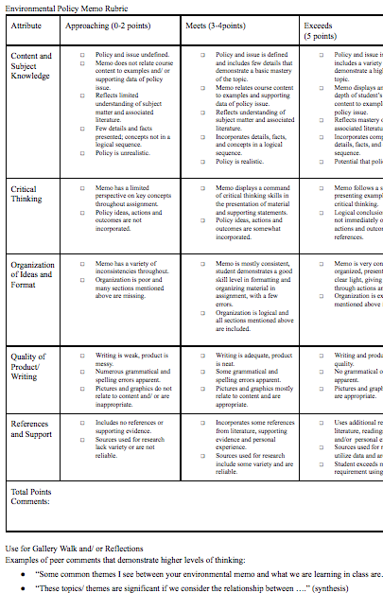
Lesson Format: 5E
Evaluate = fortune teller environmental policy memo
using rubric, discussion
Prompts and
gallery walk

