Slide 1
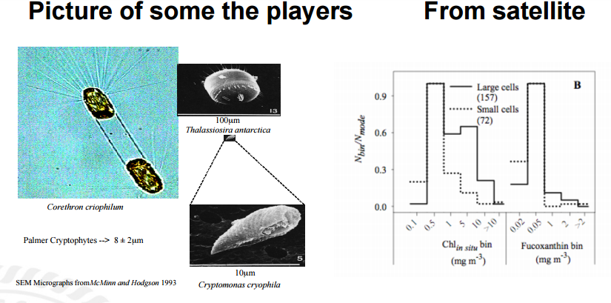
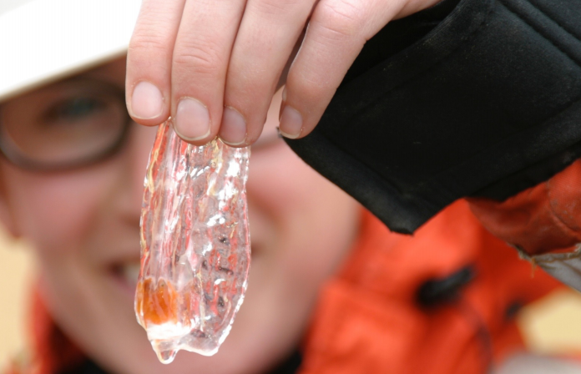
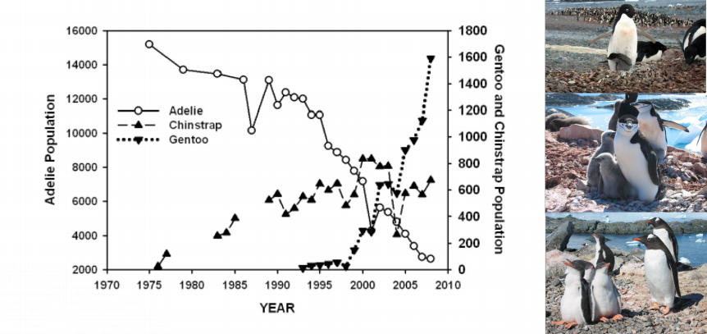
This excited us

Slide 2
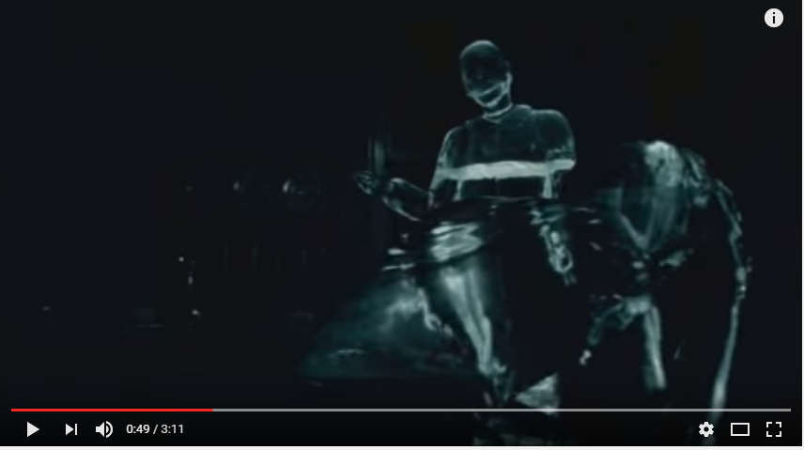
Are Adelies getting the “Cold Shoulder”
THANKS Joanne for our background picture!!!!!
https://www.youtube.com/watch?v=uGwH-x4VoH8 47 seconds in

Slide 3
SUMMARY
This activity allows students to use real scientific data to explore ecosystem dynamics; including competition and predator-prey relationships among three Antarctic penguins. Students will manipulate data using XCel Spreadsheet software to generate a graph to illustrate population changes observed in Adelie, Chinstrap, and Gentoo penguins between 1974 and 2010. A dataset for each species is provided. The penguin population and penguin diet datasets were collected in the Palmer Station Study region, which is part of the Long-Term Ecological Research program. This program began in 1992 and has been collecting annual data in this region (as well as numerous other regions in Antarctica) on a variety of ecological interactions.

Slide 4
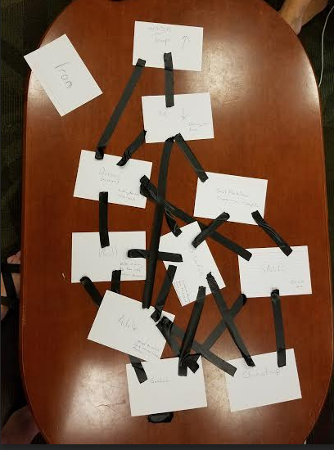
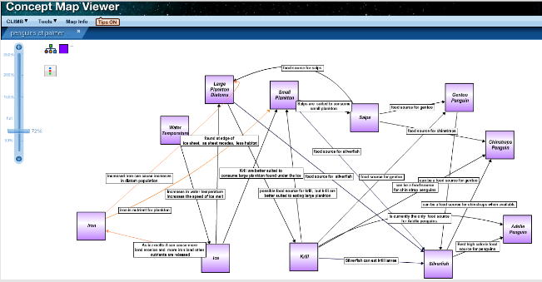

Slide 5
