Slide 1
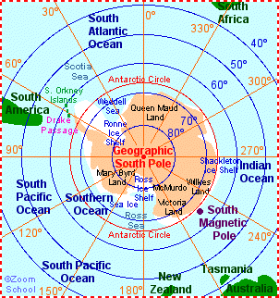
Antarctica
The Land at 70⁰ South

Slide 2
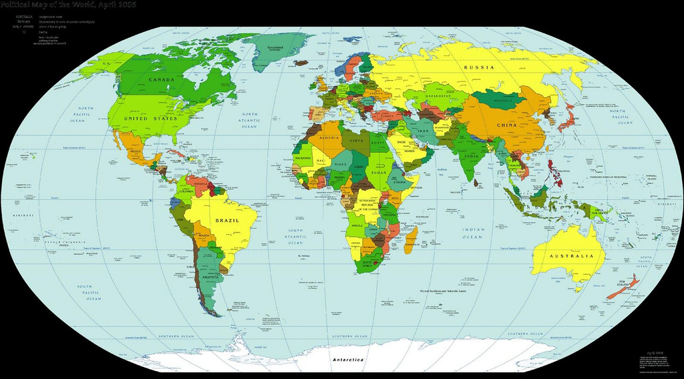
Antarctica is a continent at the south pole of the Earth.

Slide 3
Location
Antarctica hasn't always been located at the South Pole. It has drifted, like the other continents, and has ranged from the equator (during the Cambrian period, about 500 million years ago) to the South Pole. During the time of the dinosaurs
(during the Mesozoic Era, about 65 million to 248 million years ago), Antarctica was more temperate and housed dinosaurs and many other life forms. Now, there
is very little indigenous life.
Over the millennia, it drifted farther south, separated from Australia, and is now located over the South Pole of the Earth.
https://www.youtube.com/watch?v=MEh4B1Pv8YE
Over the millennia, it drifter farther south, separated from Australia, and is now located over the South Pole of the Earth.

Slide 4
Geography
Antarctica is the icy continent at the South Pole. It is covered by permafrost (permanently frozen ground) and is completely surrounded by water.(The Southern Ocean) Antarctica is about 1 1/2 times larger than the United States. This frozen continent is actually considered to be the world's largest desert. 98% of the land is covered with a continental ice sheet; making up about 87% of the world’s total ice. The remaining 2 percent of land is barren rock. McMurdo dry valley is one such a place that scientists from the US like to study.
https://www.youtube.com/watch?v=5plXAKlpDkQ

Slide 5
Climate
The South Pole aka; Antarctica, is the coldest, windiest, and driest place on Earth. The coldest temperature ever recorded on Earth was here; it reached -128.6°F (-88.0°C)! On average, because Antarctica is really a frozen desert, snowfall only averages less than 2 inches each year.
https://www.youtube.com/watch?v=7V26wCXi9fc

Slide 6
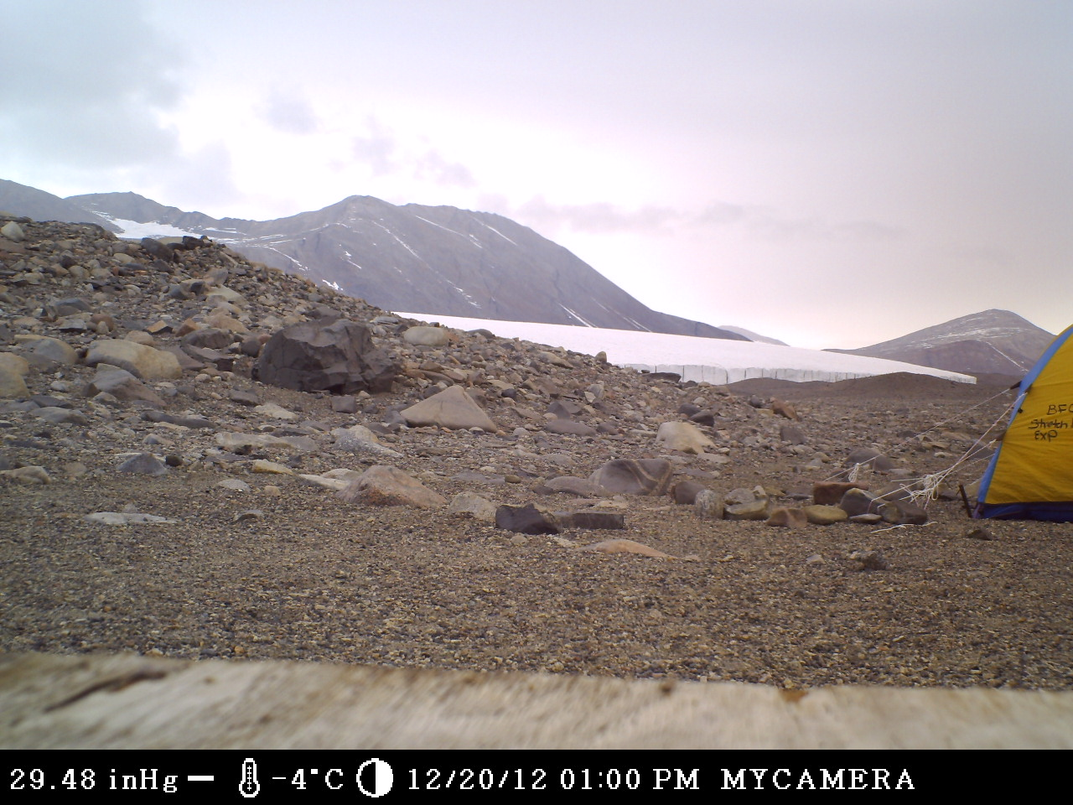
Notes:
We think of antarctica as a blanket of white – not so in the Dry Valleys.

Slide 7
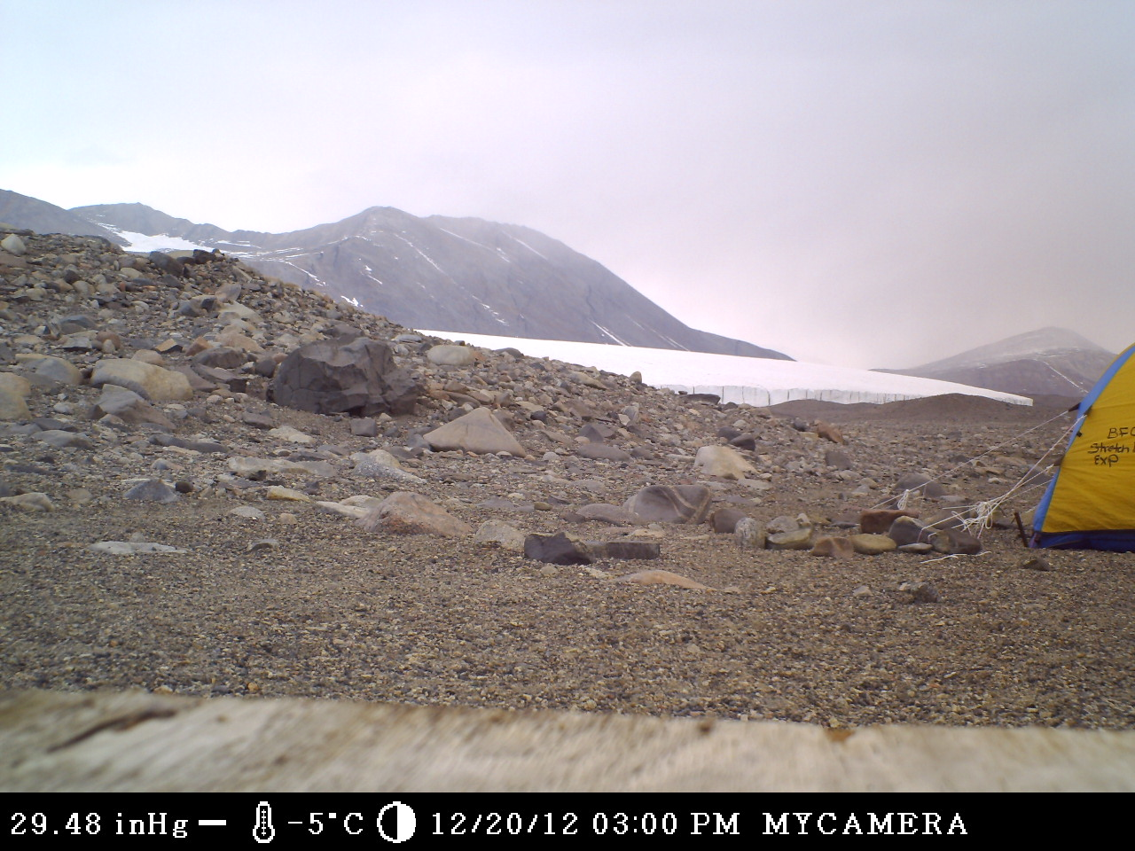

Slide 8
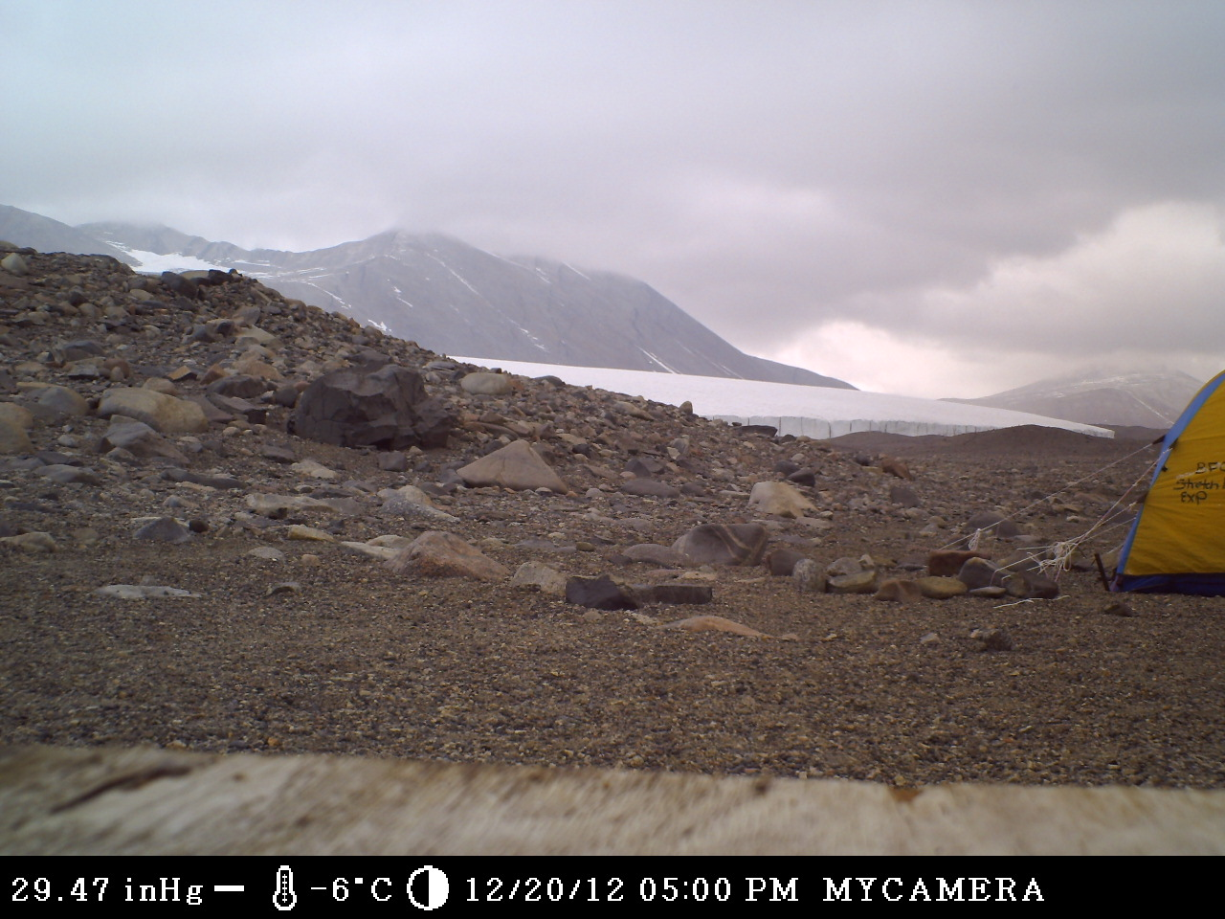

Slide 9
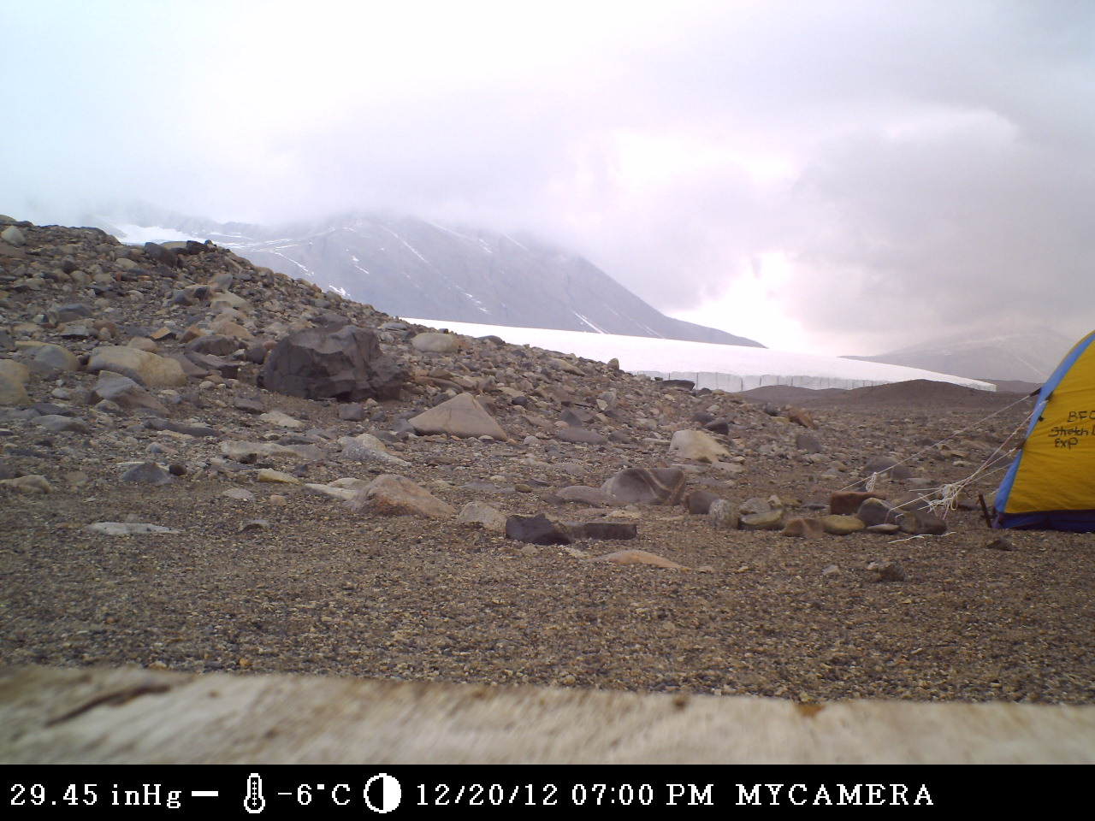

Slide 10
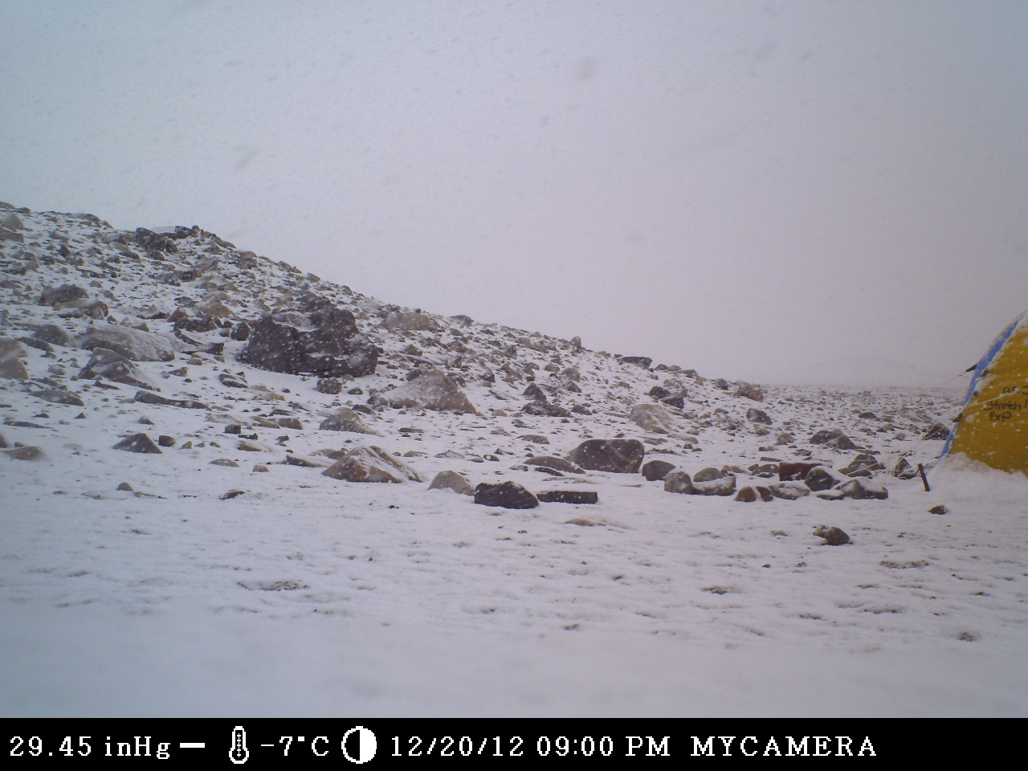

Slide 11
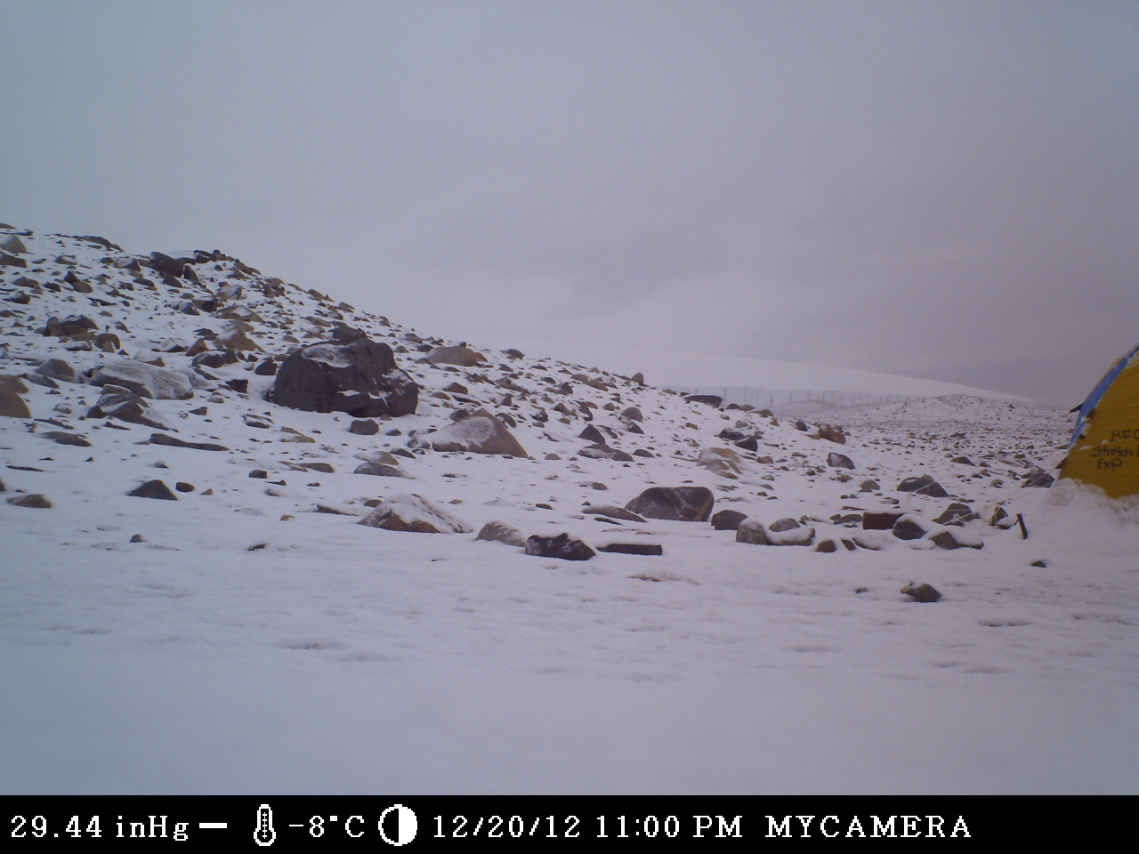
Notes:
PEAK SNOW ACCUM

Slide 12
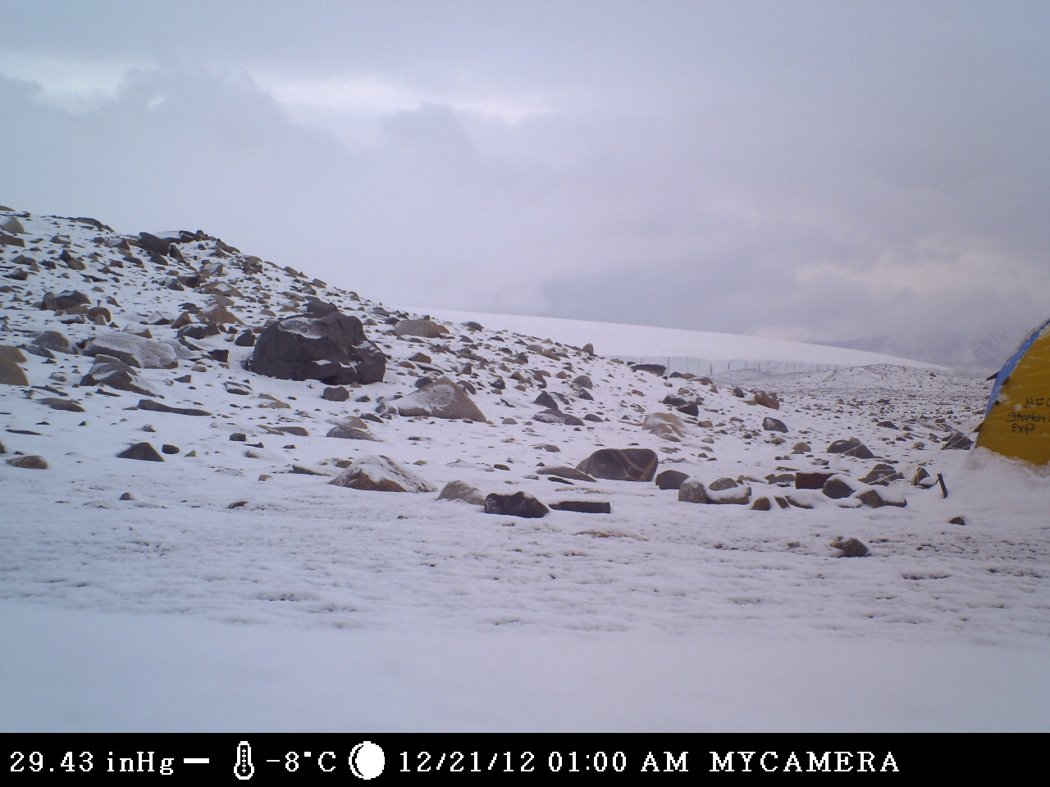

Slide 13
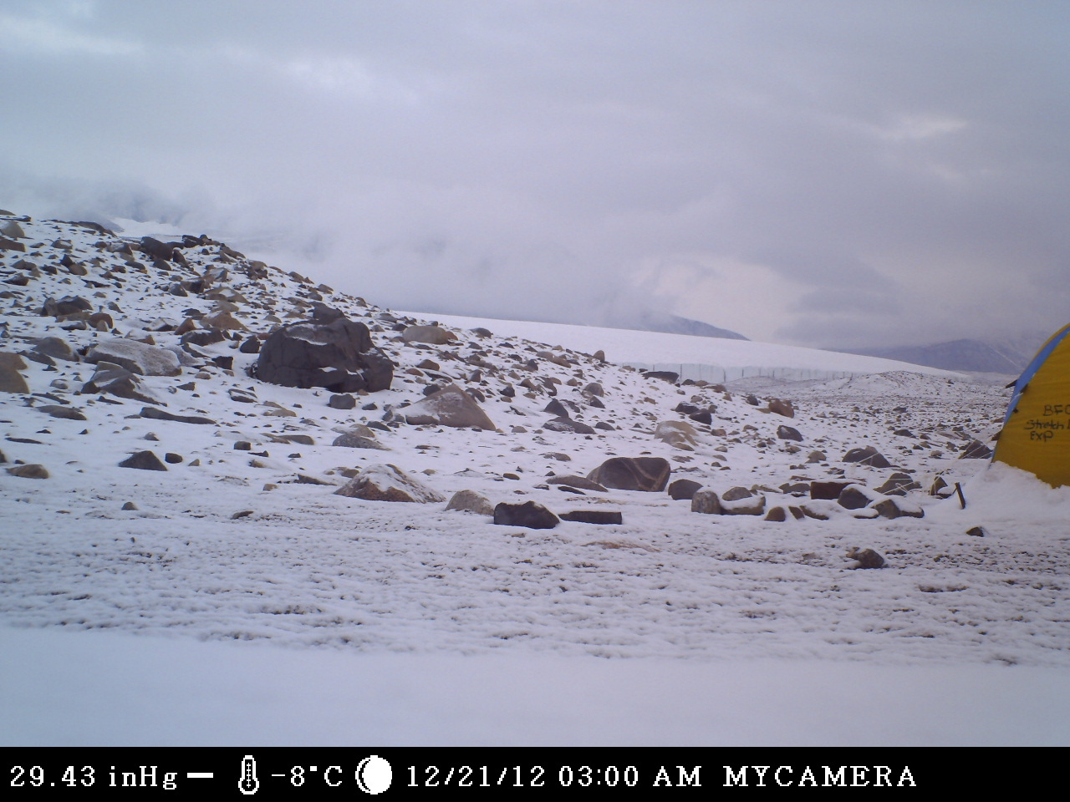

Slide 14
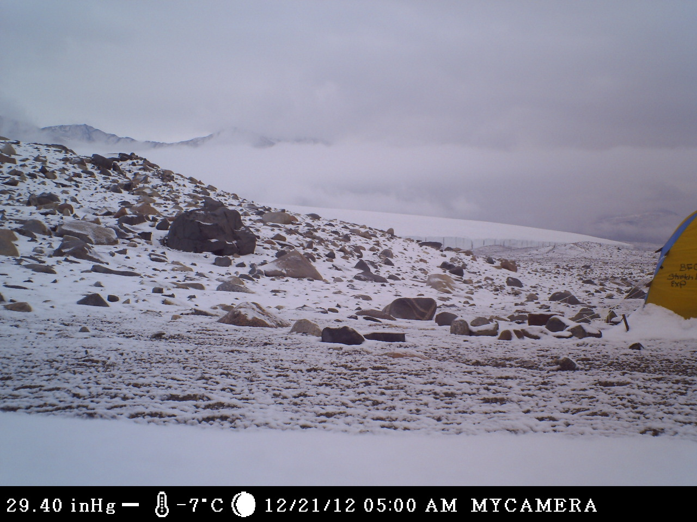

Slide 15
People
Although scientific expeditions visit Antarctica, there are no permanent human residents (because of the extreme weather, which includes freezing temperatures, strong winds, and blizzards). There are about 4,000 seasonal visitors to Antarctica.
Scientists from the US study at McMurdo station or Palmer station.

Slide 16
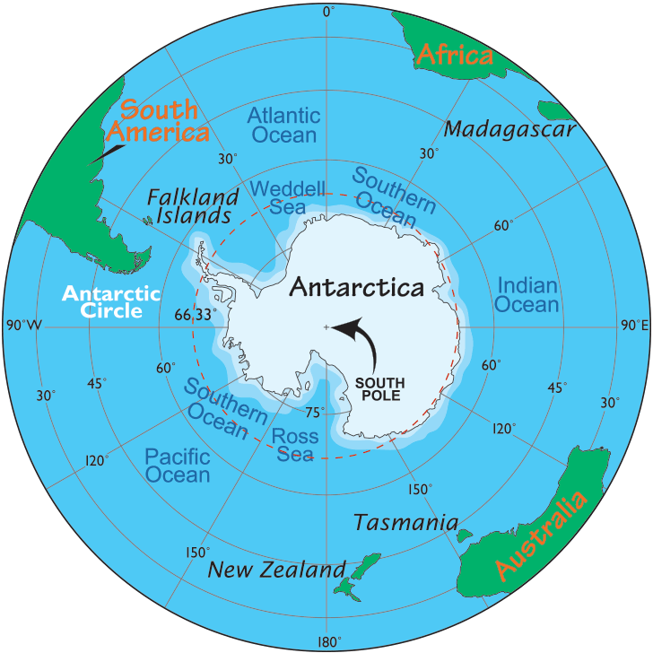
What’s the largest ant in the world?

Slide 17
Now, let’s see what you have learned.
Click on the following link to take a short quiz.
http://www.enchantedlearning.com/school/Antarctica/quiz/

Slide 18
Resources:
http://www.enchantedlearning.com/school/Antarctic/
https://www.eduplace.com/ss/maps/pdf/world_cont.pdf
https://www.youtube.com/watch?v=7V26wCXi9fc
https://www.youtube.com/watch?v=MEh4B1Pv8YE

