Slide 1
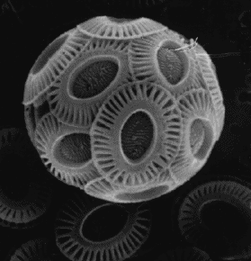
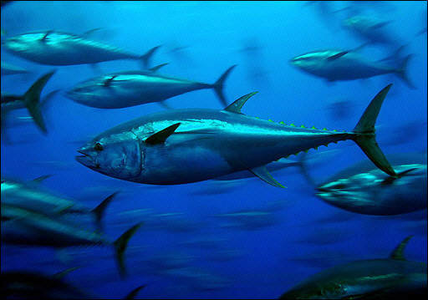
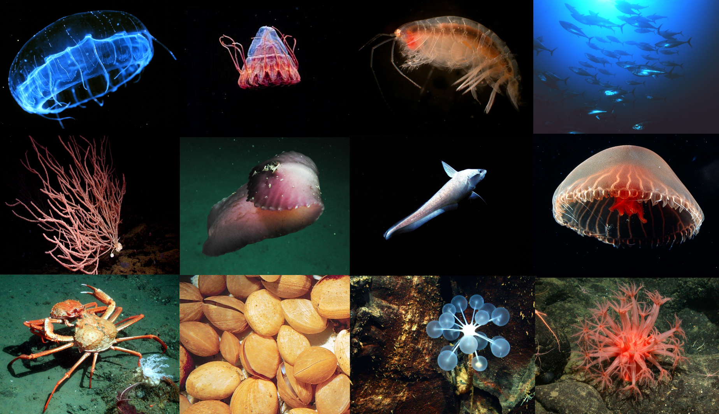
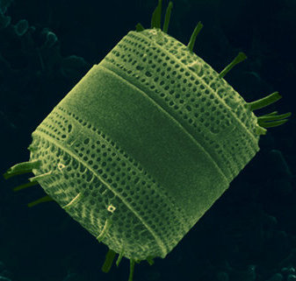

Ocean Acidification:
How does changing ocean chemistry affect ocean ecosystems?
Jim Barry, Monterey Bay Aquarium Research Institute
Stanford 2011

Slide 2
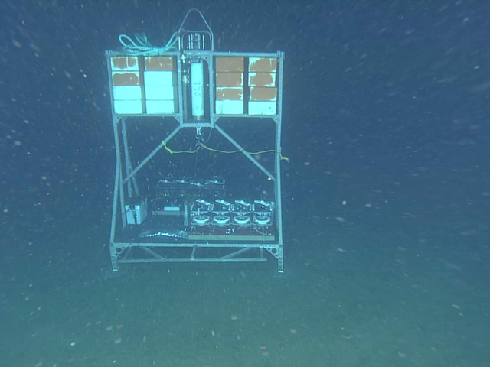
Benthic Respiration Chamber System
Perturbation experiments in the deep-sea
Show Video here

Slide 3
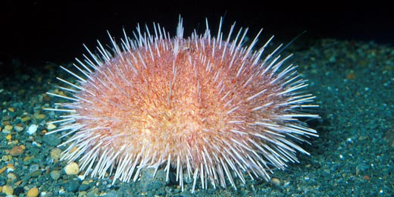
Respiration Chamber Data
Deep-sea urchins, Oxygen minimum zone
Fragile Urchin – Allocentrotus californiensis

Slide 4
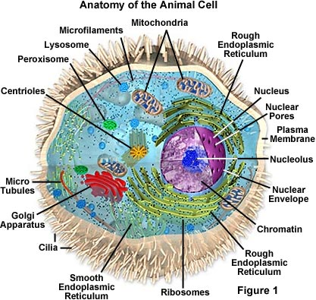
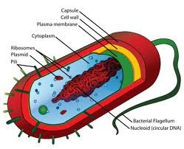
Benthic Respiration Chamber System
Perturbation experiments in the deep-sea

Slide 5
Environmental Stress, Ecosystems, and Society
Environment
Individuals
Populations
Species
Communities
Society
Ocean Acidification
Biodiversity
Physiological processes
(acclimation)
Ecosystem Function
Warming
Abundance
DistributionProductivity
Biological Interactions
(food web)
Fisheries
Hypoxia
Resilience
Metabolic Performance
Other
Ecosystem
Services
Adaptation
Energy Flow
Stability
Survival
Growth
Reproduction
Productivity

Slide 6
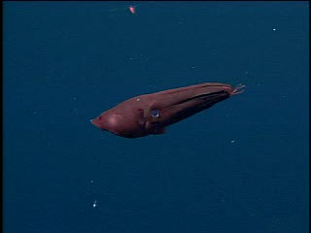
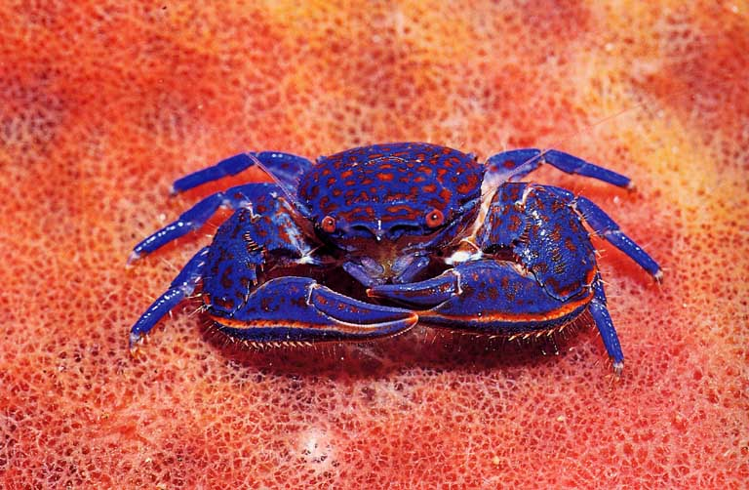
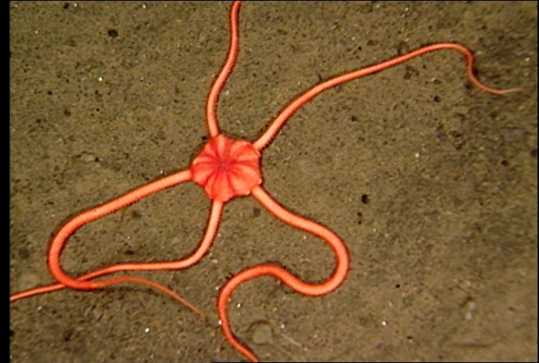
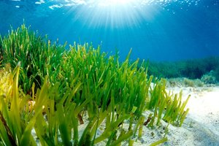
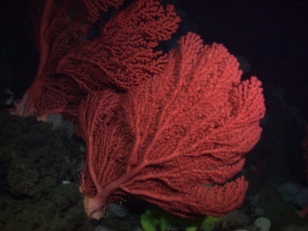
Physiological processes affected by high CO₂
Photosynthesis
Calcification
Respiration
Acid – Base Balance
Metabolic Rate
Vampire Squid

Slide 7
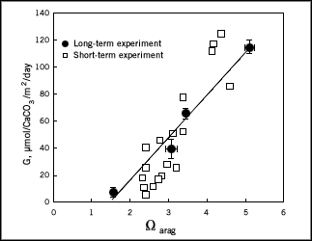
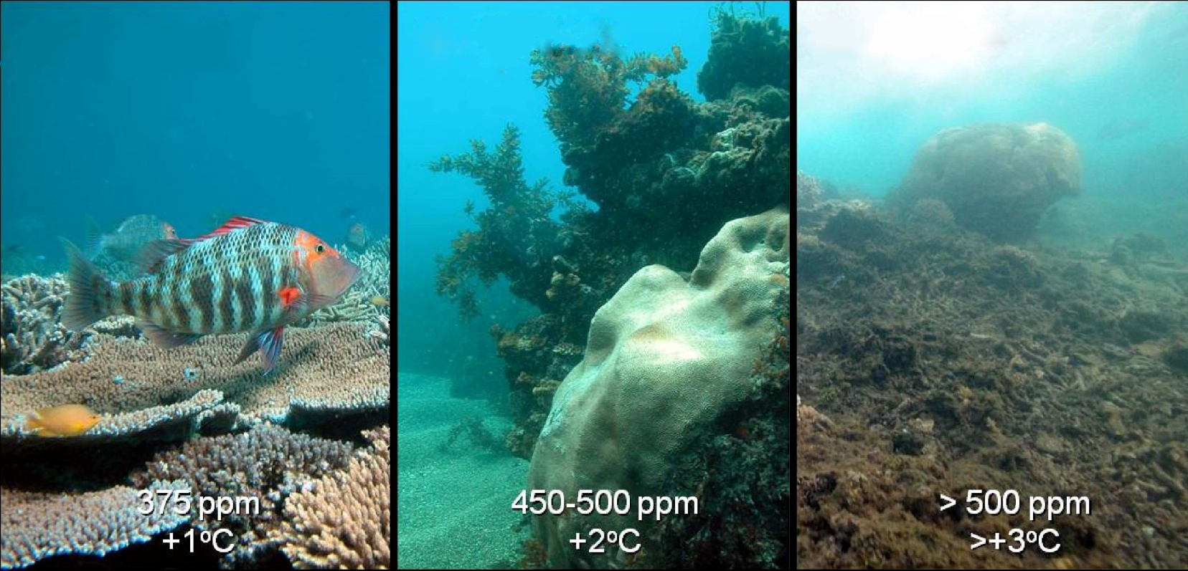
Calcification and Ocean Acidity
Low carbonate saturation associated with low calcification rate
Calcification Rate
Corals
Aragonite Saturation State

Slide 8
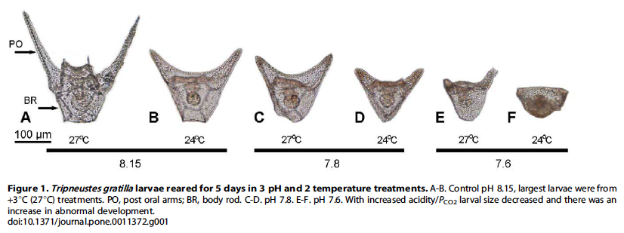
Warming may offset OA impacts for some taxa
Brennand et al. 2010

Slide 9
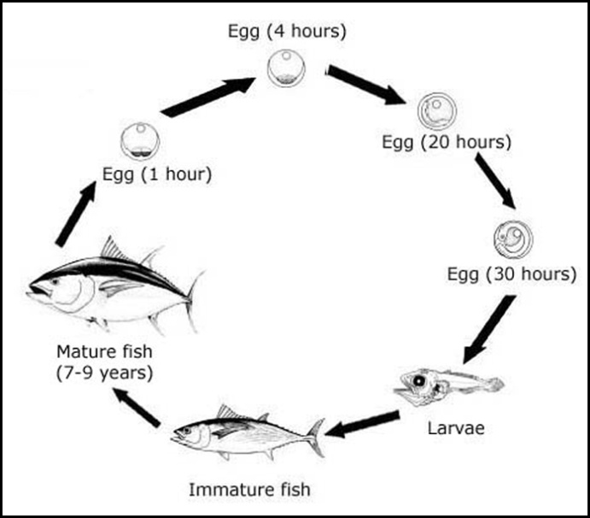
Effects on different life stages
Stage:
Duration:
Sensitivity:
Tuna Life Cycle
Fertilization
Seconds
High?
Embryo
Hours - Days
High?
Larva
Days – Months
Mod. – High?
Juvenile
Mo. – Yr.
Moderate?
Adult
Yr. – Cent.
Low – Mod.?

Slide 10
Effect of stress on individuals
Normal
Stressed
Cost of
Living
Growth
Cost of
Living
Growth
Reproduction
Energy
Budget
Reproduction
Energy budgets – If the cost of living (e.g. shells) increases, less is available for growth and reproduction.
Notes:
Stress increases “cost of living” , with less energy for growth and reproduction.
Individuals = reduced 1) survival, 2) size, 3) reproductive output.
Populations = Reduced abundance, productivity, resilience, and greater likelihood of extinction.

Slide 11
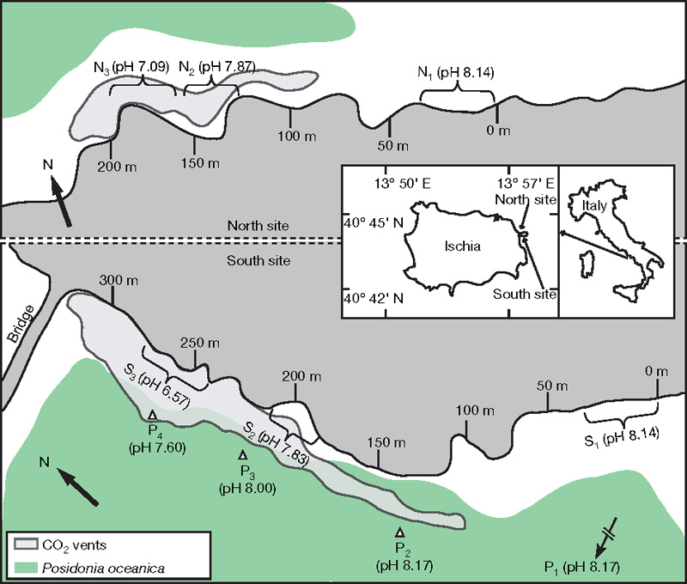
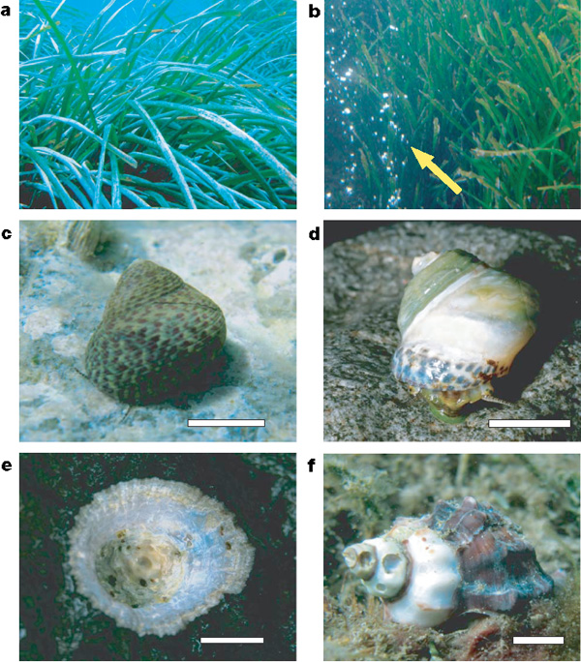
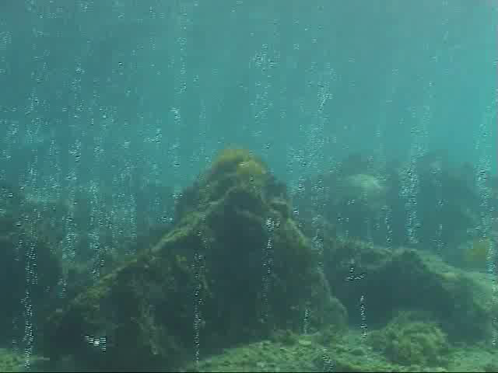
Field Survey of Natural CO₂ Venting Sites in Italy
Echinoderms conspicuously absent, shell dissolution
Seagrasses thrive
Jason Hall-Spencer et al. 2008

Slide 12
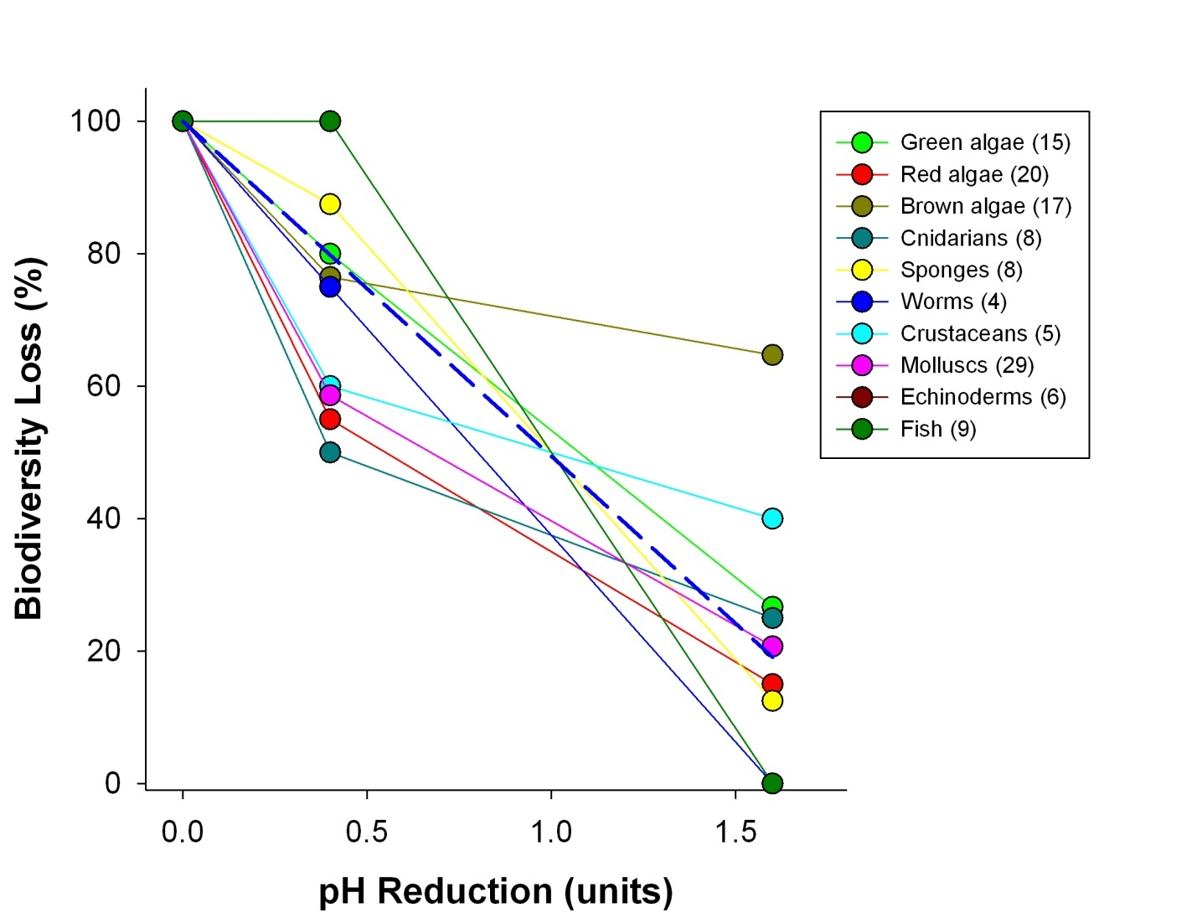
Biodiversity is reduced in natural CO2 vents
51 percent reduction in species richness per 1 pH unit
Data from Hall-Spencer et al. 2008

Slide 13
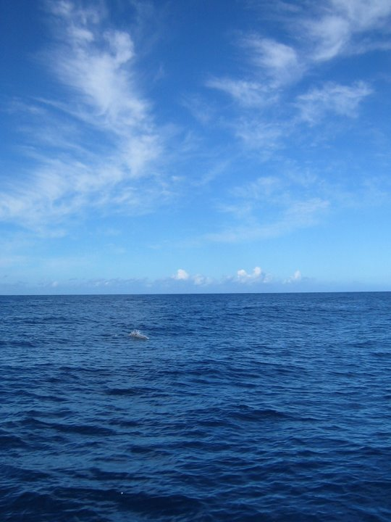
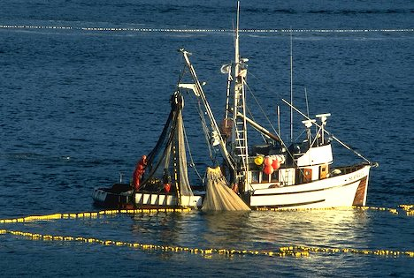
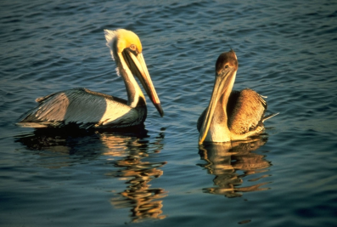
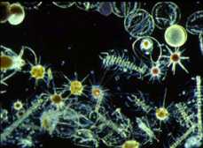
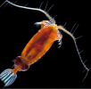
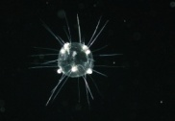




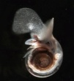
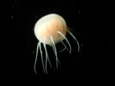
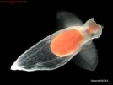
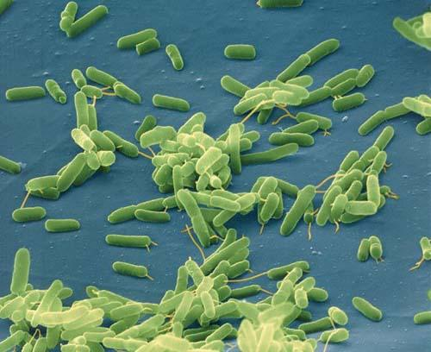
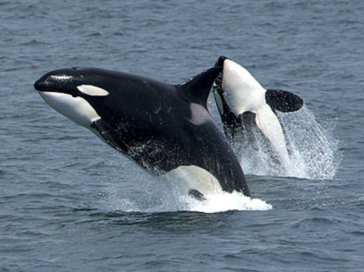
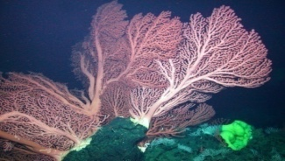
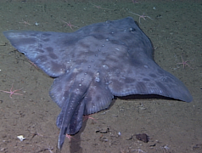
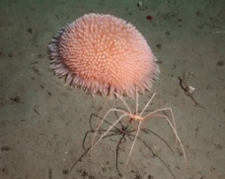
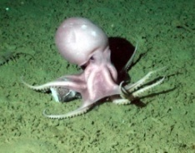
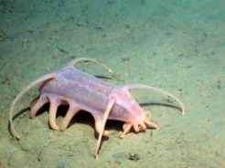
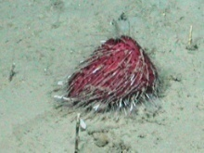
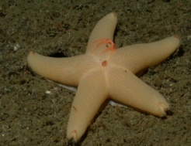
Marine Communities are Biological Networks
Primary Production
Humans
Seabirds
Phytoplankton
Zooplankton
Squid
Fish
Large zooplankton
Detritus / Bacteria
Seafloor Animals
Mammals
Marine Food Web
Notes:
Food web isn’t a very good image, but could be improved.

Slide 14
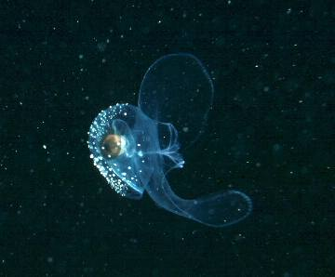
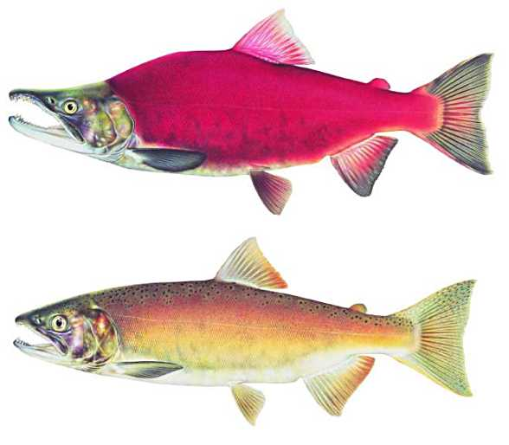
Will Ocean Acidification disrupt energy flow through marine food webs?
Pteropod = Salmon food
Sockeye Salmon

Slide 15
The bottom line – Ocean Acidification
What we know:
OA is ongoing, massive, increasing
Causes physiological stress for many species
Mitigation requires reduced atmospheric CO₂ levels
What we expect:
Food webs will be affected
Ecosystem services (e.g. fisheries) will change
What we don’t know:
Capacity for acclimation and adaptation
Interaction with other environmental changes (warming, pollution)
Effects on marine communities, ecosystems - tipping points?
Ocean ecosystems are going to be different
We don’t yet know how different
We may not like it

Slide 16
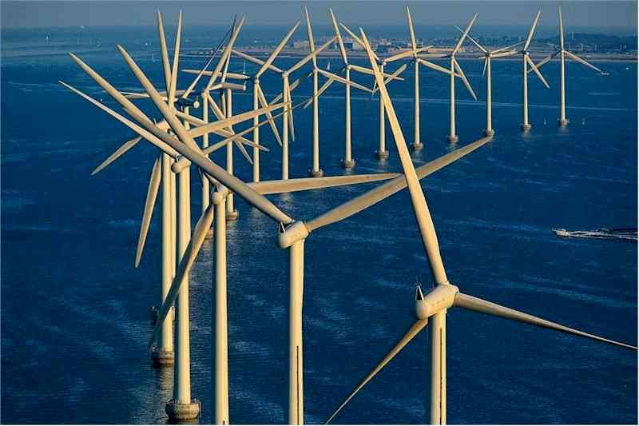
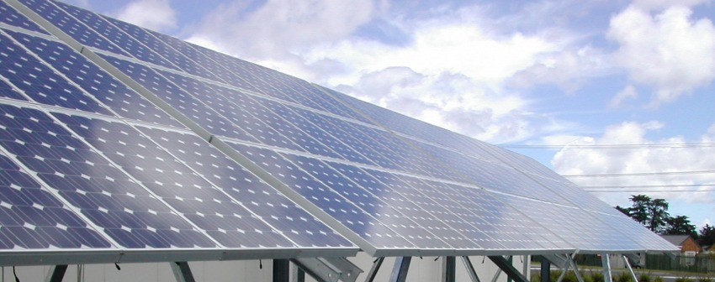
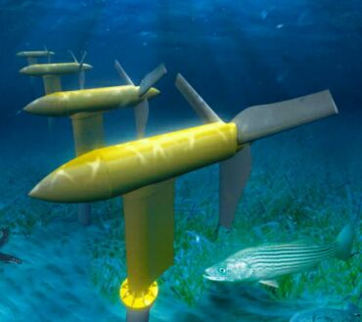
Is it hopeless, too late, too big….?
Should we worry?
  YES! Climate change / OA affects the quality of our lives
What can we do?
  Education and outreach
  Energy efficiency, non-carbon energy, reduced emissions
  Reconnect with nature
  Value the oceans
  Vote!

Slide 17
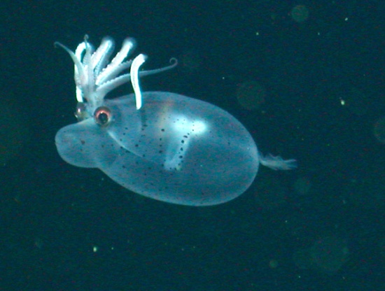
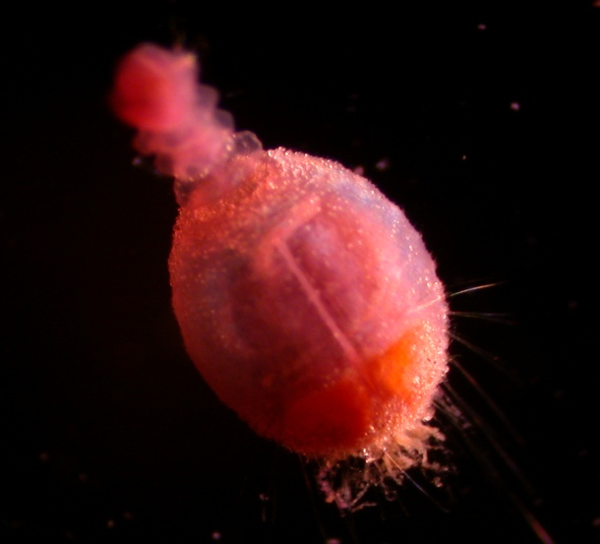
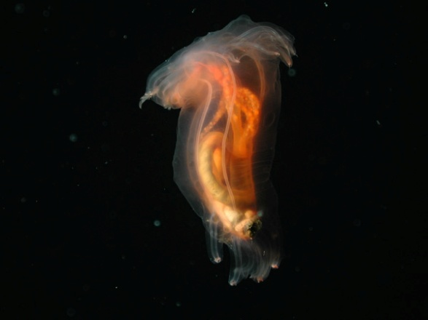
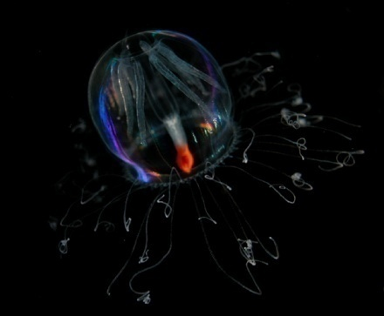
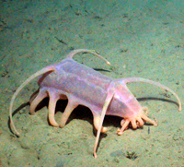
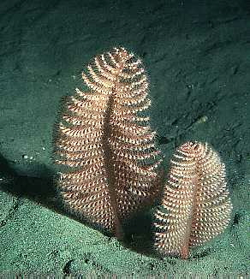


Value the Oceans

