Slide 1

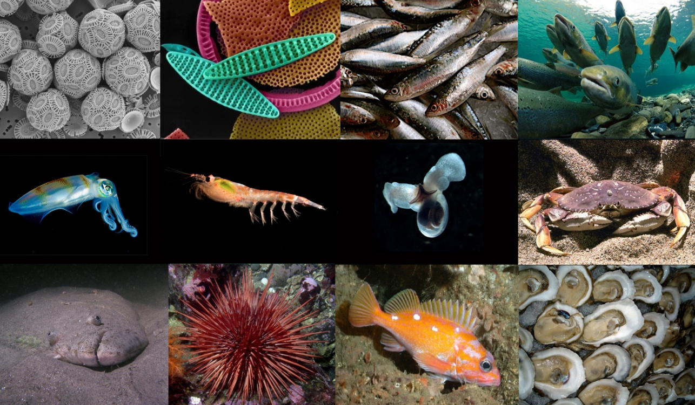
Ocean Acidification: The Other CO₂ Problem…
Jim Barry, Monterey Bay Aquarium Research Institute
Morro Bay Museum of Natural History, 2011
Fossil fuel CO₂ emissions are making the oceans more acidic
More acidic ocean appears to affect many marine organisms
OA occurring with other factors (warming, pollution…)
Potentially large consequences for ocean ecosystems and society
Notes:
Thank you
Right off the bat, I’ll provide some conclusions, most of talk will cover some of the details related to ocean acidification

Slide 2
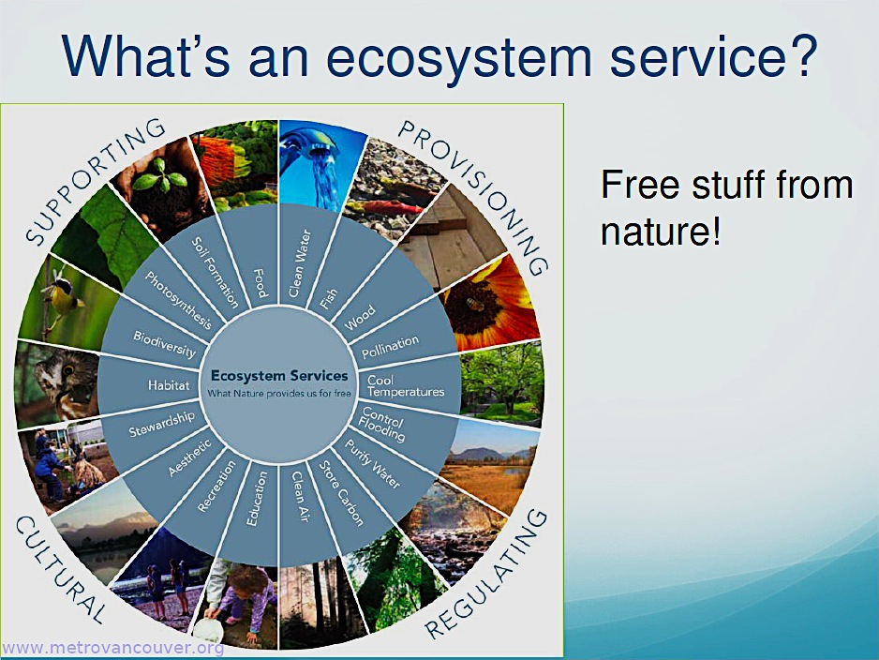
Notes:
We all care about the ocean
Ecosystem services are why all of us, even those living distant from the ocean, should care about ocean health

Slide 3
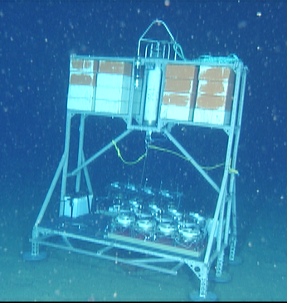
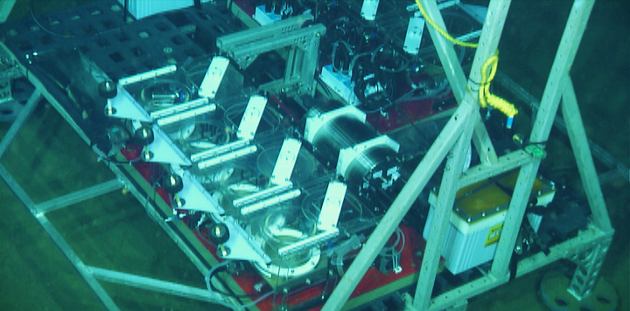
Benthic Respiration Chamber System
Perturbation experiments in the deep-sea
Notes:
What do I do?
I am a deep sea biologist,
Here we have deployed a system to measure respiration rates of deep sea animals to a depth of 2000 ‘ft off Monterey Bay
Details

Slide 4
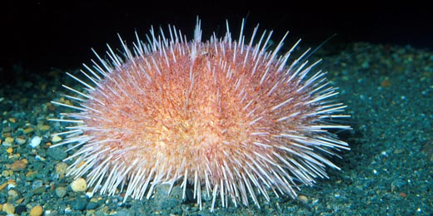
Respiration Chamber Data
Deep-sea urchins, Oxygen minimum zone
Fragile Urchin – Allocentrotus californiensis
Notes:
Results from the recent deployment

Slide 5
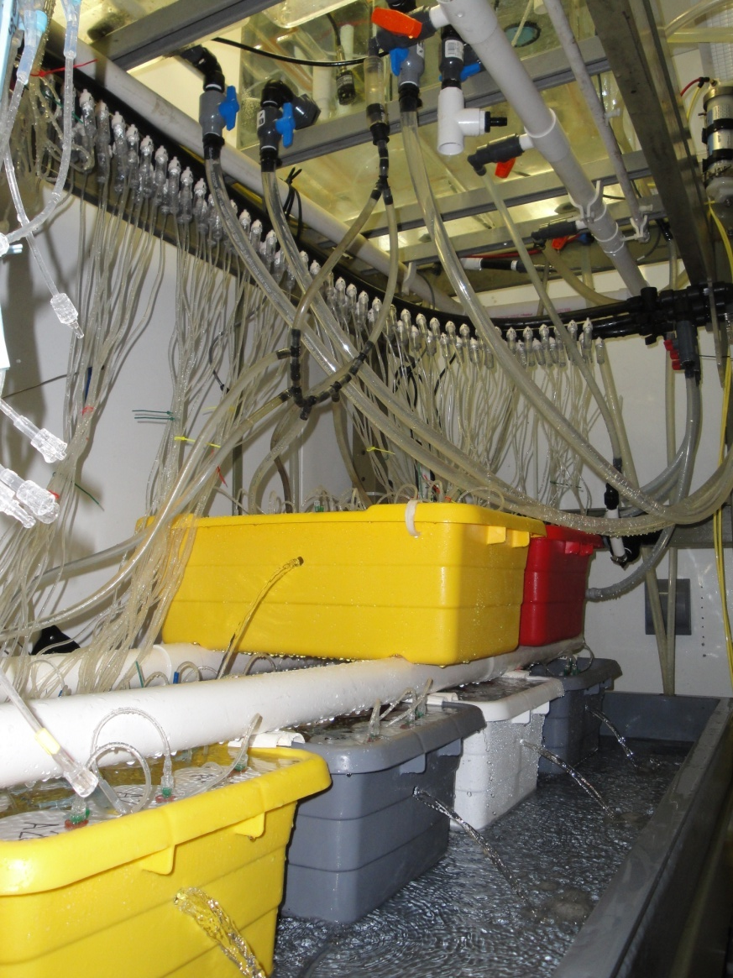
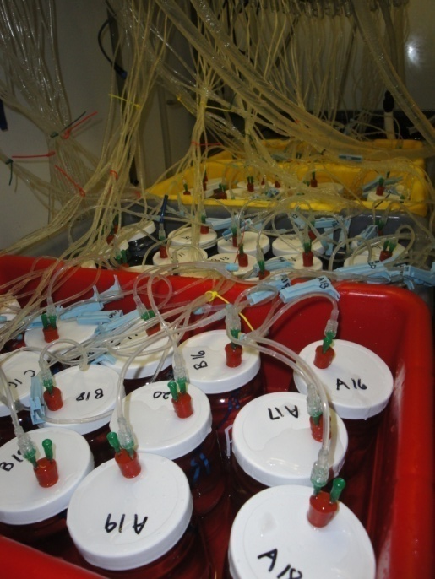
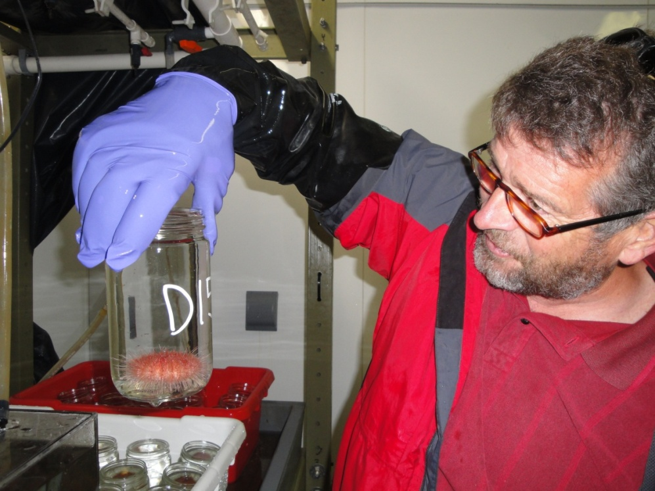
Deep-Sea Urchins
What is their sensitivity to changing ocean pH?
  Inhabit low O2, low pH (7.6) waters
  Shallow water species sensitive to pH
Ongoing studies
  Metabolic rate
  Acid-base chemistry
  calcification
  survival
  growth
  protein synthesis
Allocentrotus fragilis
Notes:
What do we do in the lab?
Who cares about deep sea urchin biology?
You need to know the big pricture to understand

Slide 6








The Global Carbon Cycle
Arrows indicate CO₂ absorbed or released per year
Natural
Cycle
207
Atmosphere
Year Human %C
<1800 <0.1
2007 4
2100 15
119
8
<0.01
119
30
121
88
88
90
125?
100?
Land
Ocean
Numbers are Billions of tons of Carbon (1 ton of Carbon = 3.7 tons of CO₂)
Notes:
Global carbon cycle and our role in it.

Slide 7
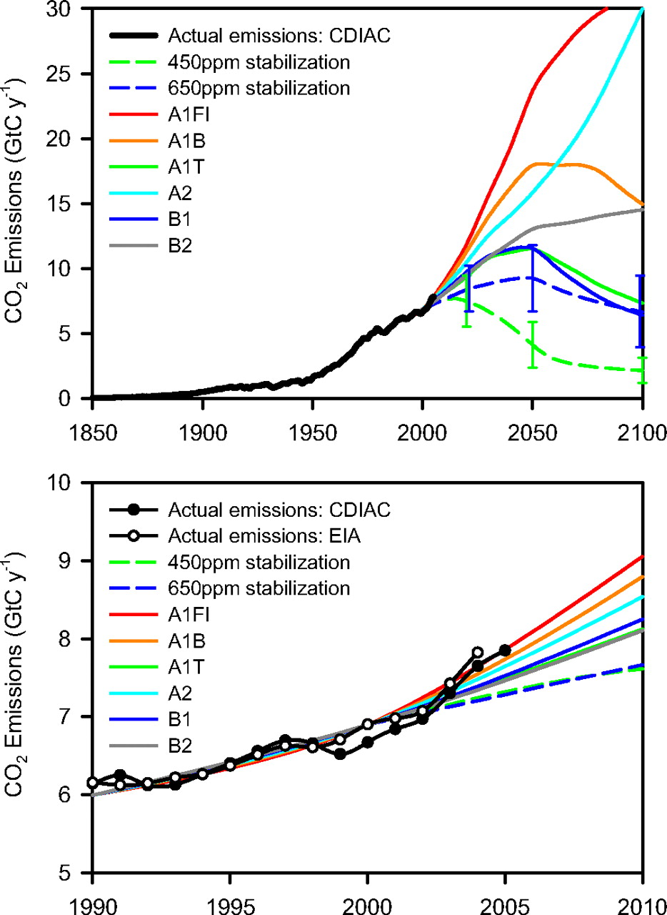
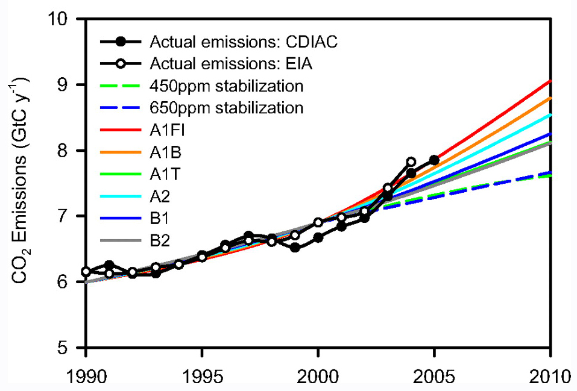
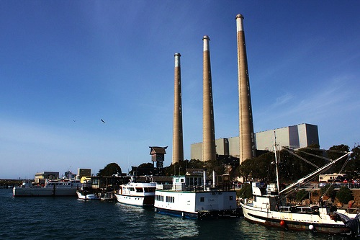
CO₂ Emissions?
Various scenarios
Current emissions high, increasing
Climate-agreements / legislation
High emissions = more ocean acidification

Slide 8
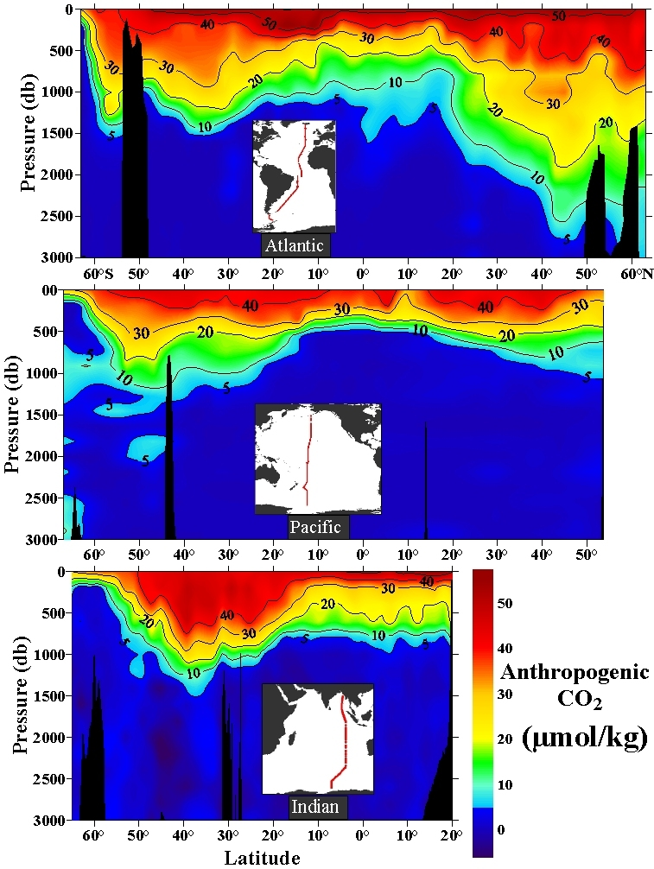
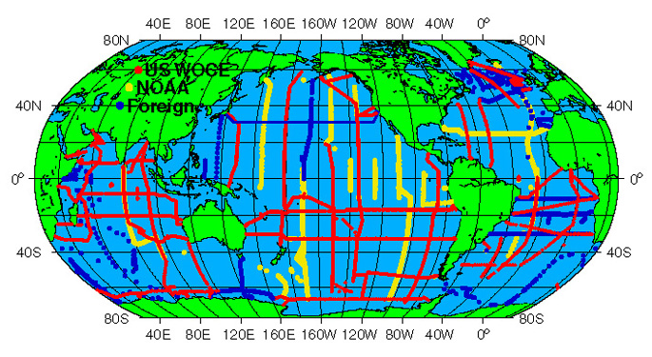
Fossil fuel CO₂
in the oceans (1994)
Atlantic
50
40
30
Anthropogenic CO₂ concentration
(μmol kg⁻¹)
20
Pacific
10
0
Indian
[Sabine et al. Science, 2004]

Slide 9
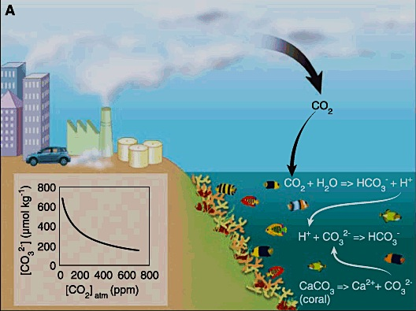
Notes:
This process works well with ocean acidification and its impact on ocean ecosystems.
In its purest sense, ocean acidification involves two steps. The first being the very deterministic step between rising atmospheric carbon dioxide and changing ocean chemistry, and the second being the link between changing ocean chemistry and biological processes such as calcification.
In this flow of effects and impacts, there are different levels of certainty. For example, the physiochemical relationship between the atmospheric concentration of carbon dioxide and the carbonate chemistry of sea water is highly deterministic, the relationship between changing chemistry and biological responses is subject to greater variability. This is especially so when one considers the influence of different species, genetics, environmental history and so on.

Slide 10
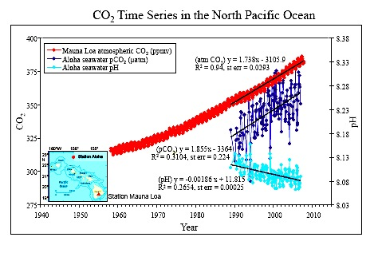
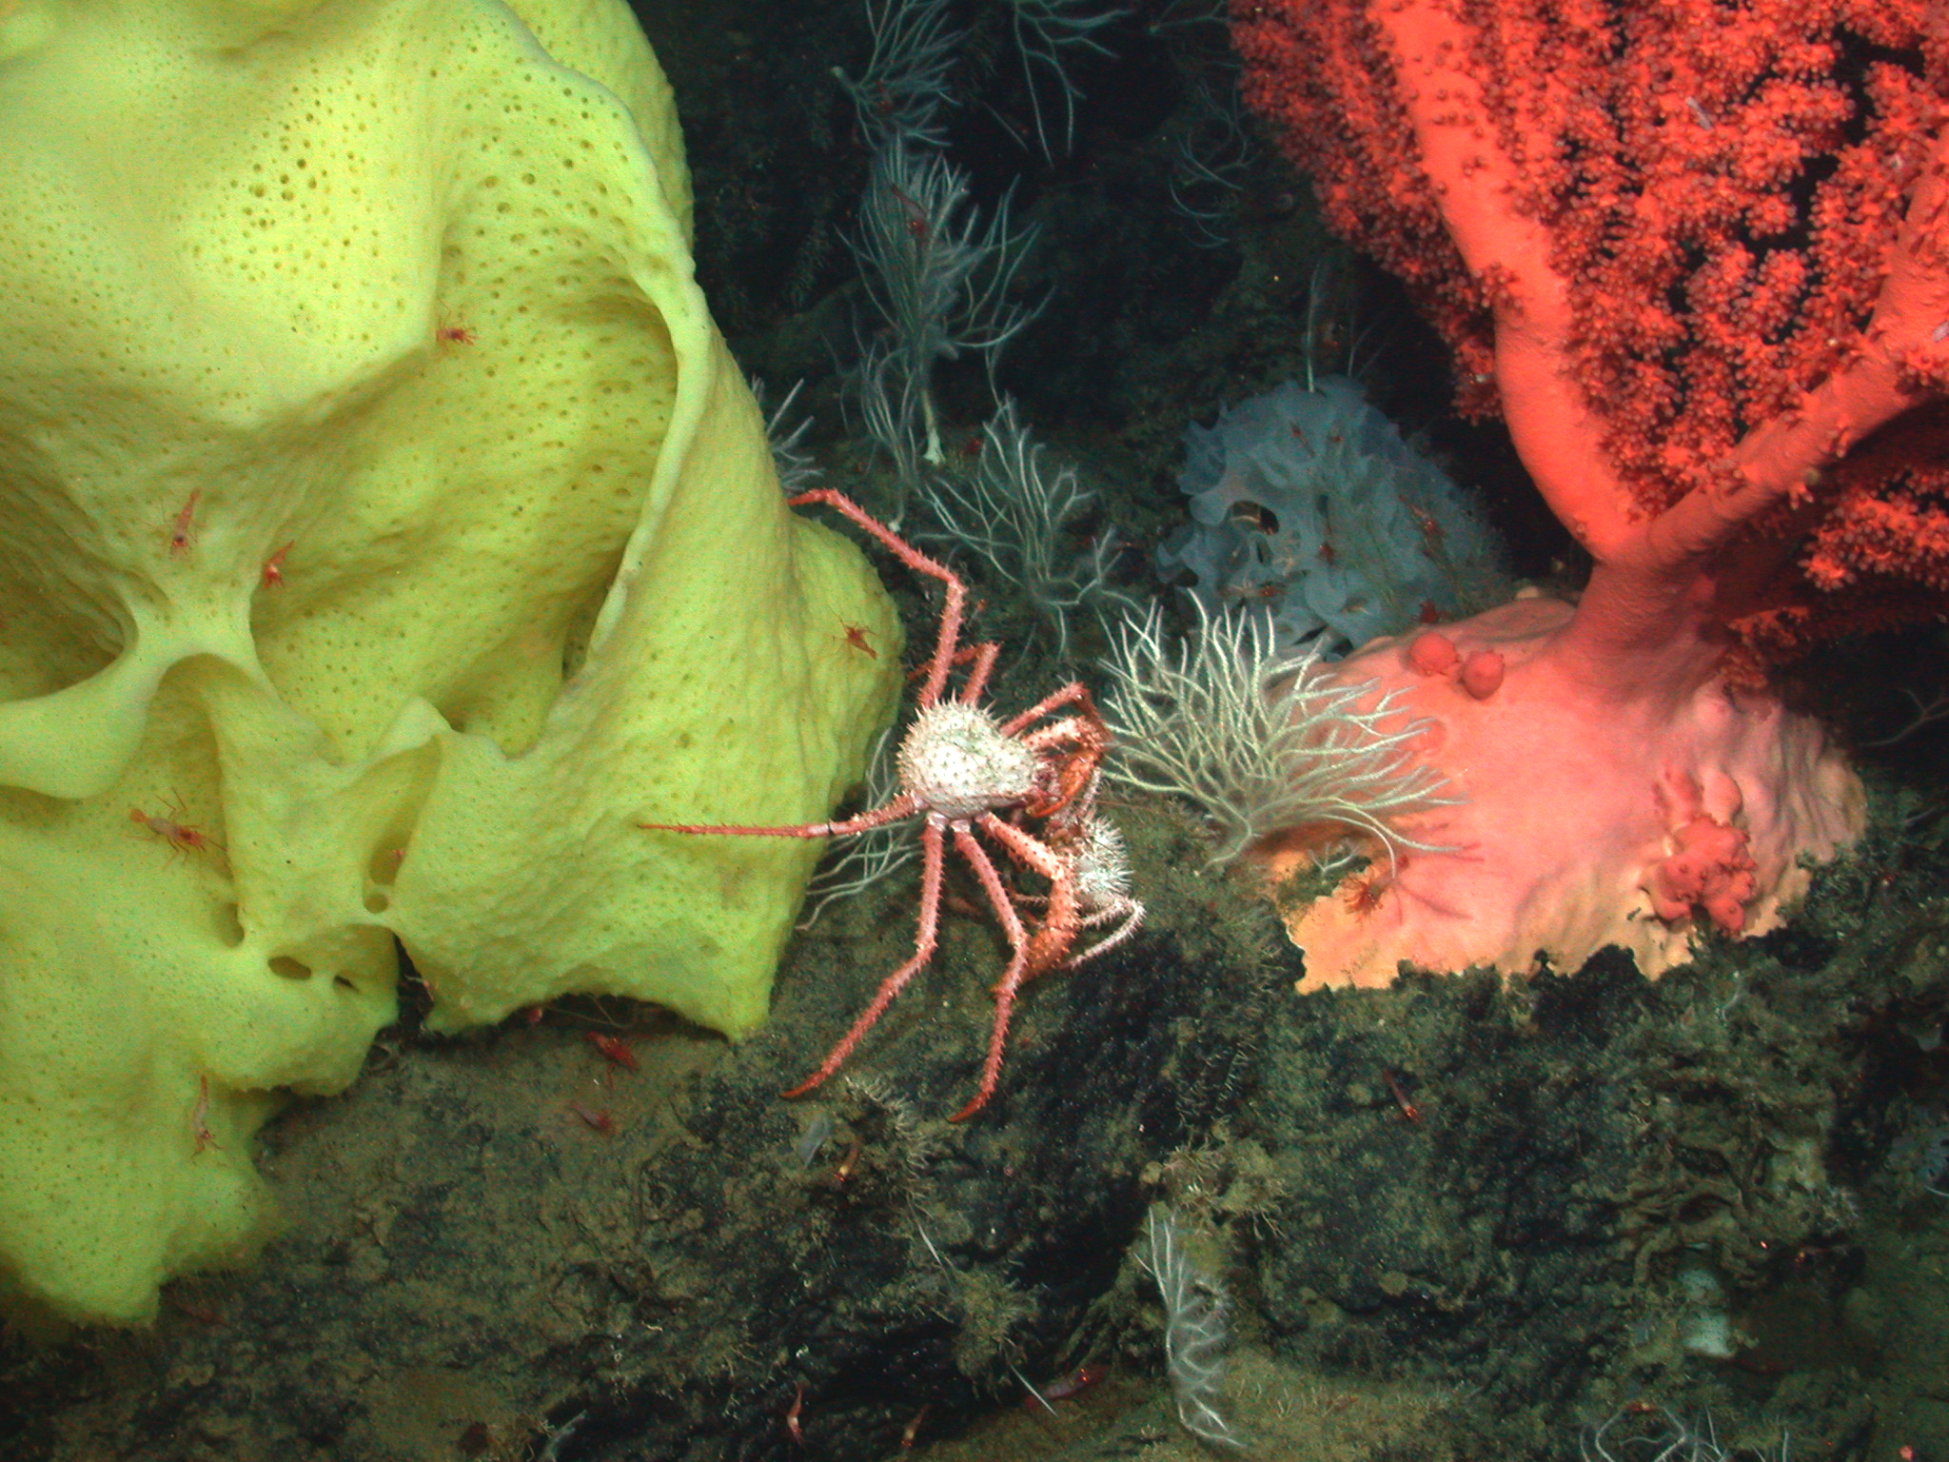
Variation in CO₂ and ocean acidity (pH)
425,000 year history
Ice Ages
CO₂ on Earth
Global CO₂ Increase
CO₂ emissions rising
Ocean becoming more acidic
Atmospheric CO₂ (ppm)
Ice Ages
Atmospheric, Ocean CO₂, & Ocean pH
Increase in Ocean Acidity due to added CO₂
200
150
100
50
Ocean pH (units)
Ice Ages
Percent Change in Acidity
25
0
-25
Doney et al. 2009

Slide 11
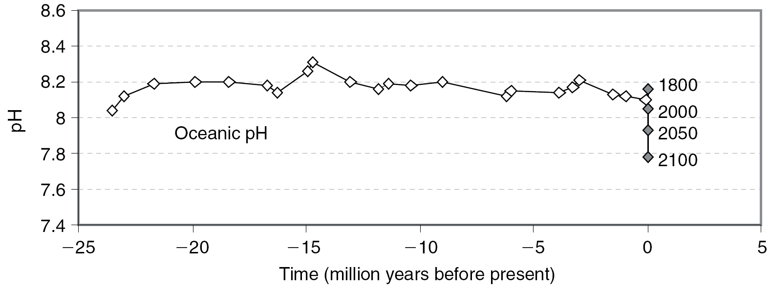
Change in ocean pH over 25 million years
Ice Ages
Turley et al 2005
Estimated from boron isotopes in seabed foraminifera
Note speed and size of current pH change

Slide 12
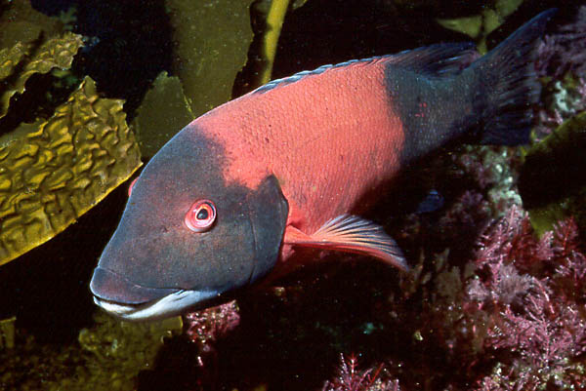
What are the options for organisms faced with ocean acidification?
Migration
Acclimation (tolerance)
Adaptation (linked to evolutionary history, generation time)
Extinction
What to
do..?

Slide 13
Environmental Stress, Ecosystems, and Society
Environment
Individuals
Populations
Species
Communities
Society
Ocean Acidification
Biodiversity
Physiological processes
(acclimation)
Ecosystem Function
Warming
Abundance
DistributionProductivity
Biological Interactions
(food web)
Fisheries
Hypoxia
Resilience
Metabolic Performance
Other
Ecosystem
Services
Adaptation
Energy Flow
Stability
Survival
Growth
Reproduction
Productivity

Slide 14
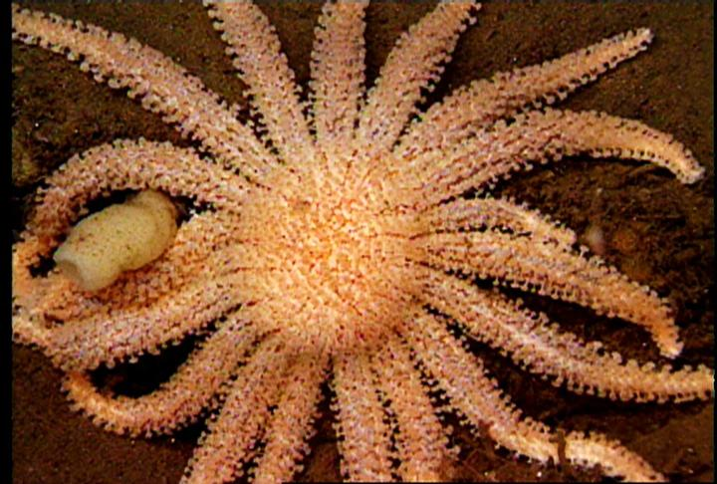
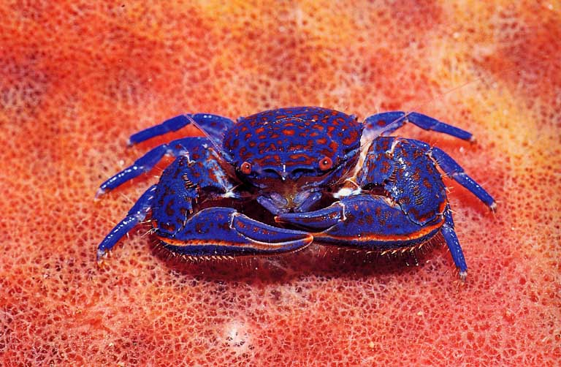
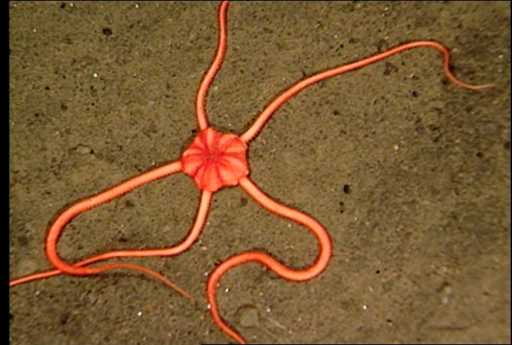
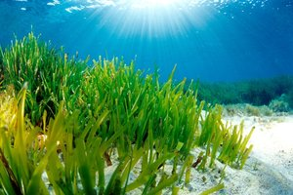
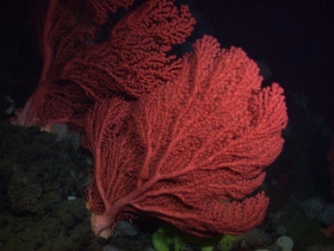
Physiological processes affected by high CO₂
Photosynthesis
Calcification
Respiration
Acid – Base Balance
Metabolic Rate
Deep-sea seastar

Slide 15
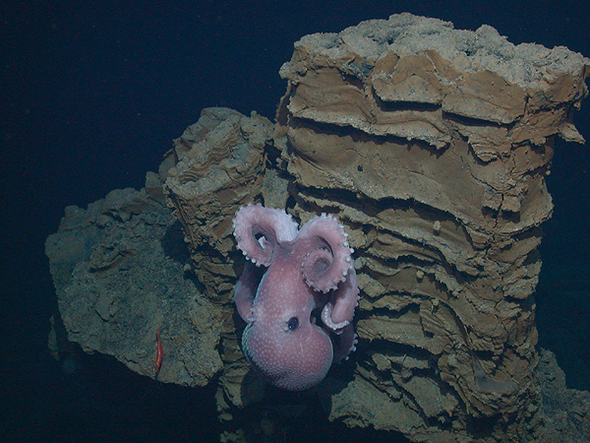
Are CO₂-related stresses severe for deep-sea animals?
Deep-Sea Animals
pH variation in the Pacific Ocean
Reduced metabolic rates
Reduced enzyme function
Evolved in highly stable deep-sea environment
Food-limited –
“Living on the edge”
More
Acidic
Less
Acidic
Future Ocean
Depth (m)
Deep-sea Octopus

Slide 16
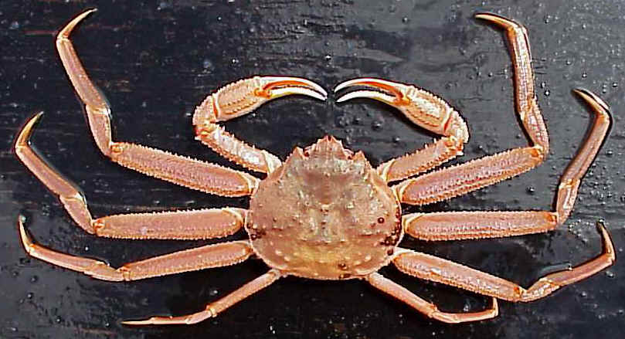
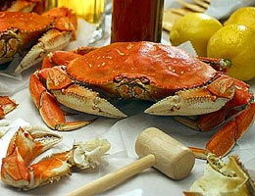
Acid-Base Regulation
Shallow versus deep-living species?
Combined effects of low pH, low O2?
Tanner Crab (deep-sea)
Metabolic alkalosis
HCO₃
Dungeness Crab (shallow)
Respiratory Acidosis
NBB
Pane and Barry, 2007, 2008
Notes:
Animals that breath low pH waters become acidotic
Some can increase bicarbonate to buffer pH
Deep sea species seem to have harder time

Slide 17
Effect of stress on individuals
Normal
Stressed
Cost of
Living
Growth
Cost of
Living
Growth
Reproduction
Energy
Budget
Reproduction
Energy budgets – If the cost of living (e.g. shells) increases, less is available for growth and reproduction.
Notes:
Stress increases “cost of living” , with less energy for growth and reproduction.
Individuals = reduced 1) survival, 2) size, 3) reproductive output.
Populations = Reduced abundance, productivity, resilience, and greater likelihood of extinction.

Slide 18
Ocean chemistry and the future of coral reefs?
Predicted aragonite saturation (Ω) [a measure of the amount of minerals available to make coral skeletons] is shown over a global map of existing coral reef locations (pink dots) for various atmospheric CO2 levels. Note that Ω decreases drastically with higher CO2 levels.
280 ppm is the preindustrial level of CO2 in the atmosphere. During 2011 CO2 is ~390 ppm. Most climate models indicate that we will reach ~800 ppm CO2 by 2100.
Corals grow best when carbonate minerals are abundant (Ω >3), and cease to grow at low mineral levels (Ω ~2) and can dissolve at very low levels (Ω < 1).
On the right, there is a count of the mineral conditions for the locations of all global coral reefs. Note that the preindustrial climate (280 ppm CO2) all reef locations had mineral conditions favorable to growth (high Ω ). As CO2 levels rise through this century, ALL existing reef are expected to have marginal or poor conditions for coral growth.
Bad
Marginal
Good
Ω_{aragonite}
Ω_{aragonite}

Slide 19
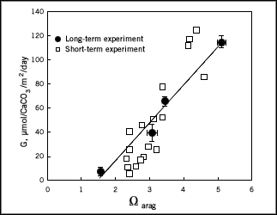
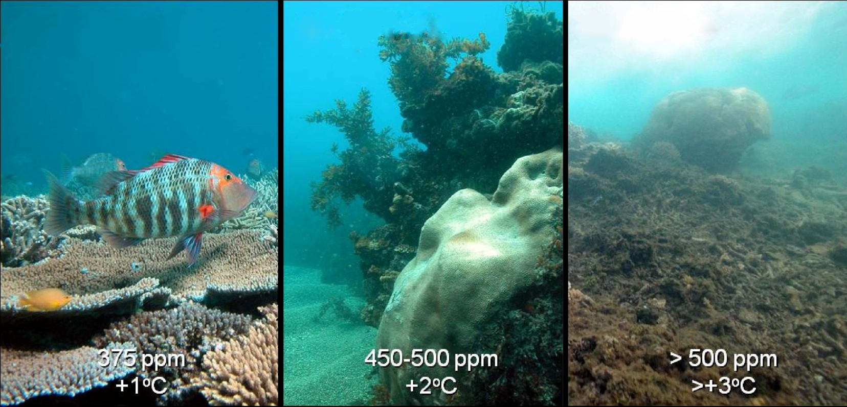
Calcification and Coral Ecosystem Tipping Points
Low carbonate saturation associated with low calcification rate
Calcification Rate
Corals
Aragonite Saturation State
Hoegh-Guldberg et al. 2007

Slide 20
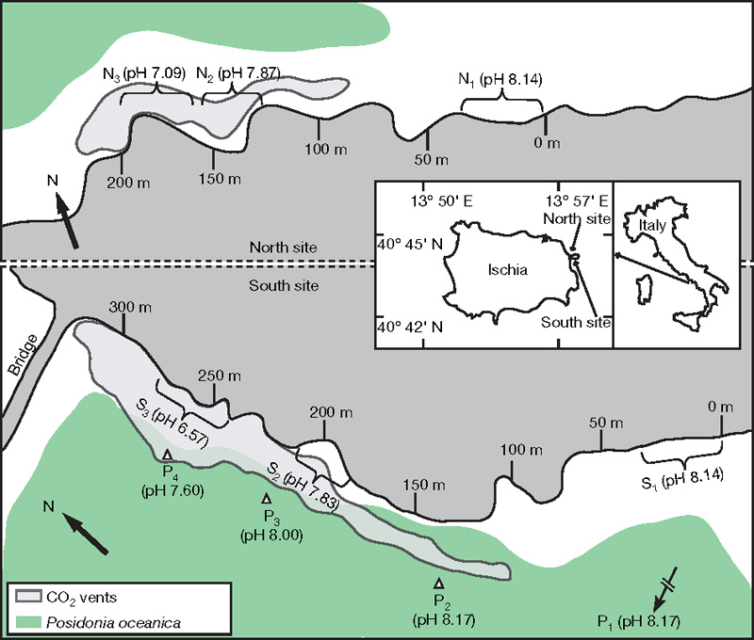
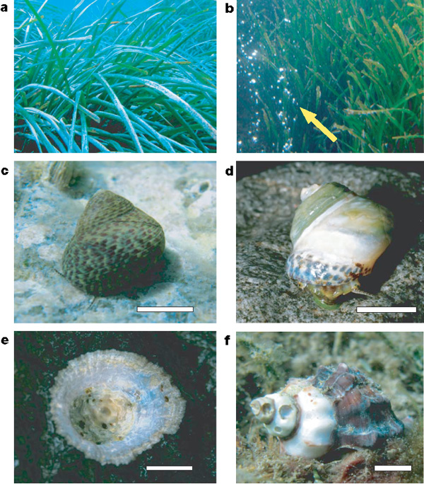
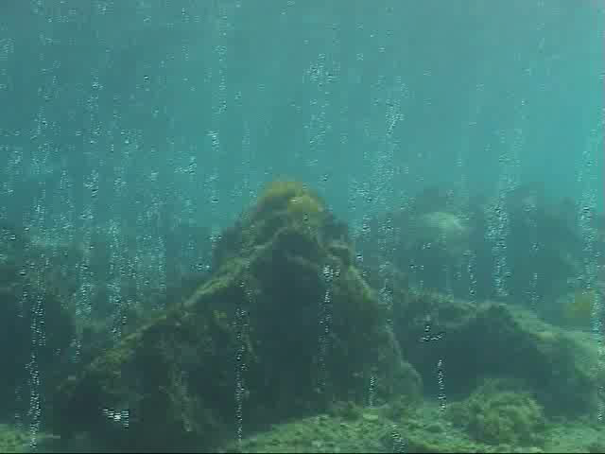
Field Survey of Natural CO₂ Venting Sites in Italy
Echinoderms conspicuously absent, shell dissolution
Seagrasses thrive
Jason Hall-Spencer et al. 2008

Slide 21
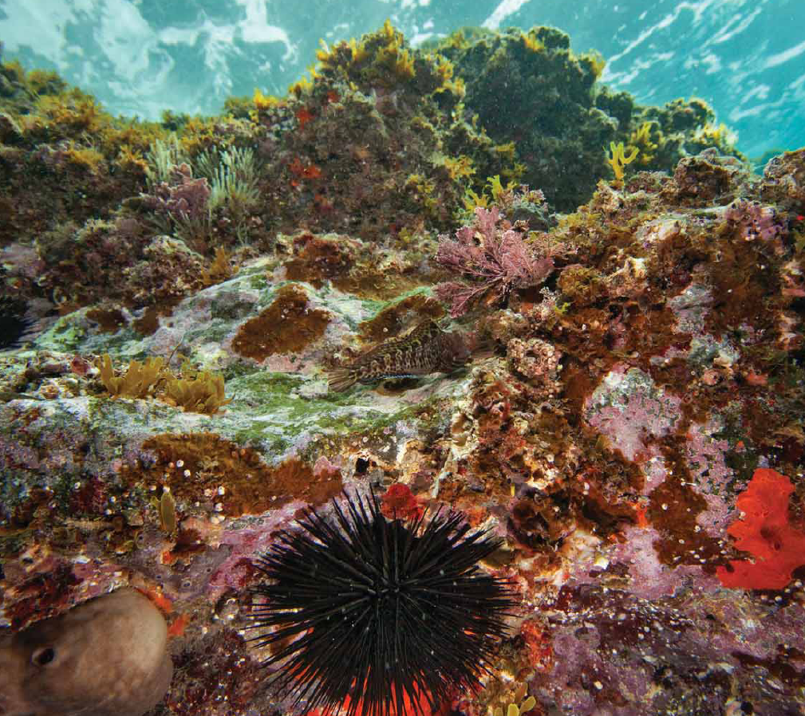
Outside the vents – abundant calcifiers e.g. sea urchins

Slide 22
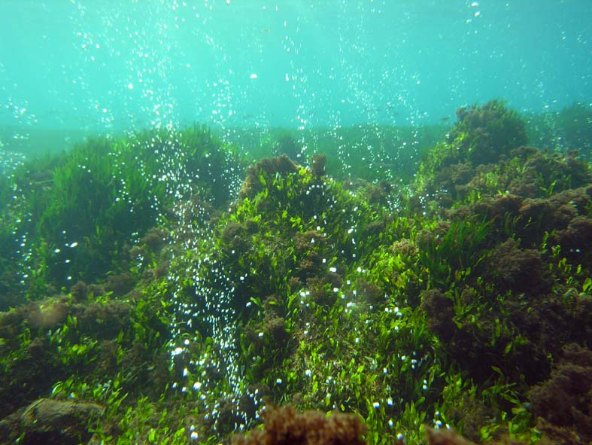
At high CO₂ there are almost no calcifiers, fleshy algae and invasive species dominate
250 taxa now examined including macroalgae (Porzio in press, JEMBE) , seagrasses, foraminifera, sponges, nematodes, polychaetes, molluscs, crustaceans, chaetognaths, bryozoans.

Slide 23
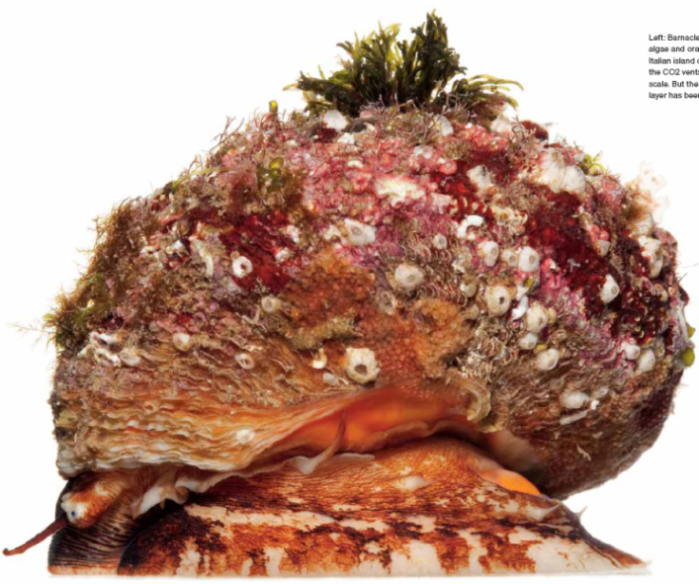
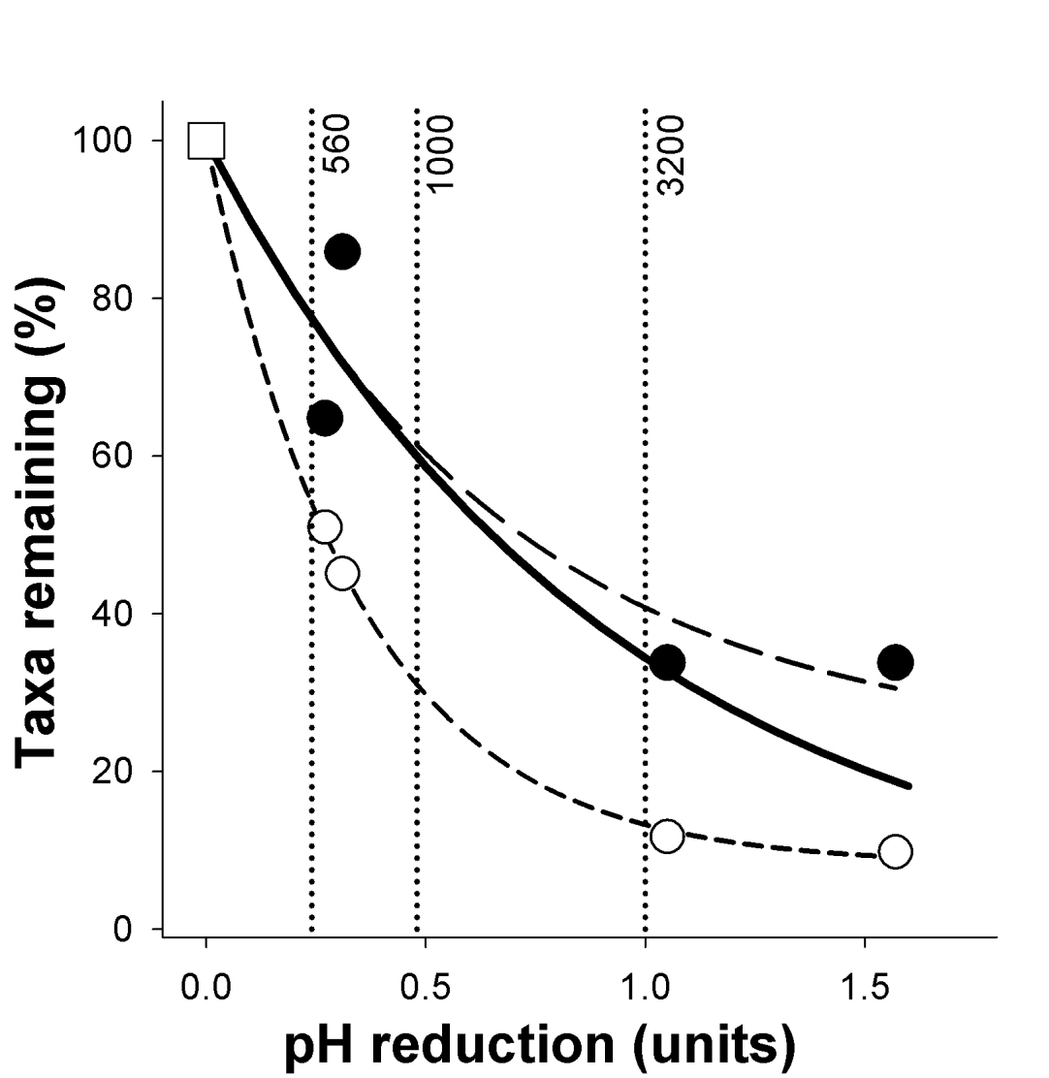
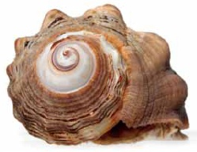
Loss of Biodiversity near Natural CO₂ Vent
pH 8.1
pH 7.6
Non-calcifiers
Calcifiers
Barry et al. OUP in press

Slide 24
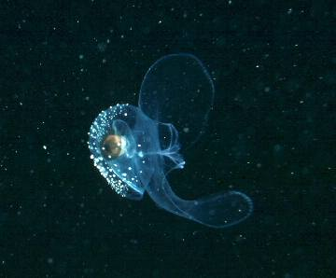
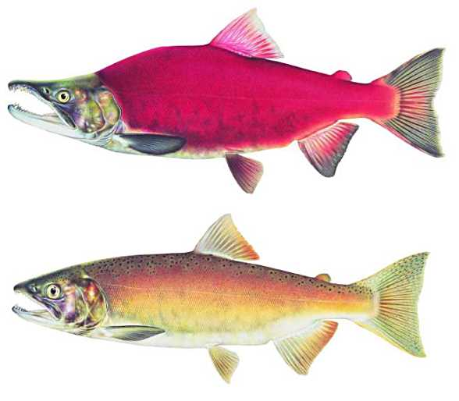
Will Ocean Acidification disrupt energy flow through marine food webs?
Pteropod = Salmon food
Sockeye Salmon

Slide 25
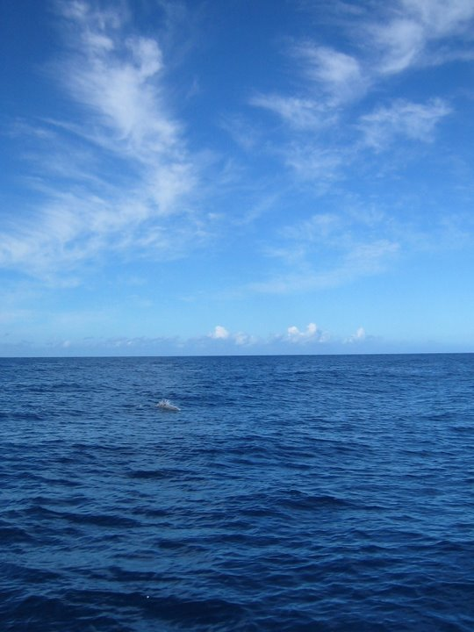
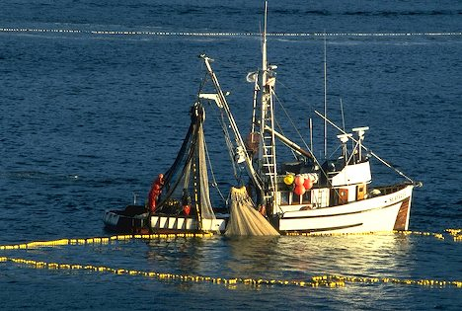
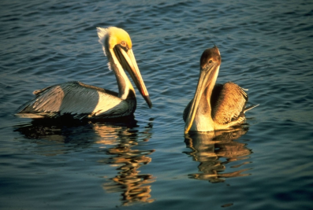
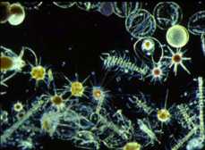
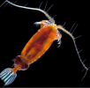
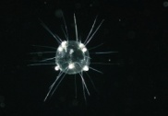

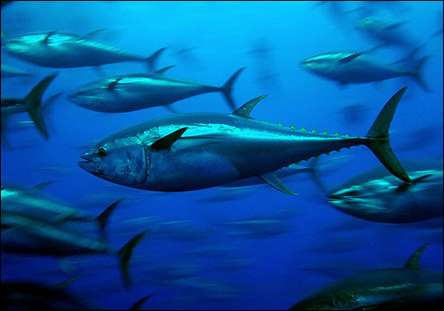


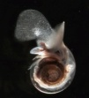
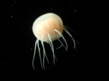
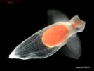
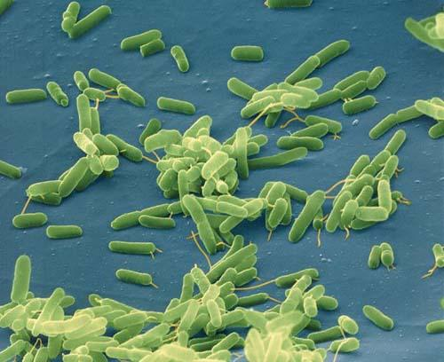
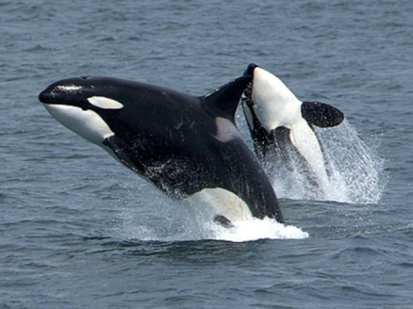







Marine Communities are Biological Networks
Primary Production
Humans
Seabirds
Phytoplankton
Zooplankton
Squid
Fish
Large zooplankton
Detritus / Bacteria
Seafloor Animals
Mammals
Marine Food Web
Notes:
Food web isn’t a very good image, but could be improved.

Slide 26


Slide 27

Mass extinctions during Earth history
5 major mass extinctions with >70% extinction of all species
10+ million years to recover (rediversify)

Slide 28



Slide 29
Latitudinal range of carbonate (coral) reefs
No correlation with temperature, so Ω (ocean chemistry) is more important
For hundreds of millions of years, at the edge of their range, shallow-water reef-building calcifiers have been “trying” to compete ecologically in low-Ω conditions.
What is the probability that they will succeed in doing in the next decades what they have been unable to do for hundreds of millions of years?

Slide 30
Many uncertainties concerning the effects of ocean acidification

Slide 31
Best of all worlds:
Strong experimental insights from all levels leading to predictive models for underpinning decision-making in a changing world
Models of global change
Models and analysis
Socio-economic
Ecosystems
Organisms
Cells
Ecosystem studies
Mechanistic understanding

Slide 32
Types of studies: published 2007-2010
Mechanistic understandings
Greater difficulty,
expense etc
Number of papers
Notes:
In terms of recent emphasis, 80% of studies that mentioned ocean acidification in the title or key terms have focused on exploring impacts on the physiology and developmental biology of organisms.
Not to say that this is a bad thing but there has been correspondingly fewer studies they have focused on large-scale ecological manipulations.
But as several people in this workshop have identified, experiments at this level tend to be difficult and expensive. As a consequence, not everyone can afford to build mesocosm facilities and conduct the required experiments.
This said, there is valuable information nation to be gained at the more fundamental levels ... Especially in terms of mechanistic understanding is that inform us at the higher levels of organisation.

Slide 33


How will OA affect different life stages?
Notes:
Only a small piece of the puzzle -> 1 species is complex (e.g. different life history stages)
All studied but not always on the same species

Slide 34
Conclusions
What we know:
Stressful for many species
Sensitivity varies - winners and losers
Reduced calcification for most
Important effects on growth, survival
What we expect:
Food webs will be affected
Ecosystem services (e.g. fisheries) will change
What we don’t know:
Long term effects
Sensitive life stages
Acclimation and adaptation
Multiple Stressors
Ecosystem tipping points?

Slide 35
International / Societal Issues
Economic / ecological stability
Predictability of fisheries & global change
Ocean acidification and marine biodiversity
Biodiversity is “insurance” for ecosystem function
Reduced biodiversity can destabilize ecosystem function

Slide 36



Is it hopeless, too late, too big….?
Should we worry?
  YES! Climate change / OA affects the quality of our lives
What can we do?
  Education and outreach
  Energy efficiency, non-carbon energy, reduced emissions
  Reconnect with nature
  Value the oceans
  Vote!

Slide 37












Reasons for Hope?
High-efficiency cars and trucks
Wave and Tidal Energy
Photovoltaic Energy
(Solar)
Wind Power

Slide 38

We’ll need to be pretty “adaptable”…

