Slide 1

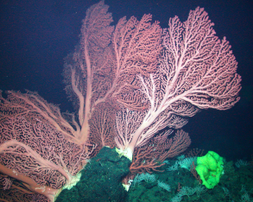
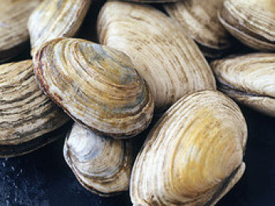
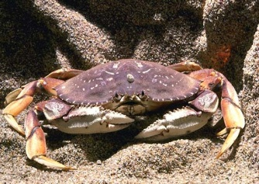
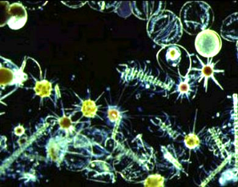
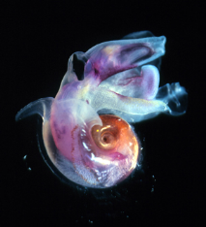
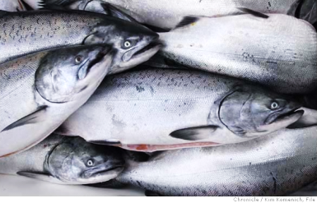
Ocean Acidification 101 – Effects of rising atmospheric CO₂ levels on ocean chemistry and marine organisms
Jim Barry
Monterey Bay Aquarium Research Institute
Moss Landing, CA
Dead Seas:
The Impact of Carbon Pollution* on Ocean Chemistry and Policy Responses
Environmental Law Conference at Yosemite
Fish Camp, CA
October 23, 2011
Jim Barry
Monterey Bay Aquarium Research Institute
Moss Landing, CA
Ocean Acidification (OA)
Cause:
  human activities - global, regional, and local scales
Effects:
  marine organisms, marine ecosystem function, benefits
  for society
Solutions?:
  Reduce CO₂ emissions
  Management of local / regional stressors can reduce or delay impacts
Notes:
Hi, I’m Jim Barry, a scientist at MBARI in Monterey Bay. My research focuses on how marine organisms are affected by ocean acidification and other environmental changes. Today, I’ll be giving you a quick overview of ocean acificiation – Ocean Acidification 101, what is ocean acidification and how does it affect organisms, ecosystems, and society.
There are 3 main messages I’d like you to leave with.
1 – Ocean acidification is global in scale and related to CO2 emissions, but is also caused by local to regional processes linked to human activities
2 – Ocean acidification affects the physiological function of organisms, leading to consequences for marine ecosystems and society
3 – Management of local to regional stressors on marine ecosystems, including those linked to ocean acidification as well as others (e.g. overfishing, pollution), can reduce or delay the impacts of OA.

Slide 2
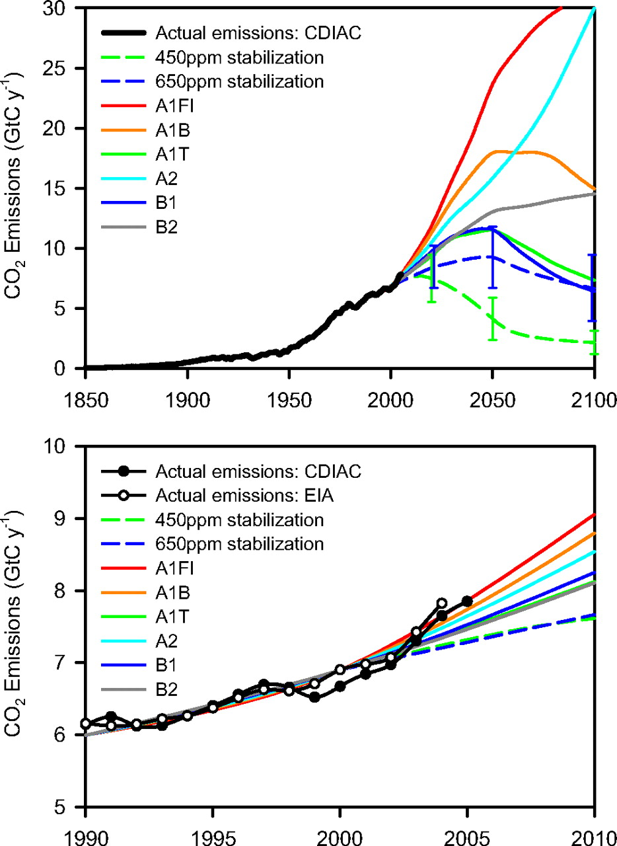
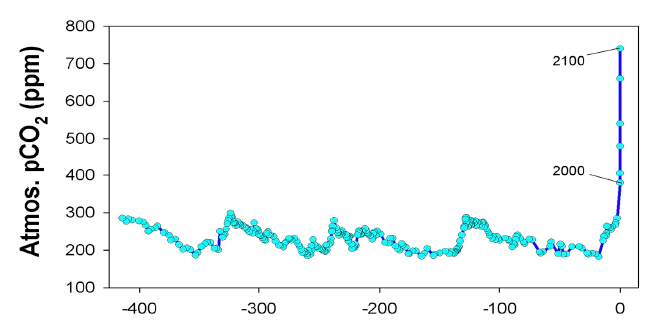
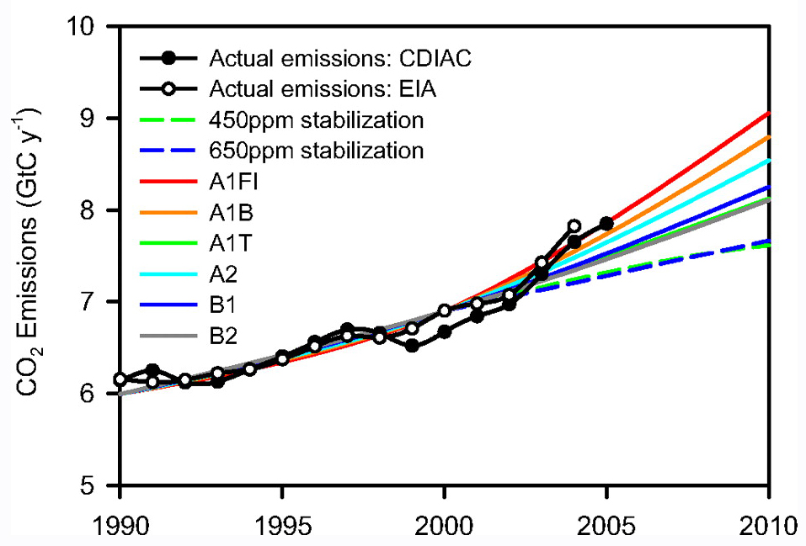
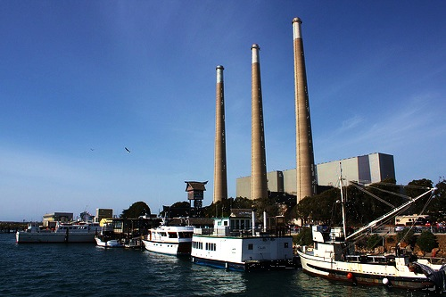
CO₂ emissions are rising rapidly
Various scenarios
Current emissions high, increasing
Climate-agreements / legislation
High emissions = larger climate / ocean
changes
450,000 year history of atmospheric CO₂ levels
1000s of year ago

Slide 3
What is Ocean Acidification?
CO₂ Emissions
CO₂
CO₂ + H₂O H₂CO₃ (Carbonic Acid)
More acidic water (>H⁺)
Loss of minerals used in shell formation (<CO₃⁼)
Notes:
This is a simplified overview of the global process of passive carbon dioxide invasion from the atmsophere to the oceans.
We emit billions of tons of CO2 into the atmosphere each year.
Roughly 1/3rd of our emissions are absorbed through the surface of the ocean
While little chemistry occurs in the atmosphere, CO2 in the ocean reacts immediately with seawater to produce carbonic acid (soda water).
I won’t discuss the chemistry further, other than to say that 2 important changes occur
1 – as CO2 increases, oceans become more acidic
2 – as CO2 increases, there is a decrease in the levels of minerals critical for shell formation in many animals (clams, corals, snails, etc.)

Slide 4
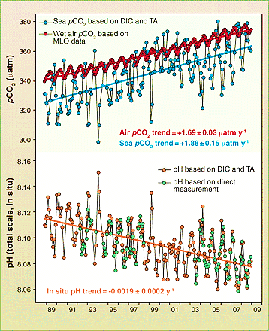
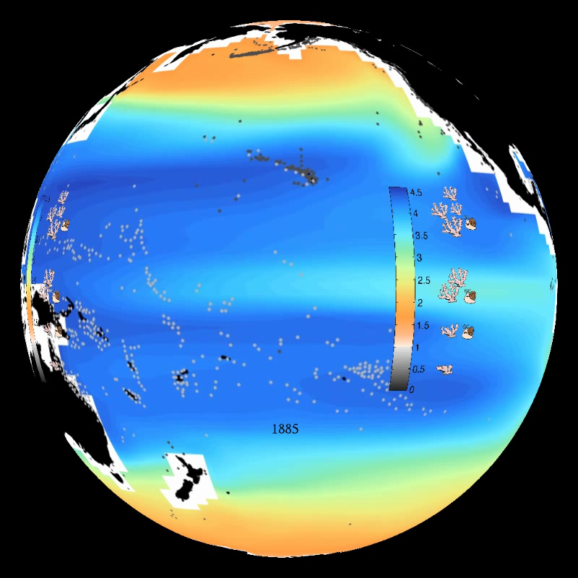
Fossil fuel CO₂ emissions are causing Ocean Acidification on global scale
Ocean CO₂ is ‘tracking’ atmospheric CO₂
Oceans becoming more acidic & mineral-poor (shell-forming minerals)
Shell-forming minerals – 1885 to ~2100
Blue – high (good for shell growth)
Orange/grey – low (bad)
NOAA - Feely
Doney 2010
Notes:
Ocean chemistry is very well understood and the amount of carbon dioxide emissions now in the oceans, as well as their effects on ocean chemistry, are highly measurable.
CO2 levels in the atmosphere are rising rapidly
CO2 in the ocean surface waters are ‘tracking ‘ atmospheric CO2
Ocean pH (Acidity) is mirroring ocean / atmospheric CO2
Levels of minerals used for shell formation are falling rapidly through this century and will be very low by ~2100
Blue indicates high levels of minerals in 1885
By ~2100, levels are low (orange), or even corrosive (exposed shells will dissolve) – even harder to make or maintain shells
Could have very imortant impacts on organimss
This is a massive and rapid change in ocean chemistry different than known on Earth for 25+ million years.

Slide 5
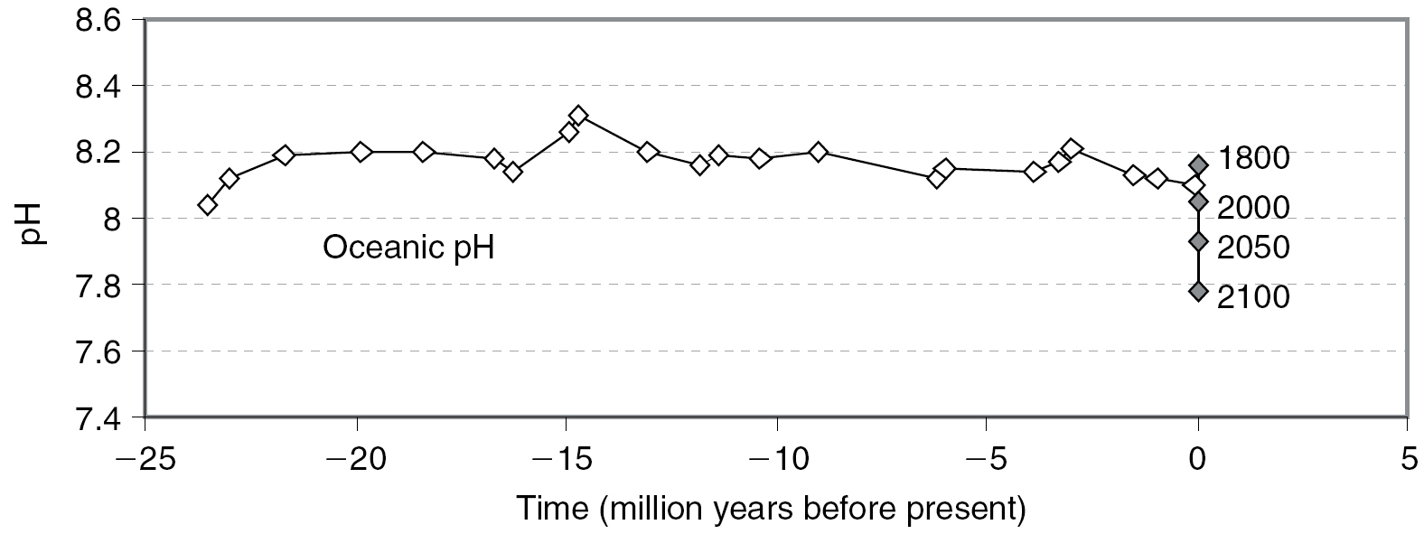
Human-driven change in ocean pH is massive and rapid
Estimated from boron isotopes in seabed foraminifera
Note speed and size of current pH change
Turley et al 2005

Slide 6
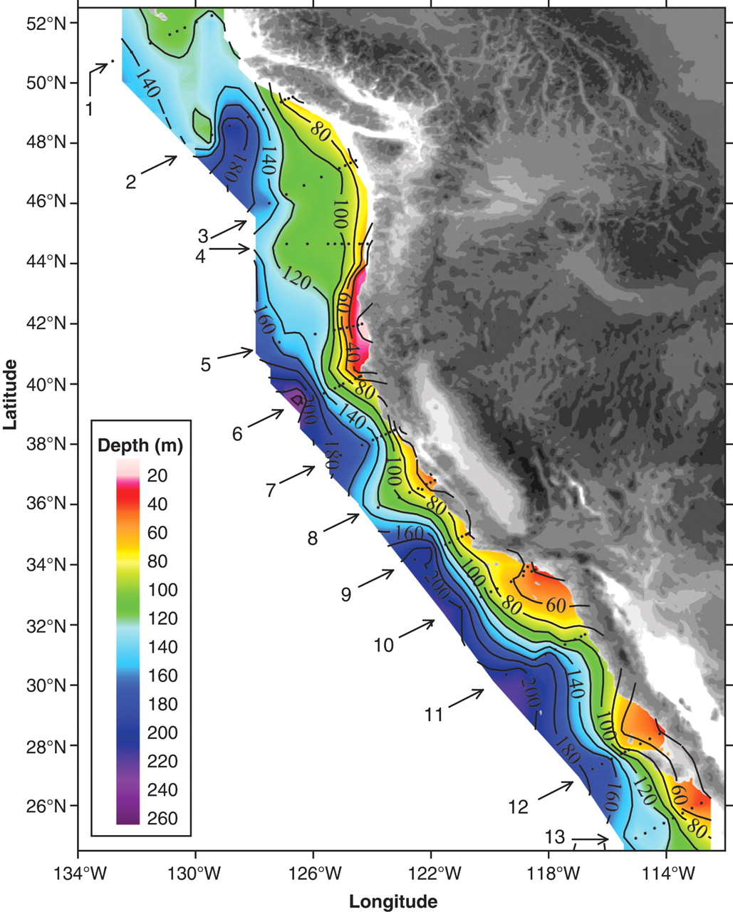
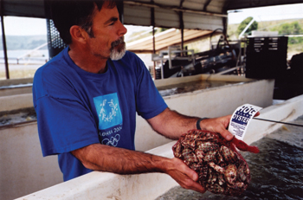
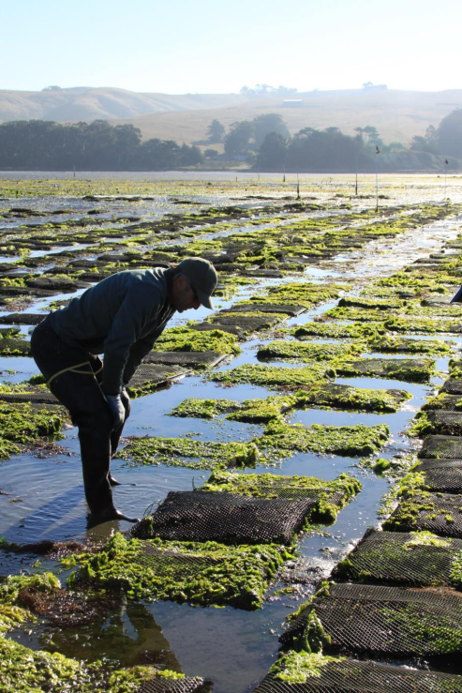
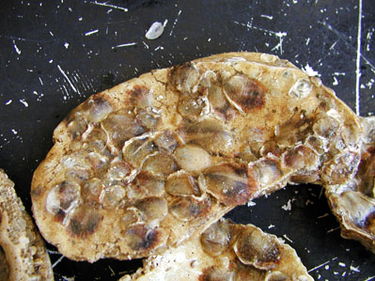
Coastal upwelling + Ocean Acidification brings corrosive waters to the coast
Related to failure of west coast oyster aquaculture from 2005-2010
Feely et al. 2008
Tomales Bay aquaculture
Oyster spat
Notes:
The California coast is special – coastal upwelling (nutrients brought from deep water by coastal winds) promotes incredible biological productivity in surface waters, but also leads to decomposition of all of the sinking organic debris. This decomposition creates low oxygen waters with very high CO2 levels ~200+ m below the surface. Coastal upwelling brings some of these watesr to near the surface and the coastline – as these water absorb more fossil fuel emissions, it makes the waters even more acidic. As they reach the coastline, it can be more stressful for coastal organisms .
These corrosive water events observed over the past sevearl years as related to the failure of oyster breeding / rearing over thepast several years.

Slide 7
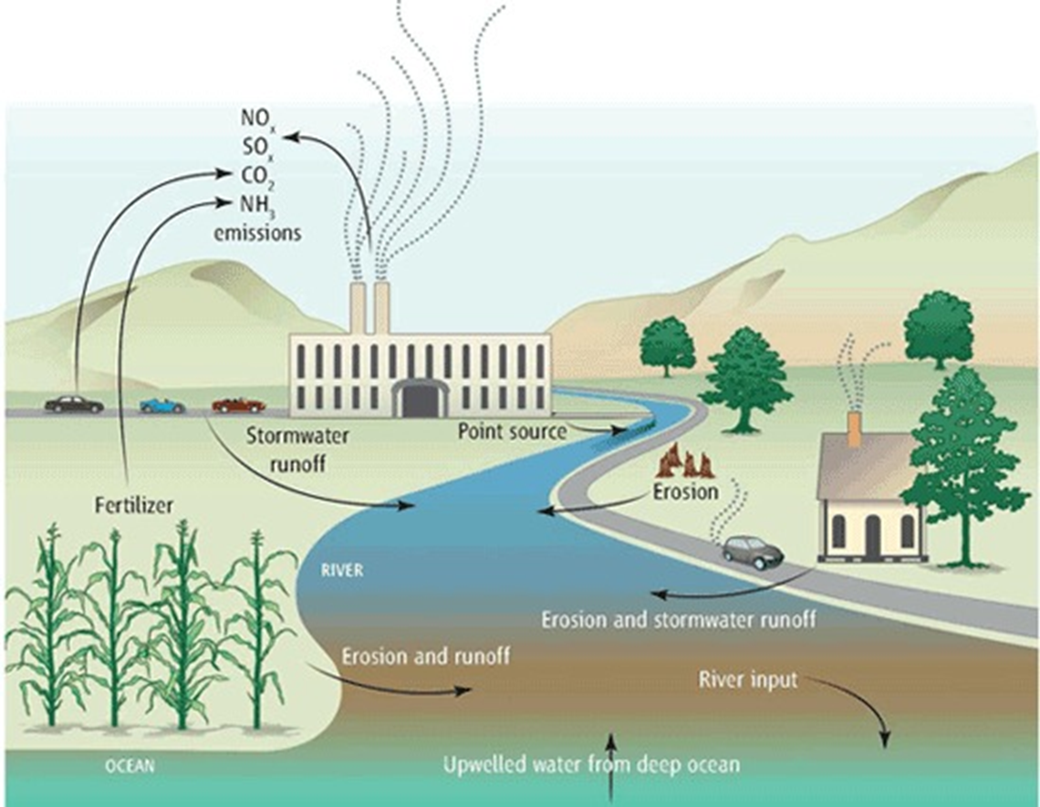
Local & regional factors can cause or amplify Ocean Acidification
Global
CO₂ emissions
Regional / Local
Runoff
Erosion
Pollution
Kelly et al. 2011
Notes:
Local and regional processes related to our activities can also cause or amplify ocean acidification
Runoff, erosion, and pollution can add nutrients, pollutants, and even acids to the oceans that make the increase ocean acidification.
Coastal areas and inshore waters (estuaries, etc) are particularly at risk for this because circulation is restricted and these sources are so near.

Slide 8
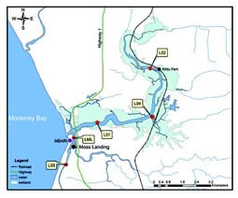
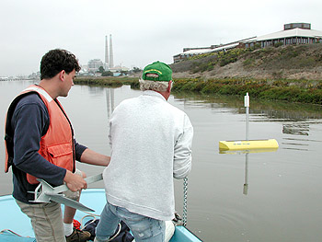
Agricultural runoff in Moss Landing can promote ocean acidification
Nitrate sensor in
Old Salinas River Channel
Nitrate Level (uM)
Normal: 20
Channel: 2000+
Notes:
Local and regional processes related to our activities can also cause or amplify ocean acidification
Runoff, erosion, and pollution can add nutrients, pollutants, and even acids to the oceans that make the increase ocean acidification.
Coastal areas and inshore waters (estuaries, etc) are particularly at risk for this because circulation is restricted and these sources are so near.

Slide 9
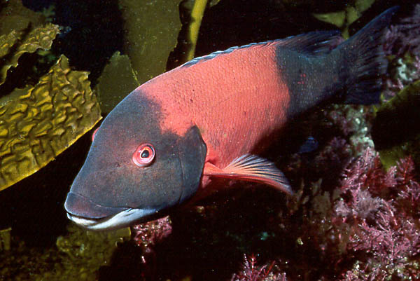
How do animals cope with ocean acidification and other environmental changes?
What to
do..?
Migration
Acclimation
Adaptation
Extinction
Notes:
Organisms and populations can respond to ocean acidification in several ways

Slide 10
Ocean Acidification acts on the physiology of individual organisms, but has consequences for ecosystems & society
Environmental
Change
Physiology
Growth
Survival
Reproduction
Food Web Function
Societal Effects
(e.g fisheries)
Less difficult
More difficult
Scientific study
Notes:
The front line of coping is always coupled to the physiology of individual organisms –
Our physiology is the ‘window to the world” for all organisms. No matter what the environmental change is, organisms can only react based on physiological adaptations shaped during their evolutionary history.
Changes in physiology due to the environment lead to changes in growht, repdocution, and survival, which in turn, affect the function of food webs, and eventually the natural benefits we receive from the oceans.

Slide 11
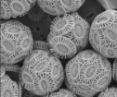
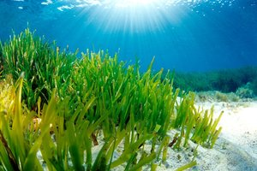
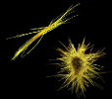
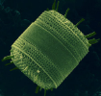
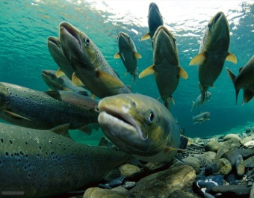
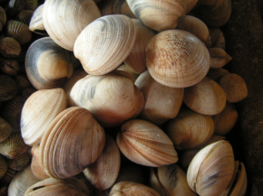
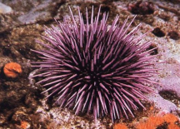
Stress increases the ‘cost of living’
Normal
Stressed
Cost of
Living
Growth
Cost of
Living
Growth
Reproduction
Energy
Budget
Reproduction
Physiological processes affected by Ocean Acidification
Photosynthesis
Shell-formation*
Respiration
Acid-base balance
Metabolism
Barry et al. 2011
Notes:
Stress increases “cost of living” , with less energy for growth and reproduction.
Individuals = reduced 1) survival, 2) size, 3) reproductive output.
Populations = Reduced abundance, productivity, resilience, and greater likelihood of extinction.

Slide 12
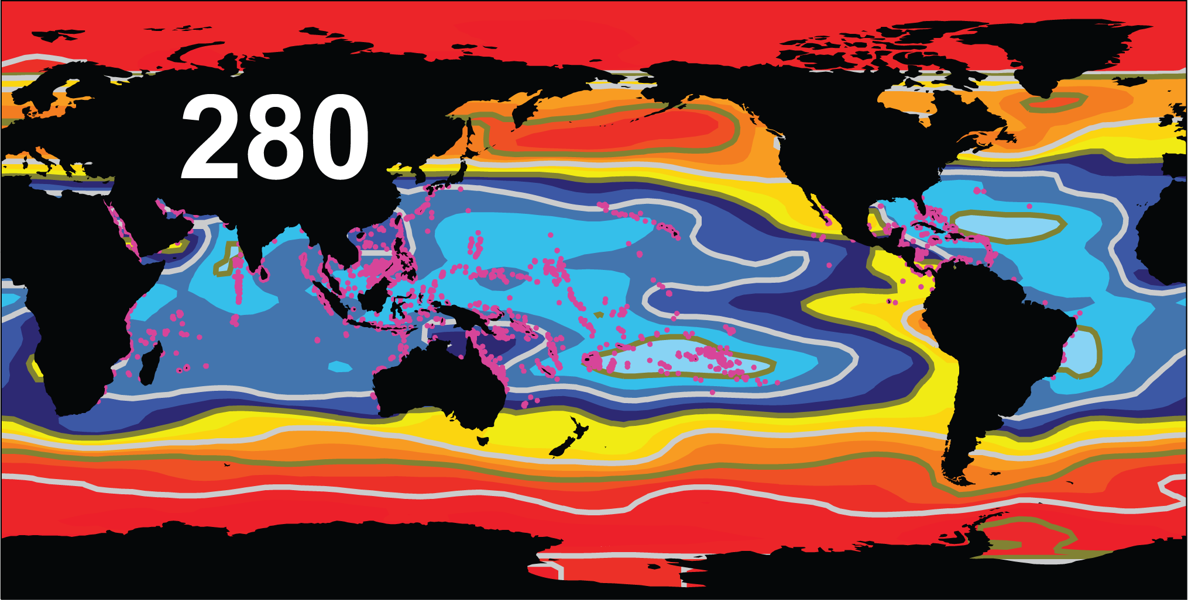

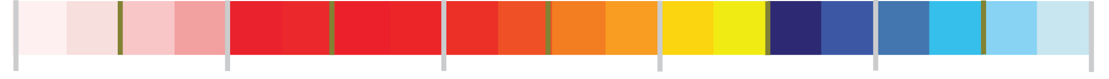
Carbon dioxide level,
Coral reef distribution,
and chemical conditions helping drive reef formation
0
1
2
3
4
5
Corrosive
Ω_{Aragonite}
Optimal
Cao and Caldeira, 2008

Slide 13
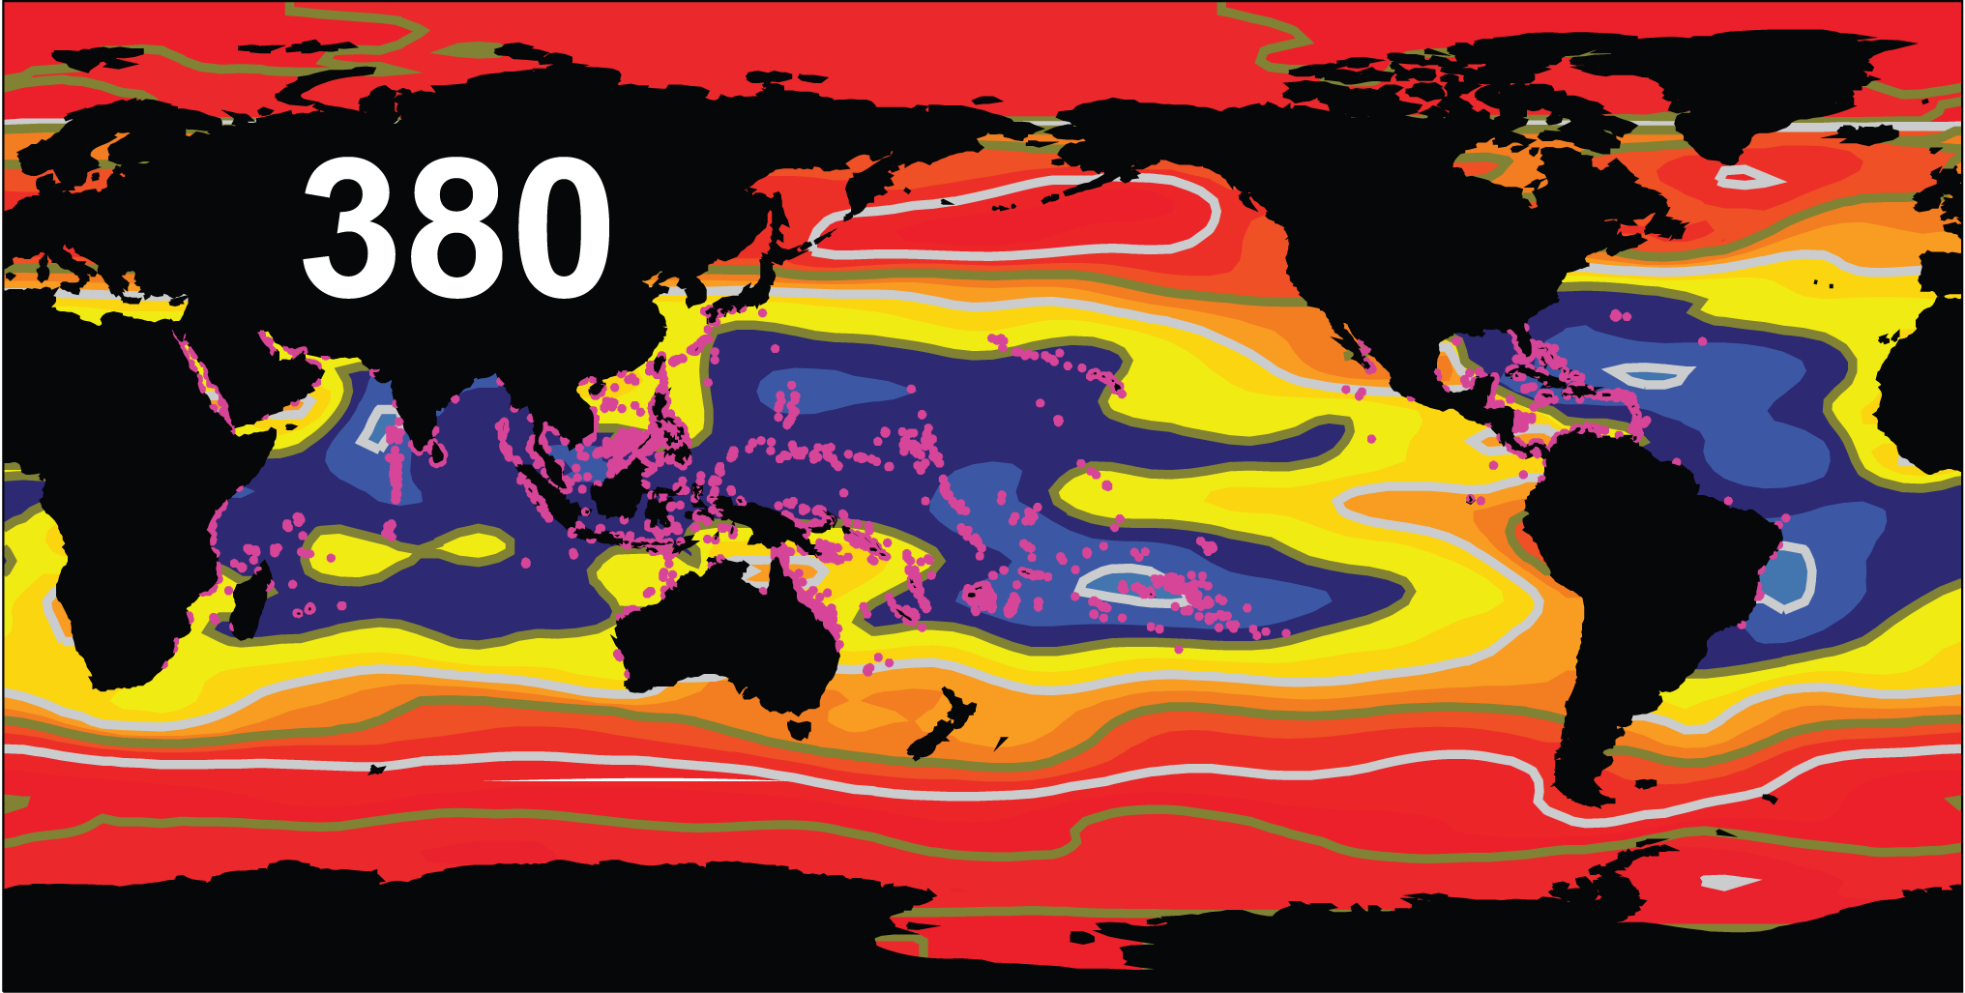
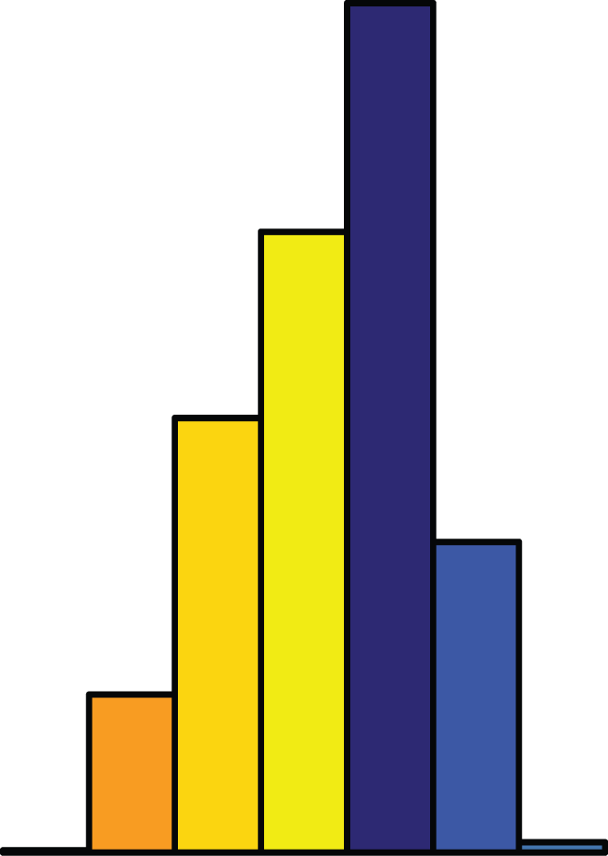
Carbon dioxide level,
Coral reef distribution,
and chemical conditions helping drive reef formation
0
1
2
3
4
5
Corrosive
Ω_{Aragonite}
Optimal
Cao and Caldeira, 2008

Slide 14
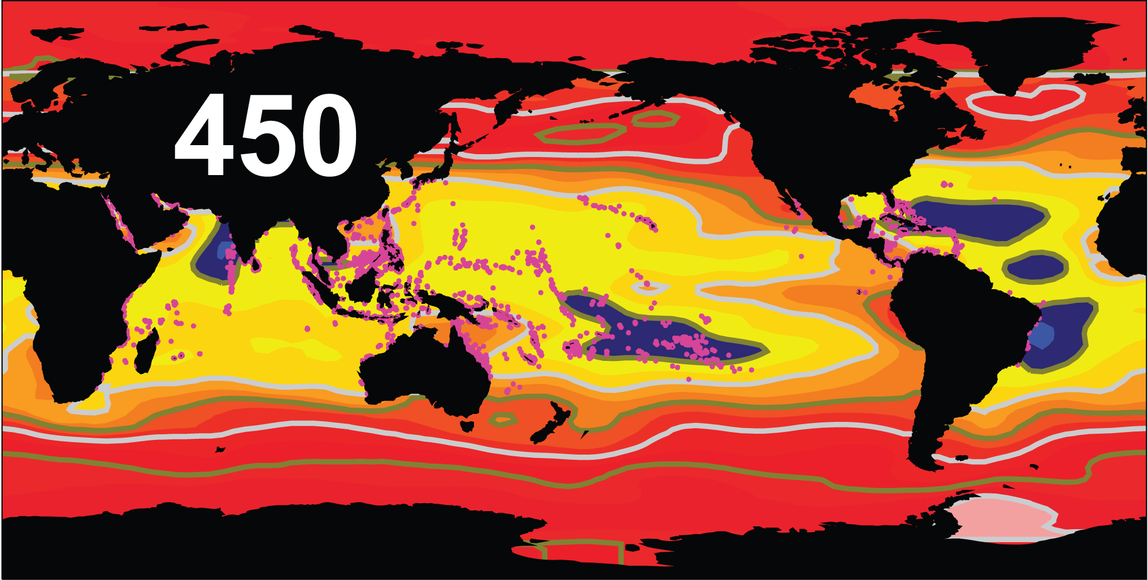
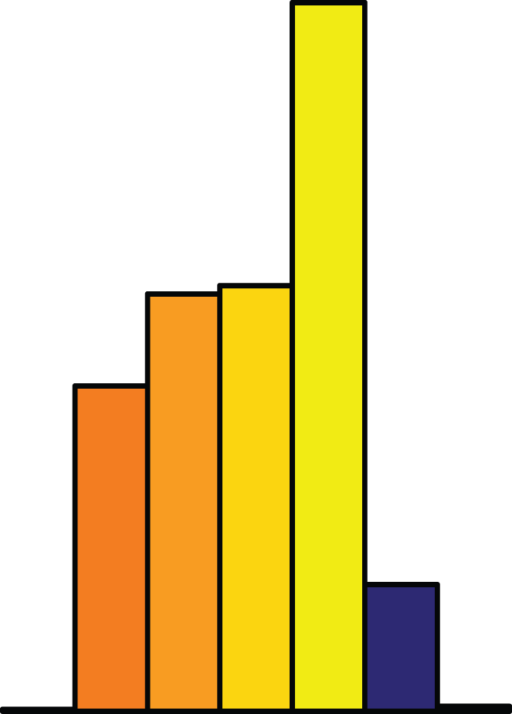
Carbon dioxide level,
Coral reef distribution,
and chemical conditions helping drive reef formation
0
1
2
3
4
5
Corrosive
Ω_{Aragonite}
Optimal
Cao and Caldeira, 2008

Slide 15
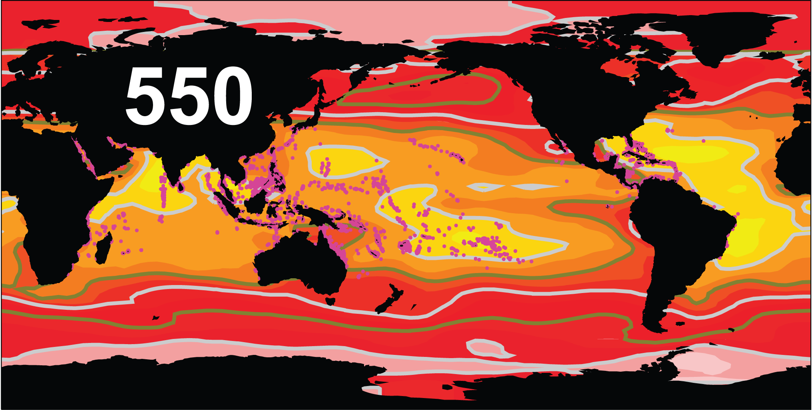
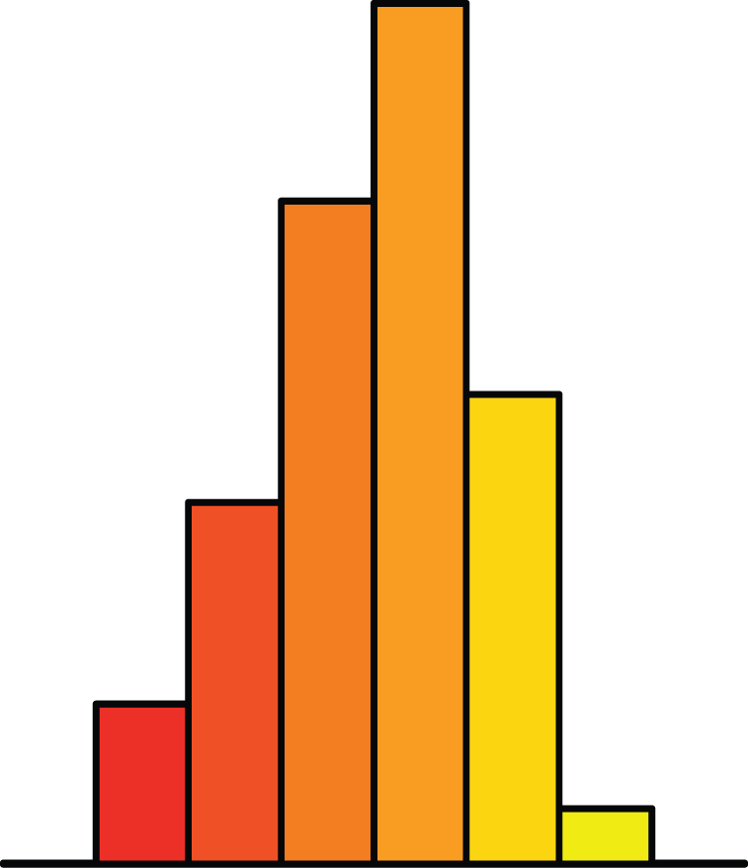
Carbon dioxide level,
Coral reef distribution,
and chemical conditions helping drive reef formation
0
1
2
3
4
5
Corrosive
Ω_{Aragonite}
Optimal
Cao and Caldeira, 2008

Slide 16
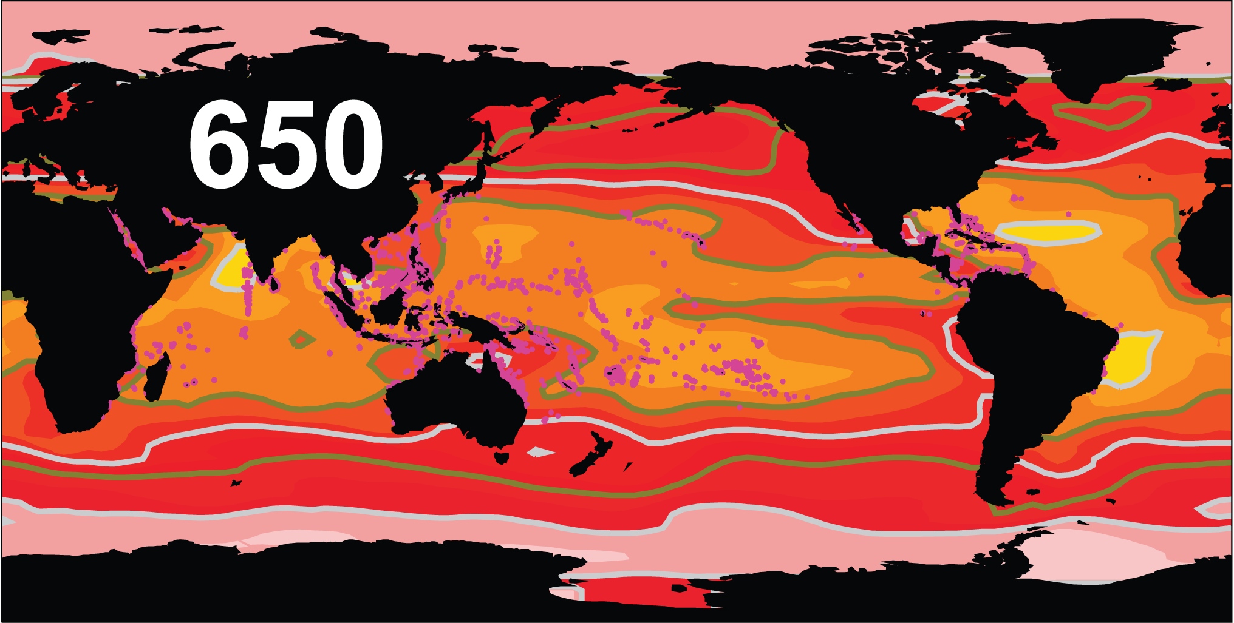
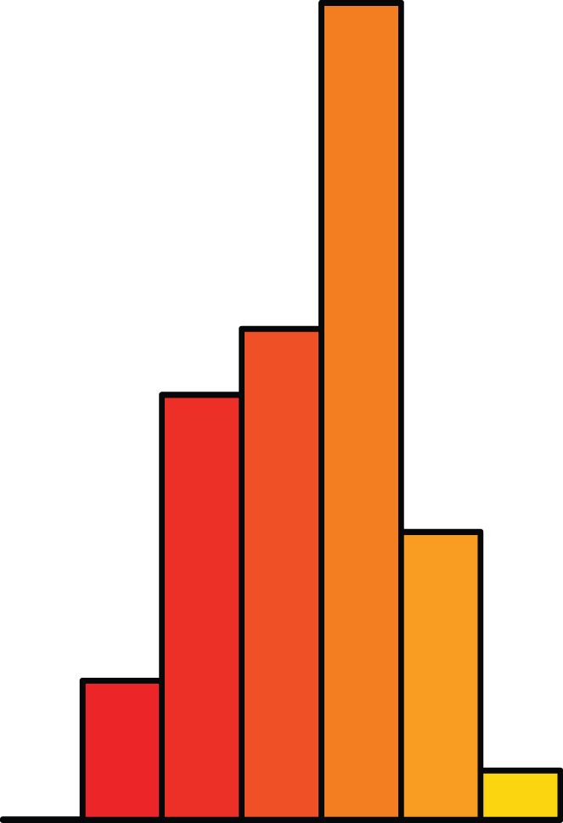
Carbon dioxide level,
Coral reef distribution,
and chemical conditions helping drive reef formation
0
1
2
3
4
5
Corrosive
Ω_{Aragonite}
Optimal
Cao and Caldeira, 2008

Slide 17
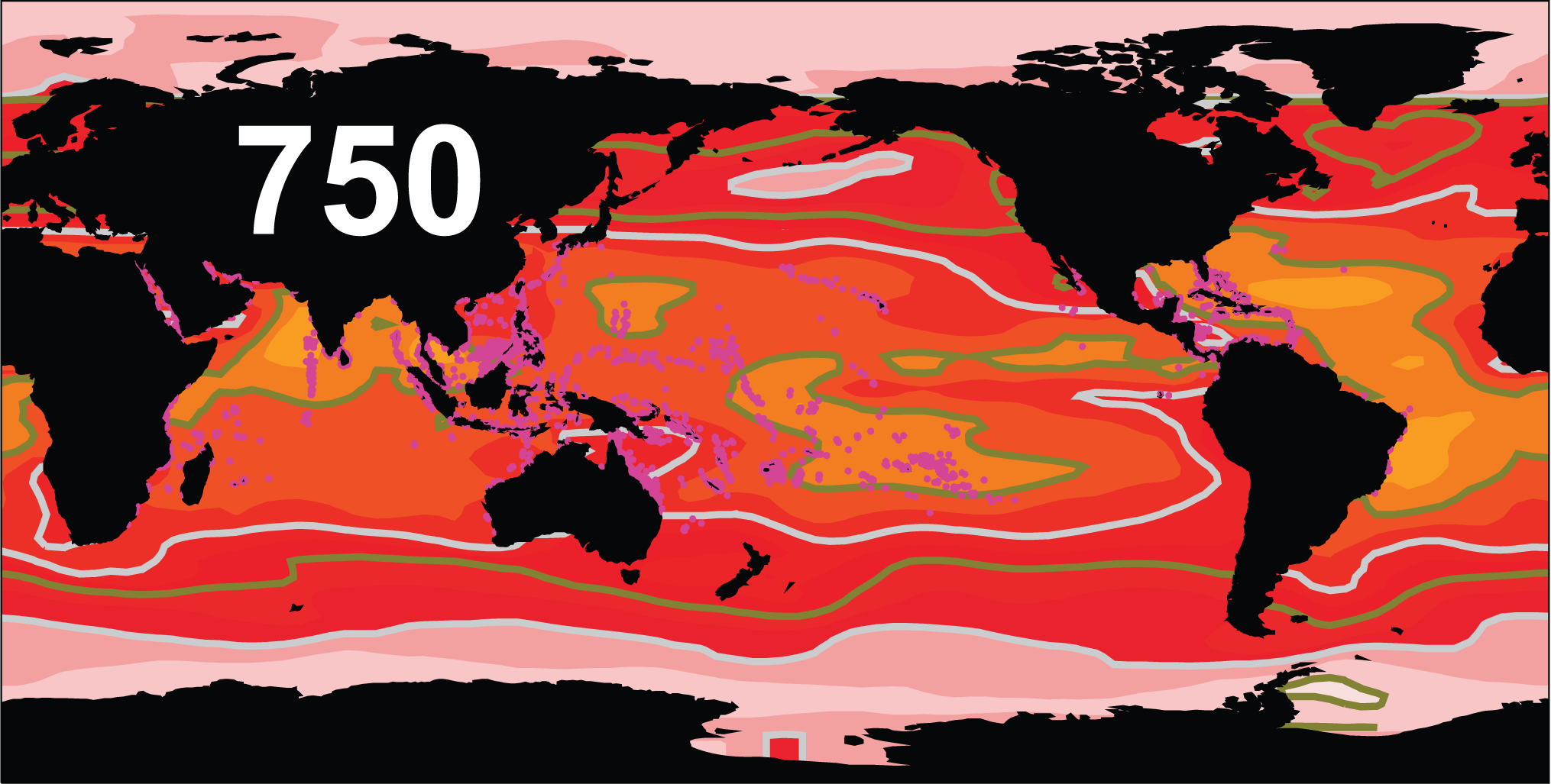

Carbon dioxide level,
Coral reef distribution,
and chemical conditions helping drive reef formation
0
1
2
3
4
5
Corrosive
Ω_{Aragonite}
Optimal
Cao and Caldeira, 2008

Slide 18
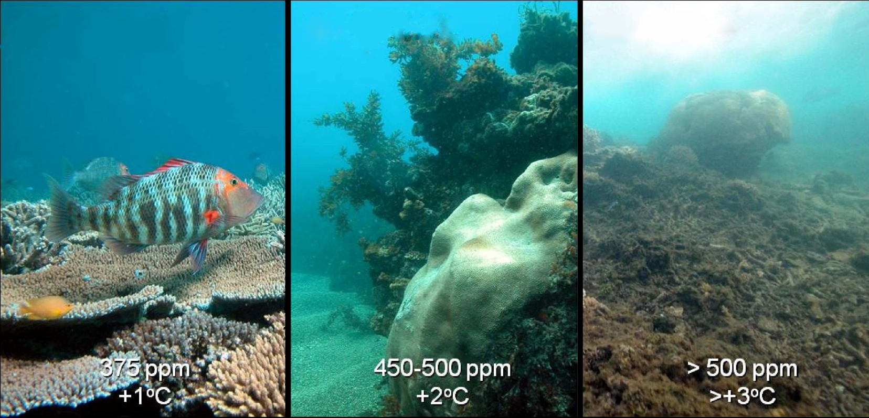
Calcification and Coral Ecosystem Tipping Points
Ocean acidification results in reduced calcification in corals
Hoegh-Guldberg et al. 2007

Slide 19
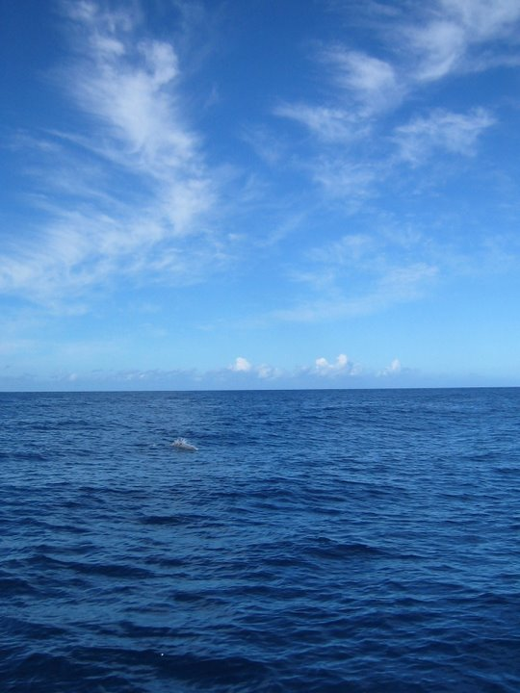
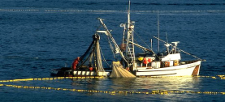


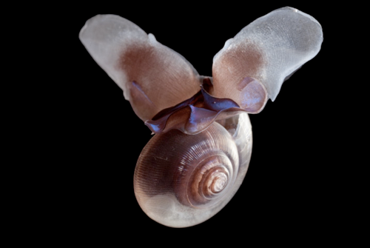



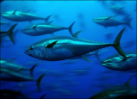




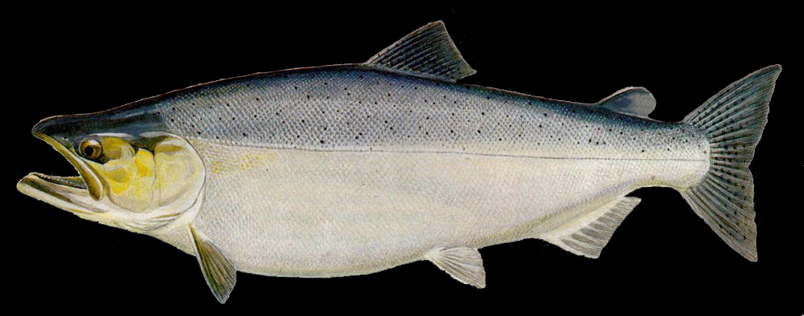


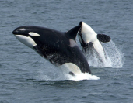







Society relies on functional marine food webs
Primary Production
Humans
Seabirds
Phytoplankton
Zooplankton
Squid
Sea butterfly
Limacina
Fish
Large zooplankton
Detritus / Bacteria
Seafloor Animals
Mammals
Marine Food Web
Notes:
The function and efficiency of food webs can / will be affected by changes in the abundance or productivity of key prey species.
E.g. marine sea butterfly (pteropods). Salmon depend upon pteropods, which are vulnerable to ocean acidiciation (shells dissolve).
Loss of pteropods – will other large zooplankton ‘pick up the slack”?
Loss of all large ZP? Will energy flow continue?

Slide 20

Management of local & regional stressors may buy time for global action
Reduced total stress from Ocean Acidification through local / regional action
Atmospheric CO₂
Erosion
Ocean acidification impacts
Runoff
Atmospheric CO₂
Pollution
Erosion
Runoff
Pollution
Upwelling
Upwelling
Our
families
Our
grandparents
Our
grandchildren
Time
Notes:
What can we do about it?
We may not be able to more very fast on the global CO2 problem, but we can manage the local to regional issues
Reducing erosion, runoff, and pollution sources of ocean acidification can decrease the total impact and buy time for global action.

Slide 21
Reduce other impacts to preserve biodiversity and mitigate Ocean Acidification
HUMAN IMPACTS
Overfishing
Pollution
Habitat degradation
Nutrient runoff
Plastics
Invasive species
Climate Change
Ocean Acidification
Loss of Biodiversity
Ecosystem
function
Societal impacts
“Biodiversity is insurance for ecosystem function”
Local, regional, global action to reduce impacts
Ecosystem-based management
Marine spatial planning
Marine protected areas
Notes:
Management of local to regional human impacts unrelated to OA will also help with OA impacts.
Preservation of marine biodiveristy will help maintain ecosystem health, which couples direction to human benefits from the oceans.
Elements of local / regional action
Ecosystem based management
Marine spatial planning
Marine protected areas
Summary
Ocean acidification arises from global, regional, and local sources and is linked to human activities
Inshore areas can be affected greatly
OA affects the physiological performance of organisms, with consequences for ecosystems and society
Management of regional and local stressors can help reduce the overall impacts of ocean acidification and buy time to develop action on the global problem

Slide 22

Value the oceans

