Slide 1

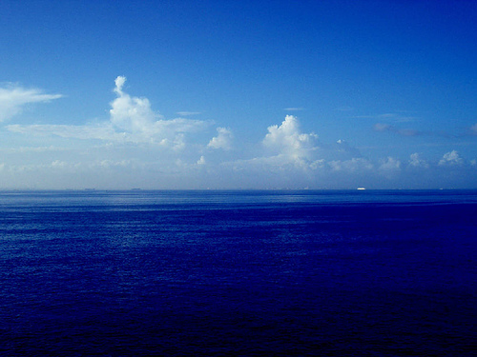
How ocean change affects ecosystem services:
Options for ocean health and societal adaptation
James Barry
Monterey Bay Aquarium Research Institute

Slide 2
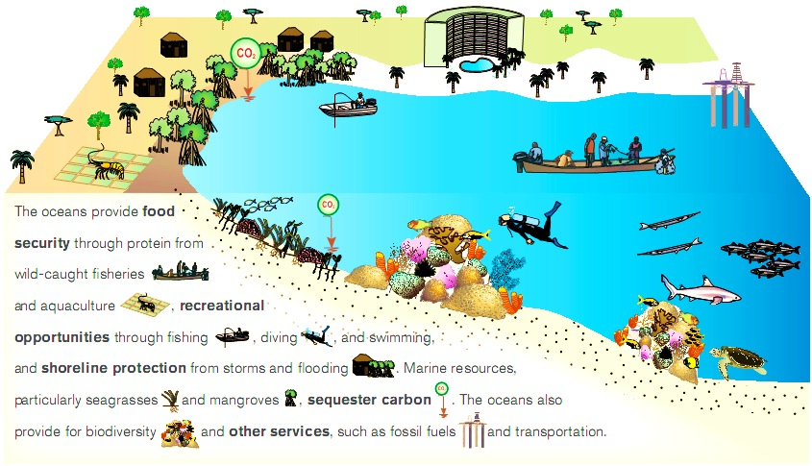
Marine Ecosystem Services
free stuff from nature
Supporting
Photosynthesis
Shoreline protection
Biodiversity
Food webs
Provisioning
Food Security
-Fisheries
-Aquaculture
Energy
-Oil
-Wind
-Wave
Cultural
Education
Recreation
Aesthetic
Stewardship
Regulating
Climate stability
Carbon storage

Slide 3
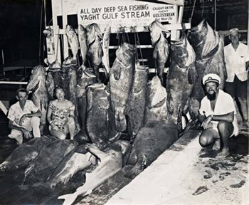
Society depends upon ecosystem function
Resource management
for ecosystem services requires
healthy ecosystem function
Society
Climate
Ecosystem
Services
Ocean
Conditions
Ecosystem
Function

Slide 4
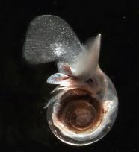

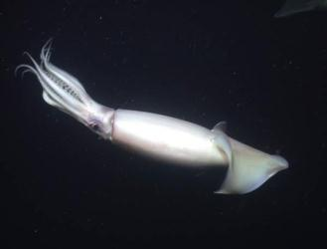
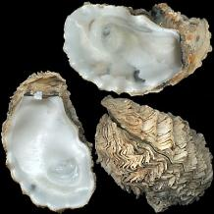
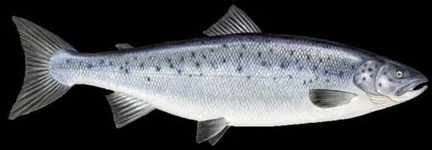
Effects of changing ocean conditions:
temperature, oxygen, and acidity
Physiological processes
Metabolism
Shell / skeleton formation
Respiration
Acid-base balance & enzyme function
Cell function

Slide 5
Effect of stress on individuals
Normal
Stressed
Cost of
Living
Growth
Cost of
Living
Growth
Reproduction
Energy
Budget
Reproduction
Energy budgets – If the cost of living increases, less is available for growth and reproduction.
Notes:
Stress increases “cost of living” , with less energy for growth and reproduction.
Individuals = reduced 1) survival, 2) size, 3) reproductive output.
Populations = Reduced abundance, productivity, resilience, and greater likelihood of extinction.

Slide 6
Windows of Performance
Multiple stressors reduce the range of animal performance
High
Physiology
Growth
Survival
Reproduction
+Hypoxia
Performance
too cold
too warm
+acidity
optimal
Low
Cold
Temperature
Hot
Modified from Portner (2008)

Slide 7
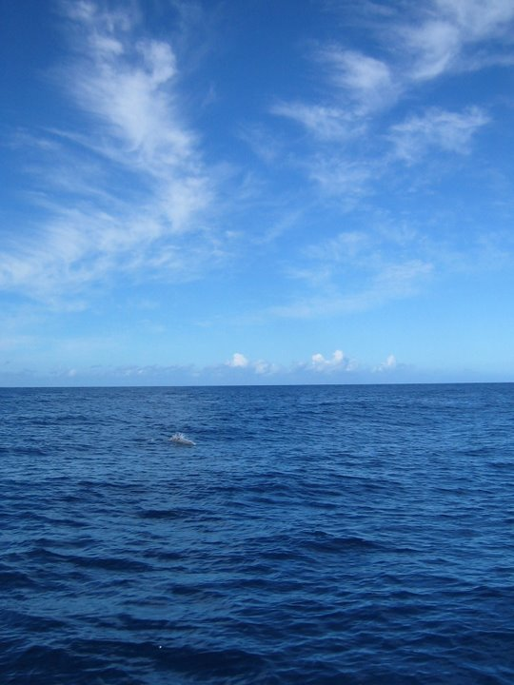
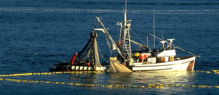
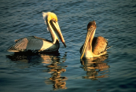
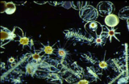



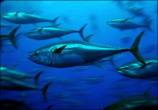





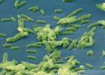
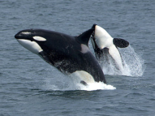







Marine Communities are Biological Networks
Primary Production
Humans
Seabirds
Phytoplankton
Zooplankton
Squid
Fish
Large zooplankton
Detritus / Bacteria
Seafloor Animals
Mammals
Marine Food Web
Notes:
Food web isn’t a very good image, but could be improved.

Slide 8
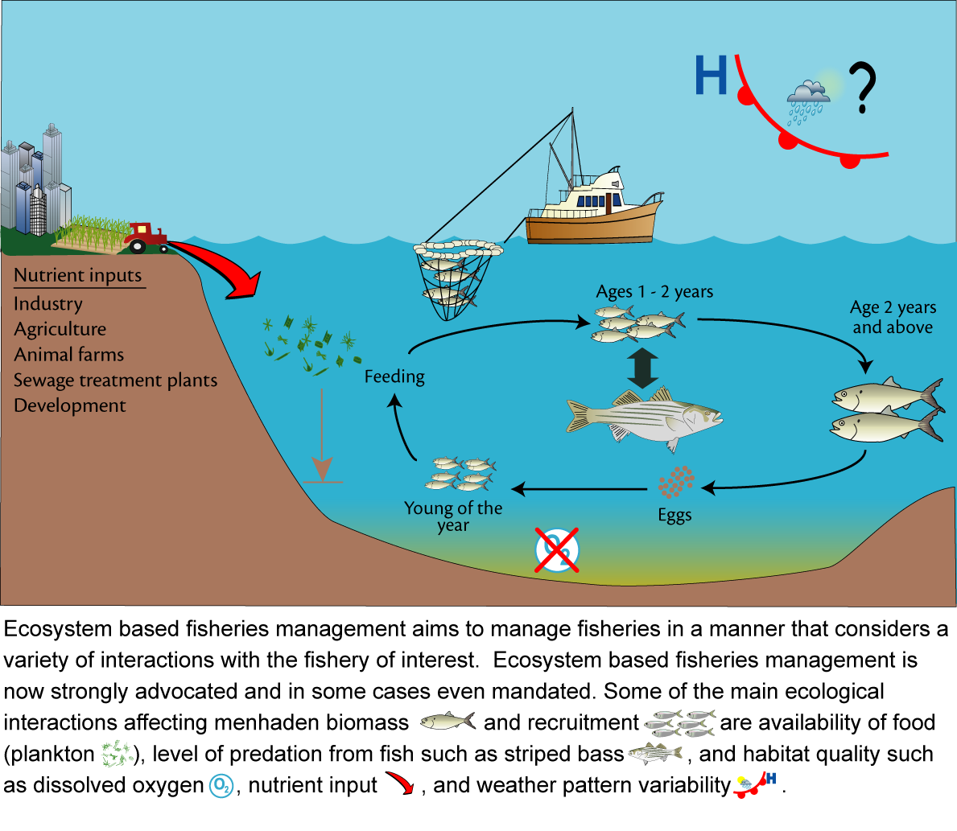
Ecosystem-based management of marine resources
ian.umces.edu/press

Slide 9
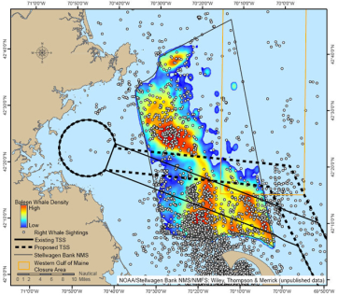
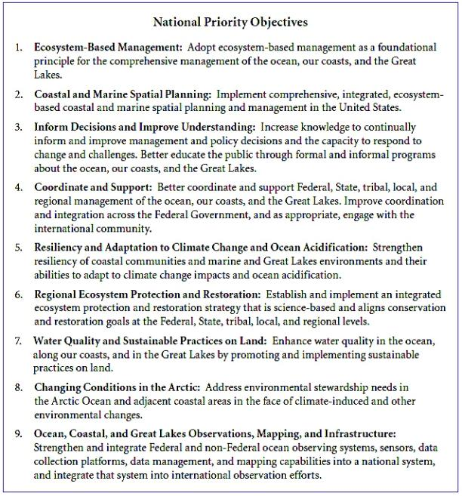
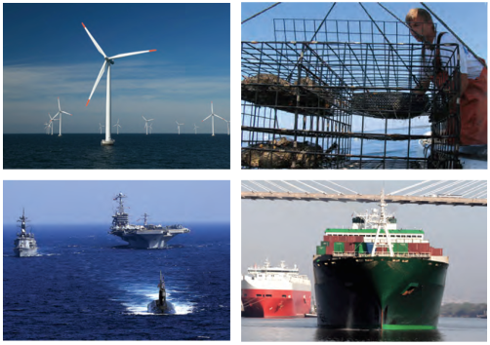
United States National Ocean Policy
Ecosystem-based management
Coastal and marine spatial planning
Inform decisions / improve understanding
Coordinate & support management agencies
Whales and Shipping Lanes
Manage for ecosystem resilience
Humans are part of the system
NOAA

Slide 10
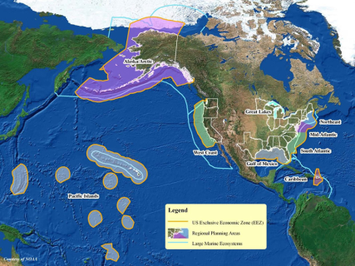
Principals for ecosystem–based management of marine resources
Ruckelshaus et al. 2008
Define the spatial boundaries of the ecosystem
Define the objectives of EBM clearly
Include humans as part of the ecosystem
Use various strategies to hedge against uncertainty
Marine spatial planning
Link governance structure with the scale of ecosystem elements managed
U.S. Large marine ecosystems (NOAA)

Slide 11
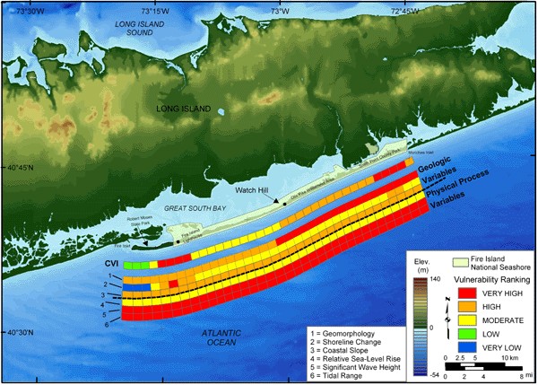
An evaluation tool for marine spatial planning
Long Island
& Natural Habitat
Social Variables
USGS

Slide 12
Solutions for a changing ocean:
Local => Regional => National
Individuals – low energy, sustainable choices
Coastal management approaches (e.g., ecosystem-based adaptation strategies)
Managing for ecosystem resilience
Adjust fishery management to changing species distributions
Marine spatial planning / management
Global
Carbon management
  Efficiency / Alternatives
  Emissions / Sequestration

Slide 13
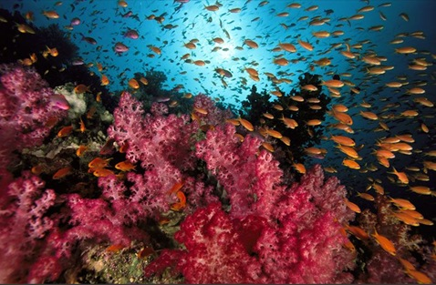
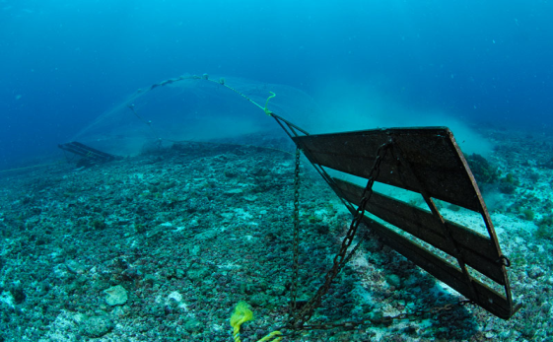
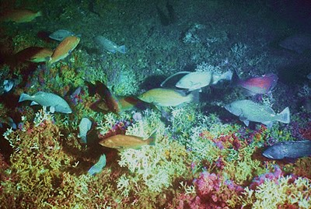
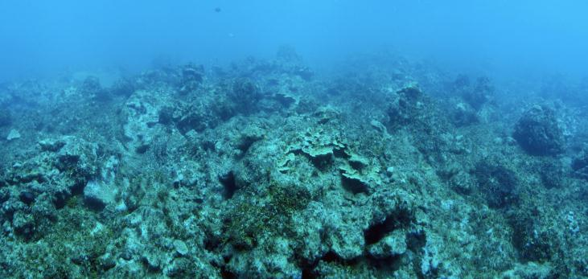
Perception of ocean health
Its blue, so it must be okay…?

Slide 14
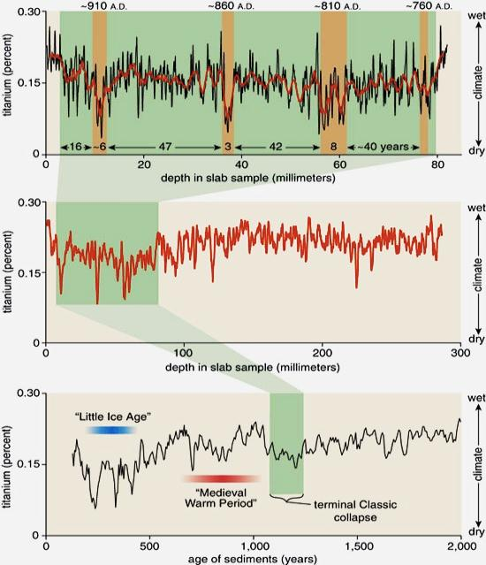
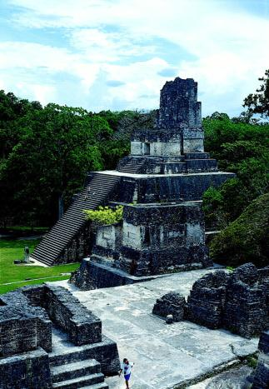
Climate-driven collapse of Mayan Civilization
Factors
Long-term decline in rainfall
Intense drought events
Haug et al. 2003

Slide 15

Climate Change and Human Conflict
Little Ice Age
0.15
Climate
0.25
Temp. Anomaly (ºC)
0.35
Cold
Warm
Cold
0.45
45
75
30
55
Regional NH Wars
Total NH Wars
15
35
0
15
1400
1500
1600
1700
1800
1900
Zhang et al. 2007
Year
Notes:
Cullen et al. 2000 Climate and collapse of akkadian empire

Slide 16
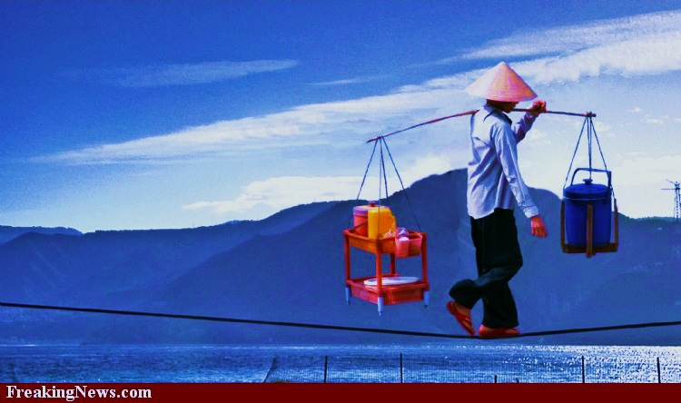
We have choices for adaptation to a changing ocean
Changes in ocean and climate conditions very large by 2100
Ecosystem services stem from effective ecosystem function
Ocean ecosystem health is not obvious
Balancing ocean health and societal demands
“Buy-in” from society
Can we avoid ocean tipping points?
A precautionary approach is required
Ecosystem
impacts
Ecosystem
Services
Past
Future

Slide 17
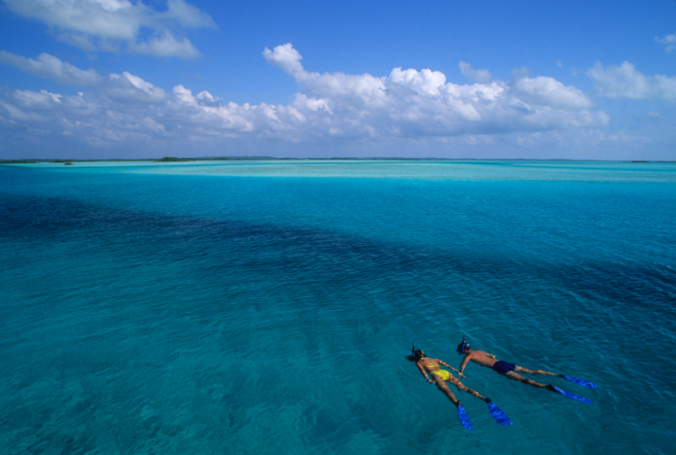
Value the oceans

